Slide 1
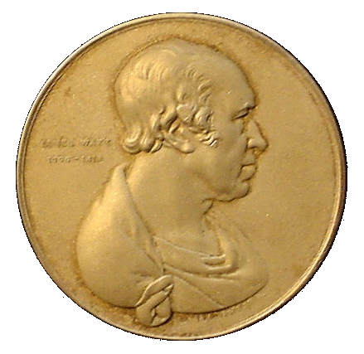
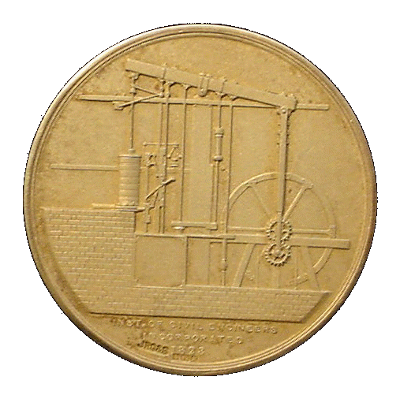
ENV-5022B Low Carbon Energy
2017 - 18
NUCLEAR POWER – Part 3
The Nuclear Fuel Cycle
Recipient of
James Watt Gold Medal for Energy Conservation
N.K. Tovey (杜伟贤) M.A, PhD, CEng, MICE, CEnv
Н.К.Тови М.А., д-р технических наук
k.tovey@uea.ac.uk

Slide 2
NUCLEAR POWER
Background Introduction
Nuclear Power – The Basics
Requirements for Nuclear Reactors
Reactor Types (general overview and introduction
Reactor Types
Nuclear Fuel Cycle

Slide 3
The Nuclear Fuel Cycle (1)
TWO OPTIONS AVAILABLE:-
ONCE-THROUGH CYCLE,
REPROCESSING CYCLE
CHOICE DEPENDS primarily on:-
REACTOR TYPE IN USE (more or less essential for MAGNOX),
AVAILABILTY OF URANIUM TO COUNTRY IN QUESTION,
DECISIONS ON THE POSSIBLE USE OF FBRs.
DECISIONS ON HOW RADIOACTIVE WASTE IS TO BE HANDLED.
Reprocessing leads to much less HIGH LEVEL radioactive waste, but more low level radioactive waste
ECONOMIC CONSIDERATIONS done 10 years ago show little difference between two types of cycle except that for PWRs, ONCE-THROUGH CYCLE appeared MARGINALLY more attractive.

Slide 4
The Nuclear Fuel Cycle (2)
NUCLEAR FUEL CYCLE divided into two parts:-
FRONT-END - includes MINING of Uranium Ore, EXTRACTION, CONVERSION to "Hex", ENRICHMENT, and FUEL FABRICATION.
BACK-END - includes TRANSPORTATION of SPENT FUEL, STORAGE, REPROCESSING, and DISPOSAL
NOTE:
Transportation of Fabricated Fuel elements has negligible cost as little or no screening is necessary.
Special Provisions are needed for transport of spent fuel for both cycles.
For both ONCE-THROUGH and REPROCESSING CYCLES, the FRONT-END is identical. The differences are only evident at the BACK- END.

Slide 5
Simplified Fuel Cycle for a PWR (1)
Fuel Rods
1 T
0.9m³
Cooling Ponds
Reactor
~ 70000 homes
60 x 2MW wind turbines
1PJ
Enrichment
REPROCESSING
Once Through
9 kg Plutonium
UF₆
Storage
Liquid 5m³
^{HL Waste}
0.96 t
Uranium
Concentrate 0.5m³
U₃O₈
0.4m³ IL waste
Ore
Mining Spoil
0.7m³
LL waste
0.8m³
IL waste
0.15m³ solid
0.9m³ HL waste
1500 m³

Slide 6
Simplified Fuel Cycle for a PWR (2)
MINING - ore > 0.05% by weight of U₃O₈ to be economic.
Typically at 0.5%, 500 tonnes (250 m³) must be excavated to produce 1 tonne of U₃O₈ ("yellow-cake") which occupies about 0.1 m³.
URANIUM leached out chemically
resulting powder contains about 80% yellow-cake. The 'tailings' contain the naturally generated daughter products.
PURIFICATION/CONVERSION
- dissolve 'yellow-cake' in nitric acid and conversion to Uranium tetrafluoride (UF₄)
UF₄ converted into URANIUM HEXAFLOURIDE (UF₆) or "HEX" if enrichment is needed.

Slide 7
Simplified Fuel Cycle for a PWR: Enrichment (1)
ENRICHMENT.
proportion of URANIUM - 235 is artificially increased.
GAS DIFFUSION - original method still used in FRANCE.
"HEX" is allowed to diffuse through a membrane separating the high and low pressure parts of a cell.
²³⁵U diffuses faster than ²³⁸U through this membrane.
Outlet gas from lower pressure is slightly enriched in ²³⁵U (by a factor of 1.0043) and is further enriched in subsequent cells.
HUNDREDS / THOUSANDS of such cells are required in cascade depending on the required enrichment.
Pumping demands are very large as are the cooling requirements between stages.

Slide 8
Simplified Fuel Cycle for a PWR: Enrichment (2)
ENRICHMENT: GAS DIFFUSION.
Outlet gas from HIGH PRESSURE side is slightly depleted URANIUM and is fed back into previous cell of sequence.
AT BACK END, depleted URANIUM contains only 0.2 - 0.3% ²³⁵U,
NOT economic to use this for further enrichment.
This depleted URANIUM is currently stockpiled, but could be an extremely value fuel resource should we decide to go for the FBR.

Slide 9
Simplified Fuel Cycle for a PWR: Enrichment (3)
ENRICHMENT.
GAS CENTRIFUGE ENRICHEMENT
similar to the Gas diffusion in that it requires many stages.
"HEX" is spun in a centrifuge, and the slightly enriched URANIUM is sucked off near the axis and passed to the next stage.
ENERGY requirements for this process are only ~10% of the GAS DIFFUSION method.
All UK fuel is now enriched by this process at Capenhurst.

Slide 10
Fuel Fabrication (1)
FUEL FABRICATION -
MAGNOX reactors: URANIUM metal is machined into bars using normal techniques.
CARE MUST BE TAKEN not to allow water into process as this acts as a moderator and might cause the fuel element to 'go critical'.
CARE MUST ALSO BE TAKEN over its CHEMICAL TOXICITY although this is not a much a problem as PLUTONIUM
URANIUM METAL bars are about 1m in length and about 30 mm in diameter.
OXIDE Fuels for Other Reactors
Because of low thermal conductivity of oxides of uranium, fuels of this form are made as small pellets which are loaded into stainless steel cladding in the case of AGRs, and ZIRCALLOY in the case of most other reactors.
TRANSPORT of FUEL Elements
Little screening is needed as URANIUM is an alpha emitter and even a thin layer of paper is sufficient to stop such particles.
No special precaution are needed as even enriched fuel is unsuitable for bomb making

Slide 11
Fuel Fabrication (2)
PLUTONIUM
Fuel fabrication presents much greater problems.
Workers require more shielding from radiation.
Chemically toxic.
Metallurgy is complex.
Can reach criticality on its own WITHOUT a MODERATOR.
Care must be taken in manufacture and ALL subsequent storage that the fuel elements are not of size and shape which could cause a criticality.
NOTE:-
Transport of PLUTONIUM fuel elements
a potential hazard if stolen, as a crude atomic bomb could be made without the need for a large amount of energy cf enriched URANIUM.
DELIBERATE 'spiking' of PLUTONIUM with some fission products is considered to make the fuel elements very difficult to handle.

Slide 12
Fuel Enrichment
1 tonne of enriched fuel for a PWR produces ~1PJ of energy.
1 tonne of unenriched fuel for a CANDU reactor produces about ~0.2 PJ in a single pass.
However, because of losses, about 20-25% MORE ENERGY PER TONNE of MINED URANIUM can be obtained with CANDU if the spent fuel is reprocessed.

Slide 13
Simplified Fuel Cycle for a PWR: BACKEND (1)
BOTH ONCE-THROUGH and REPROCESSING CYCLES
SPENT FUEL ELEMENTS from the REACTOR
FISSION PRODUCTS mostly with SHORT HALF LIVES. heat is evolved
spent fuel elements are normally stored under water
at least in the short term.
100 days, the radioactivity reduced to about 25% of its original value, and after 5 years the level will be down to about 1%.
Early reduction comes from the decay of radioisotopes such as IODINE - 131 and XENON - 133 -half-lives (8 days and 1.8 hours respectively).
CAESIUM - 137 decays to only 90% of its initial level even after 5 years.
accounts for less than 0.2% of initial radioactive decay, but 15% of the activity after 5 years.

Slide 14
Simplified Fuel Cycle for a PWR: BACKEND (2)
BOTH ONCE-THROUGH and REPROCESSING CYCLES
SPENT FUEL ELEMENTS stored under 6m of water
also acts as BIOLOGICAL SHIELD.
Water may become radioactive from corrosion of fuel cladding causing leakage - so water is conditioned –
kept at pH of 11 - 12 (i.e. strongly alkaline in case of MAGNOX). Other reactor fuel elements do not corrode so readily.
Any radionucleides escaping into the water are removed by ION EXCHANGE.
Subsequent handling depends on whether ONCE-THROUGH or REPROCESSING CYCLE is chosen.
Spent fuel can be stored in dry caverns,
drying the elements after the initial water cooling is a problem.
Adequate air cooling must be provided, and this may make air - radioactive if fuel element cladding is defective. WYLFA power station stored MAGNOX fuel elements in this form.

Slide 15
Simplified Fuel Cycle for a PWR: No Reprocessing
ADVANTAGES:-
NO REPROCESSING needed - therefore much lower discharges of low level/intermediate level liquid/gaseous waste.
FUEL CLADDING NOT STRIPPED - therefore less solid intermediate waste created. (although sometimes it is)
NO PLUTONIUM in transport so no danger of diversion.
DISADVANTAGES:-
CANNOT RECOVER UNUSED URANIUM - 235, PLUTONIUM OR URANIUM - 238. Thus fuel cannot be used again.
VOLUME OF HIGH LEVEL WASTE MUCH GREATER (5 - 10 times) than with reprocessing cycle.
SUPERVISION OF HIGH LEVEL WASTE needed for much longer time as encapsulation is more difficult than for reprocessing cycle.

Slide 16
Simplified Fuel Cycle for a PWR Reprocessing Cycle (1)
ADVANTAGES:-
MUCH LESS HIGH LEVEL WASTE - therefore less problems with storage
UNUSED URANIUM - 235, PLUTONIUM AND URANIUM - 238 can be recovered and used again, or used in a FBR thereby increasing resource base 50 fold.
VITRIFICATION is easier than with spent fuel elements. Plant at Sellafield now operational although technical problems are preventing vitrification at full capacity.
DISADVANTAGES:-
Greater volumes of both Low Level and Intermediate Level Waste are created.
Historically, routine emissions from reprocessing plants have been greater than storage of ONCE-THROUGH cycle waste.

Slide 17
Simplified Fuel Cycle for a PWR Reprocessing Cycle (2)
Dealing with liquid effluents
At SELLAFIELD the ION EXCHANGE plant
SIXEP (Site Ion EXchange Plant)
commissioned in early 1986,
substantially reduced the radioactive emissions in the effluent discharged to Irish Sea since that time by a factor of 500+ times
Further improvements with more advance waste treatment have now been installed.
PLUTONIUM is stockpiled or in transport if used in FBRs. (although this can be 'spiked').

Slide 18
Simplified Fuel Cycle for a PWR Reprocessing Cycle (3)
The Chemistry
cladding to intermediate level waste storage
Fuel stored in cooling ponds to allow further decay
Fuel decanned
Dissolve Fuel in
Nitric Acid
add tributyl phosphate (TBP) in odourless ketone (OK)
High Level Waste
further treatment with TBP/OK
medium level waste
reduced with ferrous sulphamate
URANIUM – converted into UO₃ and recycled
** PLUTONIUM – converted for storage or fuel fabrication for MOX or FBR
**Pipes in this are of small diameter to prevent CRITICALITIES.

Slide 19
Waste Disposal: An Introduction (1)
LOW LEVEL WASTE.
CONTAINS MATERIALS CONTAMINATED WITH RADIOISOTOPES
either very long half lives indeed,
or VERY SMALL quantities of short lived radioisotopes.
FEW SHIELDING PRECAUTIONS ARE NECESSARY DURING TRANSPORTATION.
PHYSICAL BULK MAY BE LARGE as its volume includes items which may have been contaminated during routine operations.
Laboratory Coats, Paper Towels etc.
Such waste may be generated in HOSPITALS, LABORATORIES, NUCLEAR POWER STATIONS, and all parts of the FUEL CYCLE.

Slide 20
Waste Disposal: An Introduction (2)
OPTIONS FOR DISPOSAL OF LOW LEVEL WASTE.
BURYING LOW LEVEL WASTE SURROUNDED BY A THICK CLAY BLANKET IS A SENSIBLE OPTION.
If clay is of the SMECTITE type acts as a very effective ion exchange barrier which is plastic and deforms to any ground movement sealing any cracks.
IN BRITAIN IT IS PROPOSED TO BURY WASTE IN STEEL CONTAINERS AND PLACED IN CONCRETE STRUCTURES IN A DEEP TRENCH UP TO 10m DEEP WHICH WILL BE SURROUNDED BY THE CLAY.
IN FRANCE, THE CONTAINERS ARE PILED ABOVE GROUND AND THEN COVERED BY A THICK LAYER OF CLAY TO FORM A TUMULUS.
Energy Field Courses in 1999 and 2001 visited the site at ANDRA near Cherbourg. (Agence National de Déchets Radioactive)

Slide 21
Waste Disposal: An Introduction (3)
INTERMEDIATE LEVEL WASTE.
contains HIGHER quantities of SHORT LIVED RADIOACTIVE WASTE,
or MODERATE QUANTITIES OF RADIONUCLEIDES OF MODERATE HALF LIFE
- e.g. 5 YEARS - 10000 YEARS HALF LIFE.
IN FRANCE SUCH WASTE IS CAST INTO CONCRETE MONOLITHIC BLOCKS AND BURIED AT SHALLOW DEPTH.
IN BRITAIN, it was originally proposed to bury similar blocks at the SAME SITES to those used for LOW LEVEL WASTE.
UNSATISFACTORY AS CONFUSION BETWEEN THE TWO TYPES OF WASTE WILL OCCUR.
SEPARATE FACILITIES ARE NOW IN OPERATION.

Slide 22
Waste Disposal: An Introduction (4)
HIGH LEVEL WASTE.
At Sellafield, high level waste is now being encapsulated and stored on site in specially constructed vaults.
A building about the size of the UEA swimming pool house in area and about twice as high houses all the high level radioative waste from the UKs Civil Nuclear Program with space for decommissioning of all final fuel from MAGNOX.
MOST RADIONUCLEIDES IN THIS CATEGORY HAVE HALF LIVES OF UP TO 30 YEARS, and thus ACTIVITY in about 700 years will have decayed to around natural background radiation level.
PROPOSALS FOR DISPOSAL INCLUDE
burial in deep mines in SALT;
burial 1000m BELOW SEA BED and BACKFILLED with SMECTITE;
burial under ANTARCTIC ICE SHEET,
shot INTO SPACE to the sun!

Slide 23
Waste Disposal: An Introduction (5)
UK processes waste from Overseas Countries.
Should we send back exact quantities of each of:
High Level Waste
Intermediate Level Waste
Low Level Waste
Or should we:
Send back same amount of radioactivity
i.e. a larger amount of a small volume of High Level Waste
and no Intermediate and Low Level Waste?

Slide 24
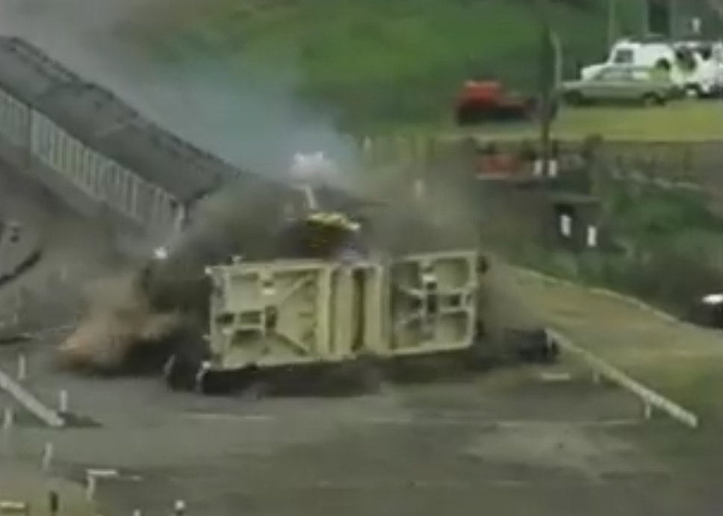
Transport of Nuclear Fuel
New Fuel requires little screening and is not a radiological hazard
Spent fuel is very radioactive and must be transported with care.
Link to crash test

Slide 25
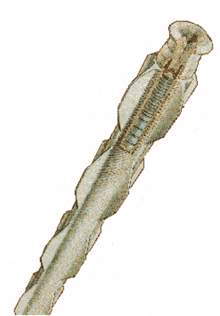
FISSION REACTORS: Fuel Elements
Magnox fuel rod:
Natural Uranium metal bar approx 35mm diameter and 1m long in a fuel cladding made of MAGNOX.

Slide 26
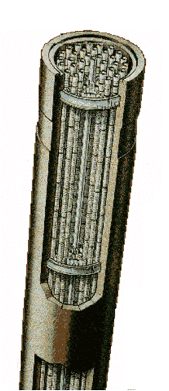
FISSION REACTORS: Fuel Elements
AGR fuel assembly:
UO₂ pellets loaded into fuel pins of stainless steel each ~ 1 m long in bundles of 36.
Whole assembly in a graphite cylinder
Burnable poison

Slide 27
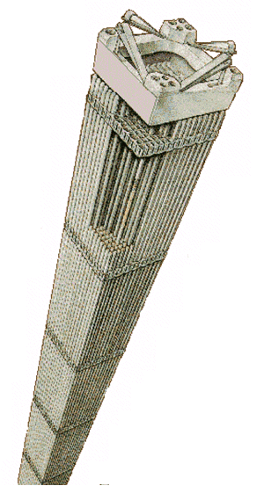
FISSION REACTORS: Fuel Elements
PWR fuel assembly:
UO₂ pellets loaded into fuel pins of zirconium each ~ 3 m long in bundles of ~200

Slide 29
Simplified Fuel Cycle for a PWR (1)
Fuel Rods
1 T
0.9m³
Cooling Ponds
Reactor
1PJ
Enrichment
REPROCESSING
Once Through
9 kg Plutonium
UF₆
Storage
Liquid 5m³
0.96 t
Uranium
Concentrate 0.5m³
U₃O₈
0.4m³ IL waste
Ore
Mining Spoil
0.8m³
IL waste
0.8m³
IL waste
0.15m³ solid
0.9m³ HL waste

