Slide 1
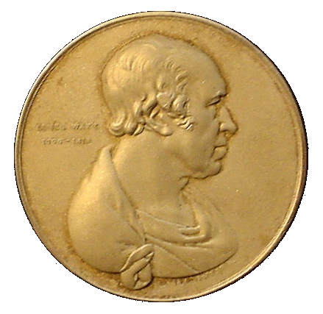
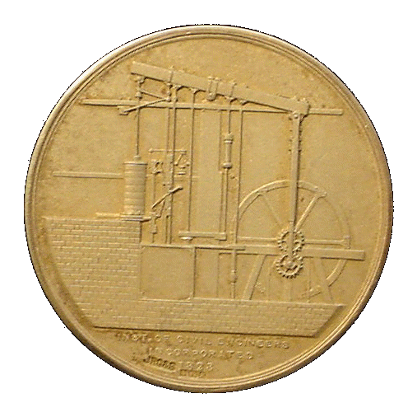
ENV-5022B
Low Carbon Energy 2017 - 18
NUCLEAR POWER – Part 2
http://www2.env.uea.ac.uk/energy/energy.htm
http://www.uea.ac.uk/~e680/energy/energy.htm
Recipient of
James Watt Gold Medal for Energy Conservation
N.K. Tovey (杜伟贤) M.A, PhD, CEng, MICE, CEnv
Н.К.Тови М.А., д-р технических наук
k.tovey@uea.ac.uk

Slide 2
NUCLEAR POWER
Background Introduction
Nature of Radioactivity
Fission Reactors
General Introduction
MAGNOX Reactors
AGR Reactors
CANDU Reactors
PWRs
BWRs
RMBK/ LWGRs
FBRs
Generation 3 Reactors
Generation 3+ Reactors

Slide 3
FISSION REACTORS (1):
FISSION REACTORS CONSIST OF:-
i) a FISSILE component in the fuel
ii) a MODERATOR
iii) a COOLANT to take the heat to its point of use.
The fuel elements vary between different Reactors
Some reactors use unenriched URANIUM
i.e. the ²³⁵U in fuel elements is at 0.7% of fuel
e.g. MAGNOX and CANDU reactors,
ADVANCED GAS COOLED REACTOR (AGR) uses 2.5 – 2.8% enrichment
PRESSURISED WATER REACTOR (PWR) and BOILING WATER REACTOR (BWR) use around 3.5 – 4% enrichment.
RMBK (Russian Rector of Chernobyl fame) uses ~2% enrichment
Some experimental reactors - e.g. High Temperature Reactors (HTR) use highly enriched URANIUM (>90%) i.e. weapons grade.

Slide 4
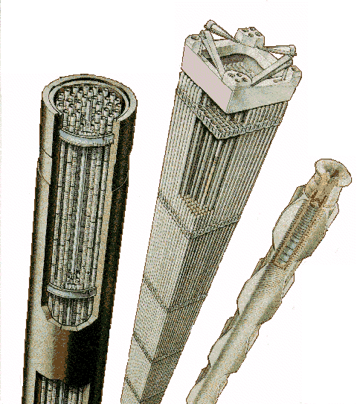
FISSION REACTORS (2): Fuel Elements
PWR fuel assembly:
UO₂ pellets loaded into fuel pins of zirconium each ~ 3 m long in bundles of ~200
AGR fuel assembly:
UO₂ pellets loaded into fuel pins of stainless steel each ~ 1 m long in bundles of 36.
Whole assembly in a graphite cylinder
Magnox fuel rod:
Natural Uranium metal bar approx 35mm diameter and 1m long in a fuel cladding made of MagNox.
Burnable poison

Slide 5
FISSION REACTORS (3):
No need for the extensive coal handling plant.
In the UK, all the nuclear power stations are sited on the coast so there is no need for cooling towers.
Land area required is smaller than for coal fired plant.
In most reactors there are three fluid circuits:-
1) The reactor coolant circuit (which can become radioactive)
2) The steam cycle (which will not be radioactive except Boiling Water Reactors)
3) The cooling water cycle.
ONLY the REACTOR COOLANT will become radioactive
The cooling water is passed through the station at a rate of tens of millions of litres of water and hour, and the outlet temperature is raised by around 10ºC.

Slide 6
FISSION REACTORS (4):
REACTOR TYPES – summary 1
MAGNOX - Original British Design named after the magnesium alloy used as fuel cladding. 8 reactors of this type were built in France, One in each of Italy, Spain and Japan. 26 units were built in UK.
The last MAGNOX reactor closed on 30th December 2015.
Oldbury closed in 2012 after operating life was extended to 45 years. One reactor at Wylfa also closed in 2012 after 41 years operation. All other MAGNOX units are being decommissioned
AGR - ADVANCED GAS COOLED REACTOR - solely British design. 14 units are in use. The original demonstration Windscale AGR is now being decommissioned. The last two stations Heysham II and Torness (both with two reactors), were constructed to time and have operated to expectations.

Slide 7
FISSION REACTORS (5):
REACTOR TYPES - summary
PWR - Originally an American design of PRESSURIZED WATER REACTOR (also known as a Light Water Reactor LWR). Now most common reactor. (Three Mile Island)
BWR - BOILING WATER REACTOR - a derivative of the PWR in which the coolant is allowed to boil in the reactor itself. Second most common reactor in use. (Fukushima)
RMBK - LIGHT WATER GRAPHITE MODERATING REACTOR (LWGR)- a design unique to the USSR which figured in the CHERNOBYL incident. 16 units still in operation in Russian and Lithuania with 9 shut down.
CANDU - A reactor named initially after CANadian DeUterium moderated reactor (hence CANDU), alternatively known as PHWR (pressurized heavy water reactor). 41 currently in use.

Slide 8
FISSION REACTORS (6):
REACTOR TYPES - summary
HTGR - HIGH TEMPERATURE GRAPHITE REACTOR - an experimental reactor. The original HTR in the UK started decommissioning in 1975. The Pebble Bed Modulating Reactor (PBMR) is a development of this and was promoted as a 3+ Generation Reactor by South Africa until 2010 – China now has some interest.
SGHWR - STEAM GENERATING HEAVY WATER REACTOR - originally a demonstration British Design which is a hybrid between the CANDU and BWR reactors.
FBR - FAST BREEDER REACTOR - unlike all previous reactors, this reactor 'breeds' PLUTONIUM from FERTILE ²³⁸U to operate, and in so doing extends resource base of URANIUM over 50 times. Mostly experimental at moment with FRANCE, W. GERMANY and UK, Russia and JAPAN having experimented with them.

Slide 9
BASIC THERMODYNAMICS
Efficiency of Power Station is governed by the Carnot Equation
where Temperatures are in Kelvin
 | T₁ | ƞ | Practical (ƞ)
Magnox | 285 | 45% | 22-28%
AGR | 575 | 64% | 40%
PWR | 385 | 53% | 33-36%

Slide 10
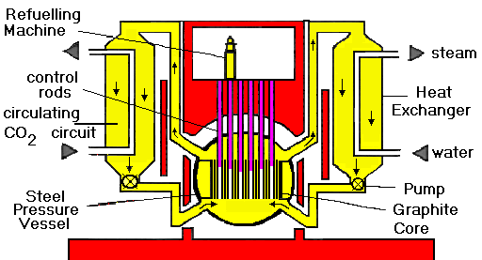
MAGNOX REACTORS (also known as GCR):
FUEL TYPE - unenriched URANIUM METAL clad in Magnesium alloy
MODERATOR - GRAPHITE
COOLANT - CARBON DIOXIDE
DIRECT RANKINE CYCLE
- no superheat or reheat efficiency ~ 20% to 28%.
ADVANTAGES:-
LOW POWER DENSITY - 1 MW/m³. Thus very slow rise in temperature in fault conditions.
UNENRICHED FUEL
GASEOUS COOLANT
ON LOAD REFUELLING
MINIMAL CONTAMINATION FROM BURST FUEL CANS
VERTICAL CONTROL RODS - fall by gravity in case of emergency.
DISADVANTAGES:-
CANNOT LOAD FOLLOW – [Xe poisoning]
OPERATING TEMPERATURE LIMITED TO ABOUT 250ºC - 360ºC limiting CARNOT EFFICIENCY to ~40 - 50%, and practical efficiency to ~ 28-30%.
LOW BURN-UP - (about 400 TJ per tonne)
EXTERNAL BOILERS ON EARLY DESIGNS.

Slide 11
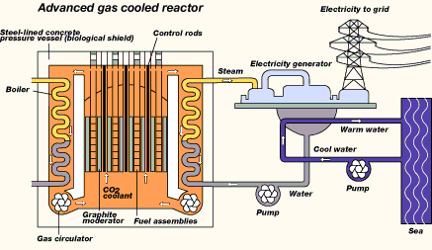
ADVANCED GAS COOLED REACTORS (AGR):
FUEL TYPE - enriched URANIUM OXIDE - 2.3% clad in stainless steel
MODERATOR - GRAPHITE
COOLANT - CARBON DIOXIDE
SUPERHEATED RANKINE CYCLE (with reheat) - efficiency 39 - 41%
ADVANTAGES:-
MODEST POWER DENSITY - 5 MW/m³. slow rise in temperature in fault conditions.
GASEOUS COOLANT (40- 45 BAR cf 160 bar for PWR)
ON LOAD REFUELLING under part load
MINIMAL CONTAMINATION FROM BURST FUEL CANS
RELATIVELY HIGH THERMODYNAMIC EFFICIENCY 40%
VERTICAL CONTROL RODS - fall by gravity in case of emergency.
DISADVANTAGES:-
MODERATE LOAD FOLLOWING CHARACTERISTICS
SOME FUEL ENRICHMENT NEEDED. - 2.3%
OTHER FACTORS:-
MODERATE FUEL BURN-UP - ~ 1800TJ/tonne (c.f. 400TJ/tonne for MAGNOX, 2900TJ/tonne for PWR).
SINGLE PRESSURE VESSEL with pres-stressed concrete walls 6m thick. Pre-stressing tendons can be replaced if necessary.

Slide 12
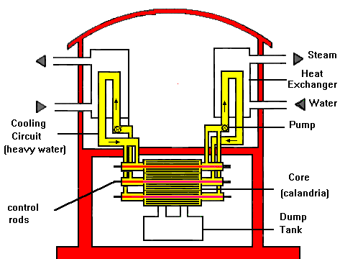
CANDU REACTOR (PHWR):
FUEL TYPE - unenriched URANIUM OXIDE clad in Zircaloy
MODERATOR - HEAVY WATER COOLANT - HEAVY WATER
ADVANTAGES:-
MODEST POWER DENSITY - 11 MW/m3.
HEAVY WATER COOLANT - low neutron absorber hence no need for enrichment.
ON LOAD REFUELLING - and very efficient indeed permits high load factors.
MINIMAL CONTAMINATION from burst fuel can - defective units can be removed without shutting down reactor.
MODULAR: - can be made to almost any size
DISADVANTAGES:-
POOR LOAD FOLLOWING CHARACTERISTICS
CONTROL RODS ARE HORIZONTAL, and therefore cannot operate by gravity in fault conditions.
MAXIMUM EFFICIENCY about 28%
OTHER FACTORS:-
MODERATE FUEL BURN-UP - ~ MODEST FUEL BURN-UP - about 1000TJ/tonne
FACILITIES PROVIDED TO DUMP HEAVY WATER MODERATOR from reactor in fault conditions
MULTIPLE PRESSURE TUBES instead of one pressure vessel.

Slide 13
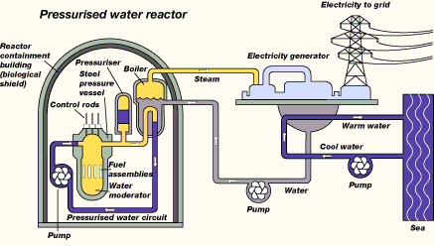
PRESSURISED WATER REACTORS – PWR (VWER):
FUEL TYPE - 3 – 4% enriched URANIUM OXIDE clad in Zircaloy
MODERATOR - WATER
COOLANT - WATER
ADVANTAGES:-
GOOD LOAD FOLLOWING CHARACTERISTICS - claimed for SIZEWELL B. - most PWRs are NOT operated as such.
HIGH FUEL BURN-UP- about 2900TJ/tonne –
VERTICAL CONTROL RODS - drop by gravity in fault conditions.
DISADVANTAGES:-
ORDINARY WATER as COOLANT - pressure to prevent boiling (160 bar). If break occurs then water will flash to steam and cooling will be less effective.
ON LOAD REFUELLING NOT POSSIBLE - reactor must be shut down.
SIGNIFICANT CONTAMINATION OF COOLANT CAN ARISE FROM BURST FUEL CANS - as defective units cannot be removed without shutting down reactor.
FUEL ENRICHMENT NEEDED. - 3-4%.
MAXIMUM EFFICIENCY ~ 31 - 32%
latest designs ~ 34%
OTHER FACTORS:-
LOSS OF COOLANT also means LOSS OF MODERATOR so reaction ceases - but residual decay heat can be large.
HIGH POWER DENSITY - 100 MW/m³, and compact. Temperature can rise rapidly in fault conditions. NEEDS active ECCS.
SINGLE STEEL PRESSURE VESSEL 200 mm thick.

Slide 14
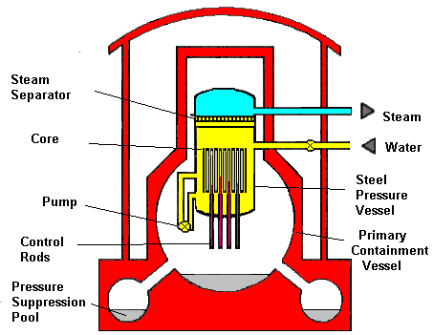
BOILING WATER REACTORS – BWR:
FUEL TYPE - 3% enriched URANIUM OXIDE clad in Zircaloy
MODERATOR - WATER
COOLANT - WATER
ADVANTAGES:-
HIGH FUEL BURN-UP- about 2600TJ/tonne
STEAM PASSED DIRECTLY TO TURBINE therefore no heat exchangers needed. BUT SEE DISADVANTAGES..
DISADVANTAGES:-
ORDINARY WATER as COOLANT – but designed to boil: pressure ~ 75 bar.
CONTROL RODS MUST BE DRIVEN UPWARDS - SO NEED POWER IN FAULT CONDITIONS. Provision made to dump water (moderator in such circumstances).
ON LOAD REFUELLING NOT POSSIBLE - reactor must be shut down.
SIGNIFICANT CONTAMINATION OF COOLANT CAN ARISE FROM BURST FUEL CANS - as defective units cannot be removed without shutting down reactor. ALSO IN SUCH CIRCUMSTANCES RADIOACTIVE STEAM WILL PASS DIRECTLY TO TURBINES.
FUEL ENRICHMENT NEEDED. - 3%.
MAXIMUM EFFICIENCY ~ 34-35%
OTHER FACTORS:-
LOSS OF COOLANT also means LOSS OF MODERATOR so reaction ceases - but residual decay heat can be large.
HIGH POWER DENSITY - 100 MW/m³, and compact. Temperature can rise rapidly in fault conditions. NEEDS active ECCS.
SINGLE STEEL PRESSURE VESSEL 200 mm thick.

Slide 15
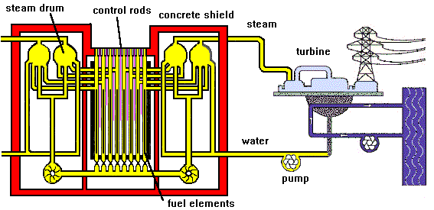
RMBK (LWGR): (involved in Chernobyl incident)
FUEL TYPE - 2% enriched URANIUM OXIDE clad in Zircaloy
MODERATOR - GRAPHITE
COOLANT - WATER
ADVANTAGES:-
ON LOAD REFUELLING
VERTICAL CONTROL RODS which can drop by GRAVITY in fault conditions.
NO THEY CANNOT!!!!
See the YouTube Video on exactly what happened at Chernobyl – link given in handout
DISADVANTAGES:-
ORDINARY WATER as COOLANT - flashes to steam in fault conditions hindering cooling.
POSITIVE VOID COEFFICIENT !!! - positive feed back possible in some fault conditions -other reactors have negative voids coefficient in all conditions.
IF COOLANT IS LOST moderator will keep reaction going.
FUEL ENRICHMENT NEEDED. - 2%
PRIMARY COOLANT passed directly to turbines. This coolant can be slightly radioactive.
MAXIMUM EFFICIENCY ~30% ??
OTHER FACTORS:-
MODERATE FUEL BURN-UP - ~ MODEST FUEL BURN-UP - about 1800TJ/tonne
LOAD FOLLOWING CHARACTERISTICS UNKNOWN
POWER DENSITY probably MODERATE?
MULTIPLE PRESSURE TUBES

Slide 16
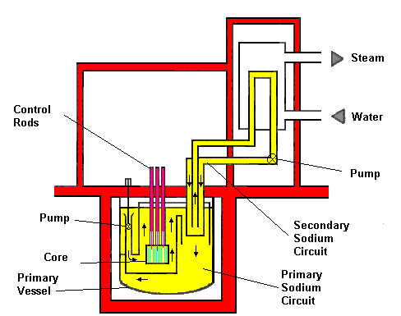
FAST BREEDER REACTORS (FBR or LMFBR)
FUEL TYPE - depleted Uranium or UO₂ surround PU in centre of core. All elements clad in stainless steel.
MODERATOR - NONE
COOLANT - LIQUID METAL
ADVANTAGES:-
LIQUID METAL COOLANT - at ATMOSPHERIC PRESSURE. Will even cool by natural convection in event of pump failure.
BREEDS FISSILE MATERIAL from non-fissile 238U – increases resource base 50+ times.
HIGH EFFICIENCY (~ 40%)
VERTICAL CONTROL RODS drop by GRAVITY in fault conditions.
DISADVANTAGES:-
DEPLETED URANIUM FUEL ELEMENTS MUST BE REPROCESSED to recover PLUTONIUM and sustain the breeding of more plutonium for future use.
CURRENT DESIGNS have SECONDARY SODIUM CIRCUIT
WATER/SODIM HEAT EXCHANGER. If water and sodium mix a significant CHEMICAL explosion may occur which might cause damage to reactor itself.
OTHER FACTORS:-
VERY HIGH POWER DENSITY - 600 MW/m³ but rise in temperature in fault conditions limited by natural circulation of sodium.

Slide 17
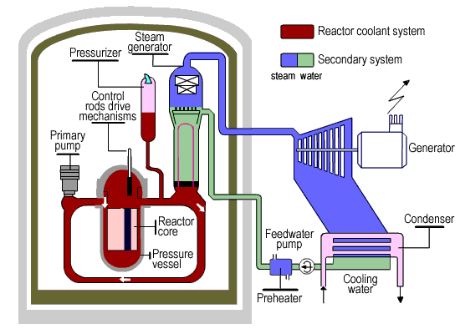
GENERATION 3/3+ REACTORS: the EPR1300
Schematic of Reactor is very similar to later PWRs (SIZEWELL) with 4 Steam Generator Loops.
Main differences? from earlier designs.
Output power ~1600 MW from a single turbine
(cf 2 turbines for 1188 MW at Sizewell).
Each of the safety chains is housed in a separate building.
Efficiency claimed at 37%
But no actual experience and likely to be less
Construction is under way at Olkiluoto, Finland.
Second reactor under construction in Flammanville, France
Now under construction at Hinkley Point C – Sept 2016

Slide 18
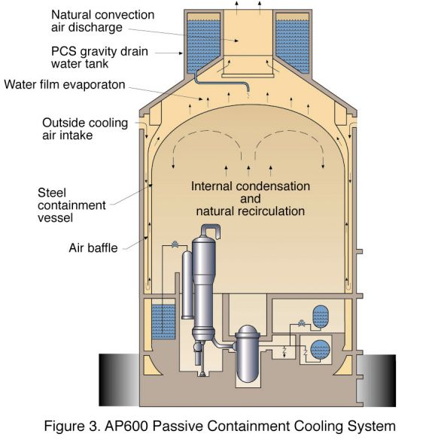
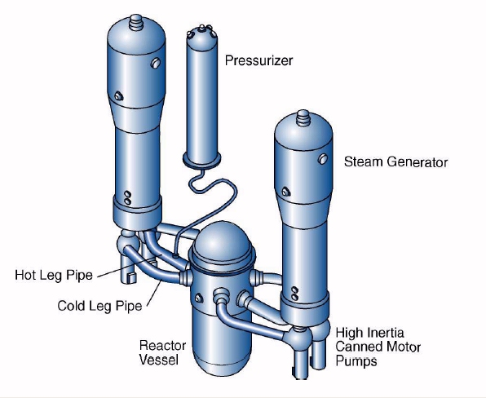
GENERATION 3/3+ REACTORS: the AP1000
A development from SIZEWELL
Power Rating comparable with SIZEWELL
Possible Contender for new UK reactors
Will two turbines be used ??
Passive Cooling – water tank on top – water falls by gravity
Two loops (cf 4 for EPR)
Significant reduction in components e.g. pumps etc.

Slide 19
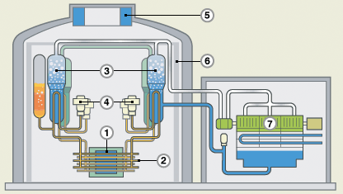
GENERATION 3/3+ REACTORS: the ACR1000
A development from CANDU with added safety features less Deuterium needed
Passive emergency cooling as with AP1000
See Video Clip of on-line refuelling

Slide 20
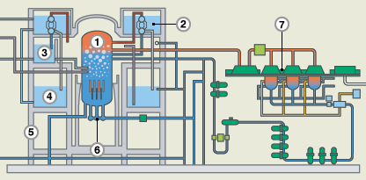
ESBWR: Economically Simple BWR
A derivative of Boiling Water Reactor for which it is claimed has several safety features but which inherently has two disadvantages of basic design
Vertical control rods which must be driven upwards
Steam in turbines can become radioactive
HITACHI ABWR 1000 submitted design for Generic Design Assessment in 2013

Slide 21
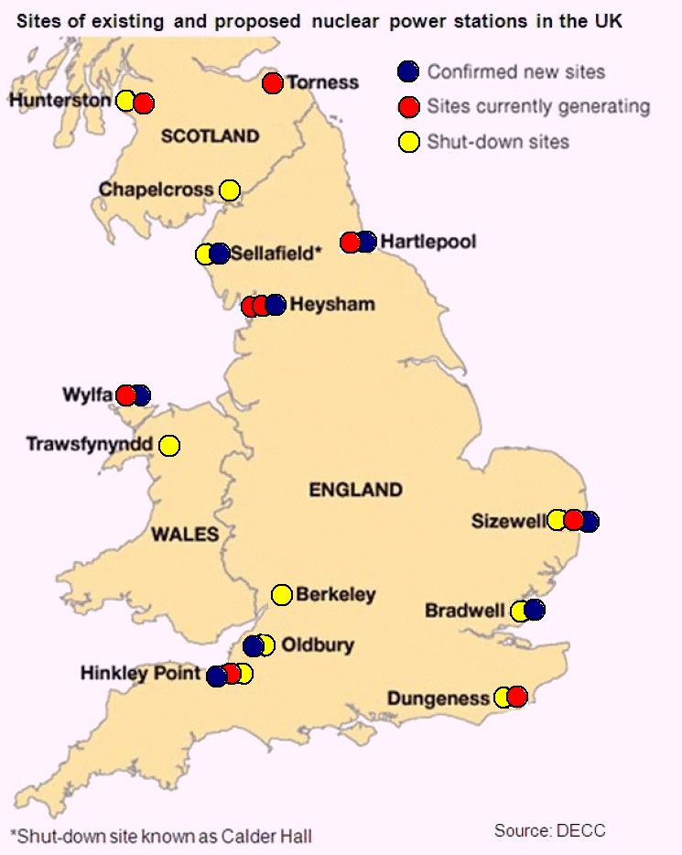
Possible Locations of New Nuclear Stations in UK

Slide 22
Generic Design Assessment
All Nuclear Reactors for use in UK must undergo a Generic Design Assessment which typically lasts up to 5 years. Primarily aimed at the Generic Design.
Involves 5 Stages with an opportunity for the Public and others to participate in Consultations
Coordinated by the Environment Agency and Office of Nuclear Regulation
Most thorough assessment anywhere in the World
Separate from any Planning Permission which is site specific.
To date only the EPR Reactor has achieved approval from this process

Slide 23
New Nuclear Stations – UK – Hinkley Point C
Hinkley Point C (HPC) - Two 1600MW Reactors of EPR design now under construction (as of September 2016).
Adjacent to Hinkley Point A a MAGNOX Station closed in 2000, and Hinkley Point B an AGR, commissioned in late 1976.
Same design as
Olkiluto, Finland – began construction in 2005 for scheduled completion in 2010, -will not start operating until 2018.
Flammanville, France – began construction in 2007 for completion in 2012, will not start operating until late 2018/early 2019.
Operation of Hinkley Point C not expected until 2026.
Both Olkiluoto and Flammanville have also seen significant cost over runs.
UK Government has guaranteed a price of generation at HPC or £92.50/MWh (9.25p/kWh) compared to current price for Onshore wind of ~£80/MWh and a current wholesale price of ~ £45/MWh

Slide 24
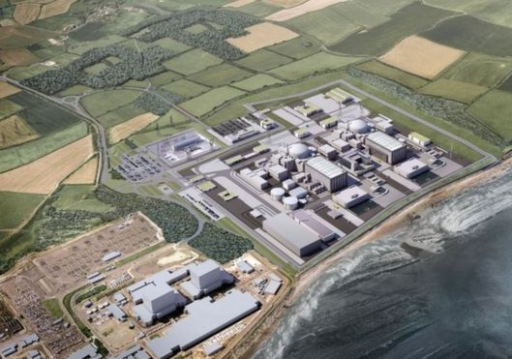
Hinkley Point C
Artists impression of Hinkley Point C with Hinkley Point B in foreground

Slide 25
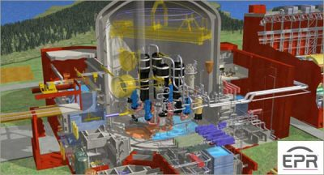
Hinkley Point C
December 2013. EPR Reactor gains approval for use in UK in the Generic Design Assessment after 5 years of detailed study
http://www.world-nuclear-news.org/NN-EPR_reactor_design_meets_UK_approval-1312127.html

Slide 26
Generic Design Assessment Timeline
Year | 2007 |  |  |  | 2008 |  |  |  | 2009 |  |  |  | 2010 |  |  |  | 2011 |  |  |  | 2012
Quarter | 1 | 2 | 3 | 4 | 1 | 2 | 3 | 4 | 1 | 2 | 3 | 4 | 1 | 2 | 3 | 4 | 1 | 2 | 3 | 4 | 1 | 2 | 3 | 4
UK EPR |  | S1 |  | S2 |  |  | S3 |  |  |  |  |  | S4 |  |  |  |  |  |  |  | Closure
AP 1000 |  | S1 |  | S2 |  |  | S3 |  |  |  |  |  | S4 |  |  |  |  |  |  |  | Paused
UK ABWR
UK HPR1000
Year | 2013 |  |  |  | 2014 |  |  |  | 2015 |  |  |  | 2016 |  |  |  | 2017
Quarter | 1 | 2 | 3 | 4 | 1 | 2 | 3 | 4 | 1 | 2 | 3 | 4 | 1 | 2 | 3 | 4 | 1 | 2 | 3 | 4
UK EPR
AP 1000 | Paused |  |  |  |  |  | Closure
UK ABWR |  | S1 |  |  | S2 |  |  | S3 |  |  |  | S4
UK HPR1000 |  |  |  |  |  |  |  |  |  |  |  |  |  |  |  |  | S1
S1 - Stage 1 Assessment
S2 - Stage 2 Assessment
S3 - Stage 3 Assessment
S4 - Stage 4 Assessment
GDA for CANDU ACR1000 currently in abeyance

Slide 27
Other Reactors under consideration - 2017
Sizewell C will be identical to Hinkley Point C
Stage 2 Consultation end on Friday 3rd February 2017
Construction unlikely to start before 2019 and possible generation from 2030+ onwards.
By 2030 only Sizewell B and potentially Hinkley Point C will be operating as all other nuclear plant in UK will have been shut down.
Bradwell:
The main contender for this the Chinese CGN HPR1000 Reactor

Slide 28
CHINESE HPR1000 – a possible reactor for Bradwell
A development of a design by China General Nuclear (CGN) and EdF
Jesse Norman
Parliamentary Under-Secretary (Department for Business, Energy and Industrial Strategy)
I have today asked the UK’s independent nuclear regulators, the Office for Nuclear Regulation, and the Environment Agency, to begin a Generic Design Assessment of the UK HPR1000 reactor.

Slide 29
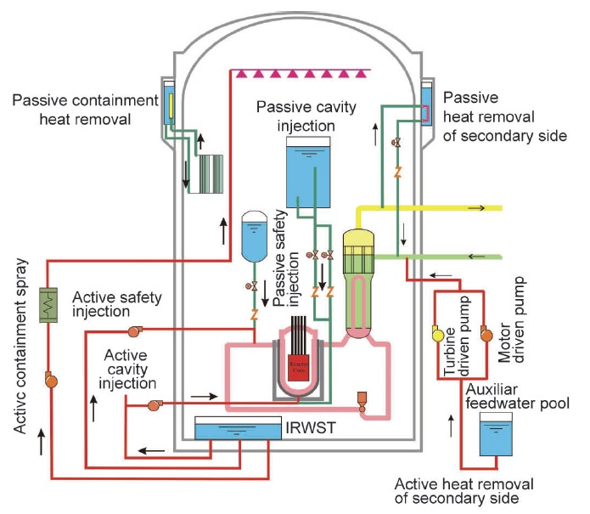
HPR 1000 Reactor
IRWST
In - containment
Refuelling Water Storage Tank

Slide 30
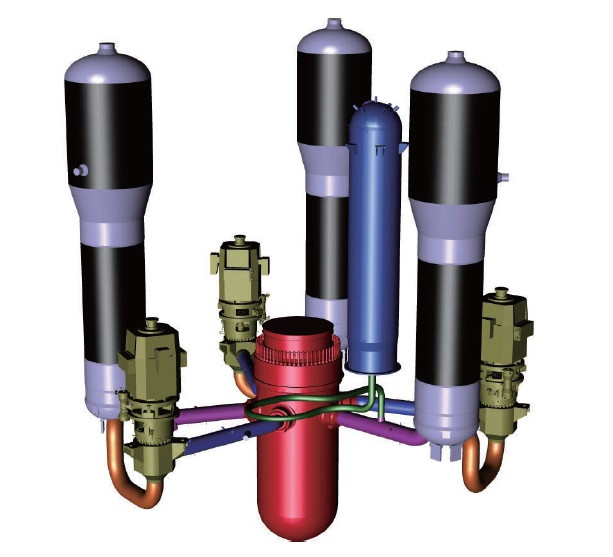
HPR 1000 Reactor
Arrangement of 3 Steam Generation Loops and Reactor (red)

Slide 31
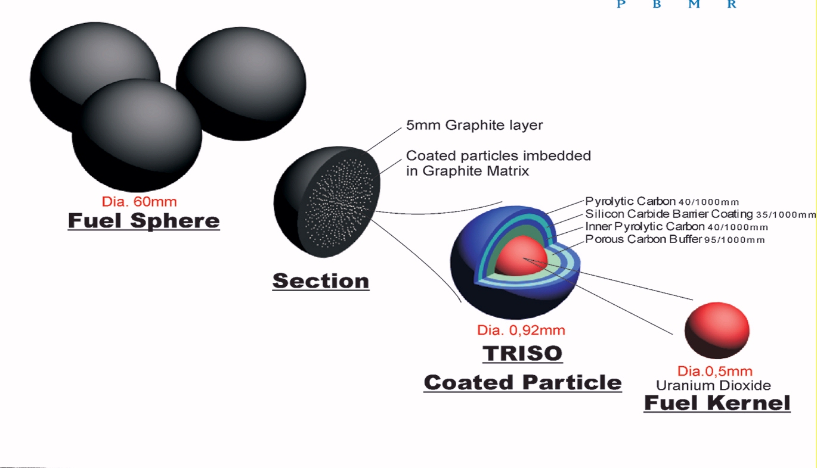
Generation 3+/4 Reactors : the PBMR
Pebble Bed Modulating Reactors are a development from Gas Cooled Reactors.
Sand sized pellets of Uranium each coated in layers of graphite/silicon carbide and aggregated into pebbles 60 mm in diameter.
Coolant: Helium
Connected directly to closed circuit gas turbine
Efficiency ~ 39 – 40%, but possibility of CCGT??
Graphite/silicon carbide effective cladding – thus very durable to high temperatures

Slide 32
Generation 3+/4 Reactors : the PBMR
Unlike other Reactors, the PBMR uses a closed circuit high temperature gas turbine operating on the Brayston Cycle for Power. This cycle is similar to that in a JET engine or the gas turbine section of a CCGT.
Normal cycles exhaust spent gas to atmosphere.
In this version the helium is in a closed circuit.
Fuel In
PBM Reactor
Combustion Chamber
Turbine
Compressor
Generator
Open Brayston Cycle
Closed Brayston Cycle
Heat Exchanger
Exhaust
Air In

Slide 33
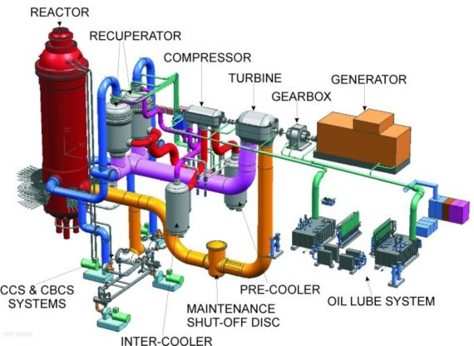
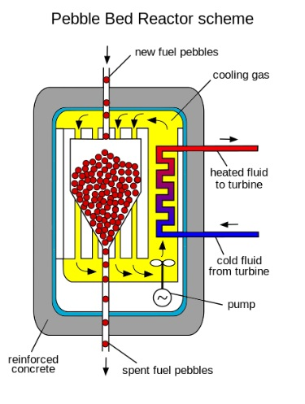
Generation 3+/4 Reactors : the PBMR
Efficiency of around 38 – 40%, but possibility of CCGT???
Helium passes directly from reactor to turbine
Pebbles are continuously fed into reactor and collected.
Tested for burn up and recycled as appropriate ~ typically 6 times

Slide 34
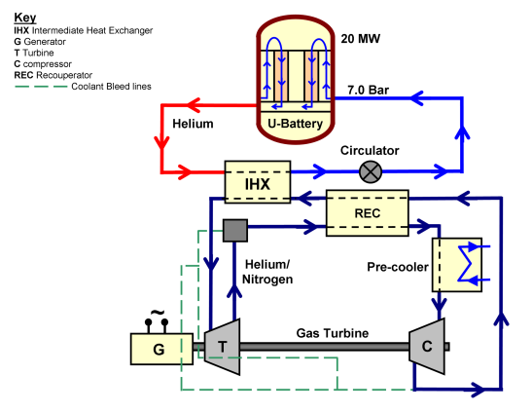
Generation 3+/4 Reactors U2 Battery
G – Generator
T – Turbine
C - Compressor
REC – Recuporator
IHX - Intermediate Heat Exchanger
Uses PBMR principle for fuel
Much smaller than conventional reactors @ 10MWe.
Could be truck mounted for deployment in remote areas
U2-Battery Small 20 MW_{th} / 10 MW_{e} Nuclear Plant
Using closed Brayton Cycle
Deployment from late 2020s???

Slide 35
Supplementary Slides on Fusion which will only be shown if time permits

Slide 36
Nuclear Fusion
Fusion of light elements e.g. DEUTERIUM and TRITIUM produces even greater quantities of energy per nucleon are released.
Deuterium – Tritium fusion
³H
Tritium
⁴He
Deuterium
²H
(3.5 MeV)
n
(14.1 MeV)
In each reaction 17.6 MeV is liberated or 2.8 picoJoules (2.8 * 10⁻¹⁵J)

Slide 37
Nuclear Fusion
The basic reaction for D - T fusion is
D + T ----→ He + n
Where waste product is Helium an inert gas
To generate tritium, two further reactions are needed
⁶Li + n = T + He
and ⁷Li + n = T + He + n
In operation the Deuterium and Trition must be as a Plasma
The performance of Fusion and how close it is to sustained power output is measured as the Triple Product of:
Ion plasma density,
The temperature – at least 10 million degrees Celcius
The confinement time

Slide 38
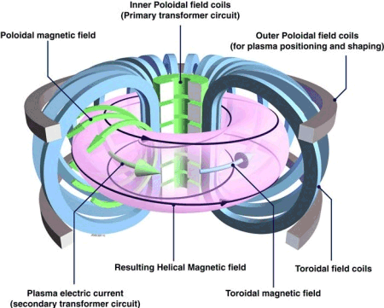
Nuclear Fusion

Slide 39
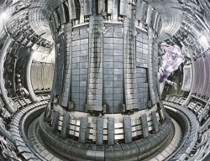
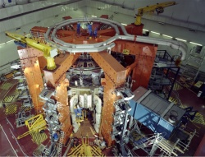
Nuclear Fusion
Photographs of JET Culham Reactor
Reactor achieved Break Even in mid 1990s
– i.e. amount of Energy Out = amount of Energy
ITER Reactor, under construction in Cadarache should generate up to 500MWe of thermal power
DEMO Reactor to provide electricity to Grid, planned from 2030
COMMERCIAL OPERATION from late 2040s

Slide 40
Nuclear Fusion
Possible Configuration of DEMO

Slide 41
Nuclear Fusion
STOP PRESS: 30th January 2017

