Slide 1


ENV-5022B / ENVK5023B
Low Carbon Energy
2017 - 18
NUCLEAR POWER – Part 1
http://www2.env.uea.ac.uk/energy/energy.htm
http://www.uea.ac.uk/~e680/energy/energy.htm
To date Nuclear Power has reduced cumulative UK carbon dioxide emissions by ~1.5 billion tonnes
N.K. Tovey (杜伟贤) M.A, PhD, CEng, MICE, CEnv
Н.К.Тови М.А., д-р технических наук

Slide 2
NUCLEAR POWER
Background Introduction
Nuclear Power – The Basics
Requirements for Nuclear Reactors
Reactor Types (general overview and introduction
Reactor Types
  Nuclear Fusion Reactors
Covered in 2016-17 but not covered this year but included in accompanying handout
  Nuclear Fuel Cycle
  Supplementary Handout
  Notes written relating to Fukushima Incident in March 2011
Session 2
Session 3
Session 1

Slide 3
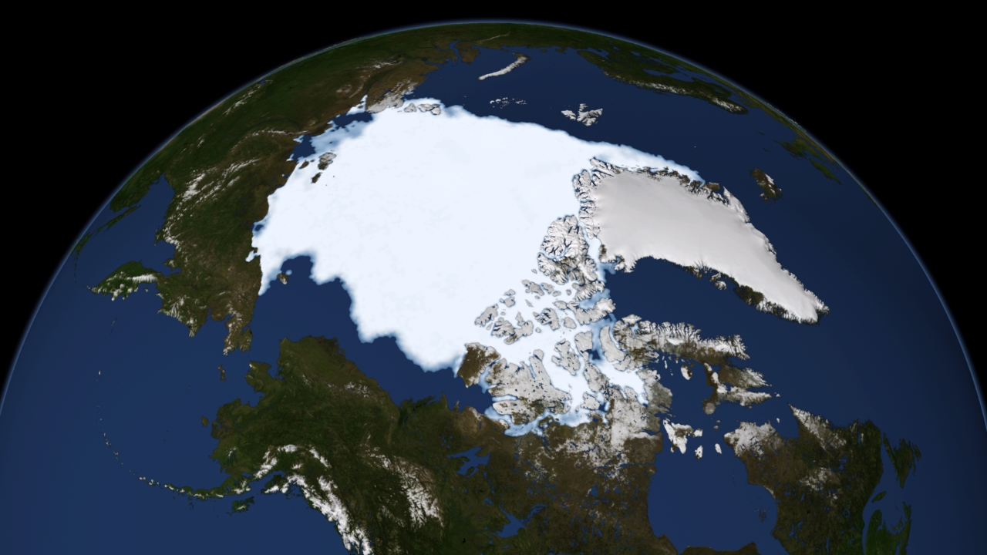
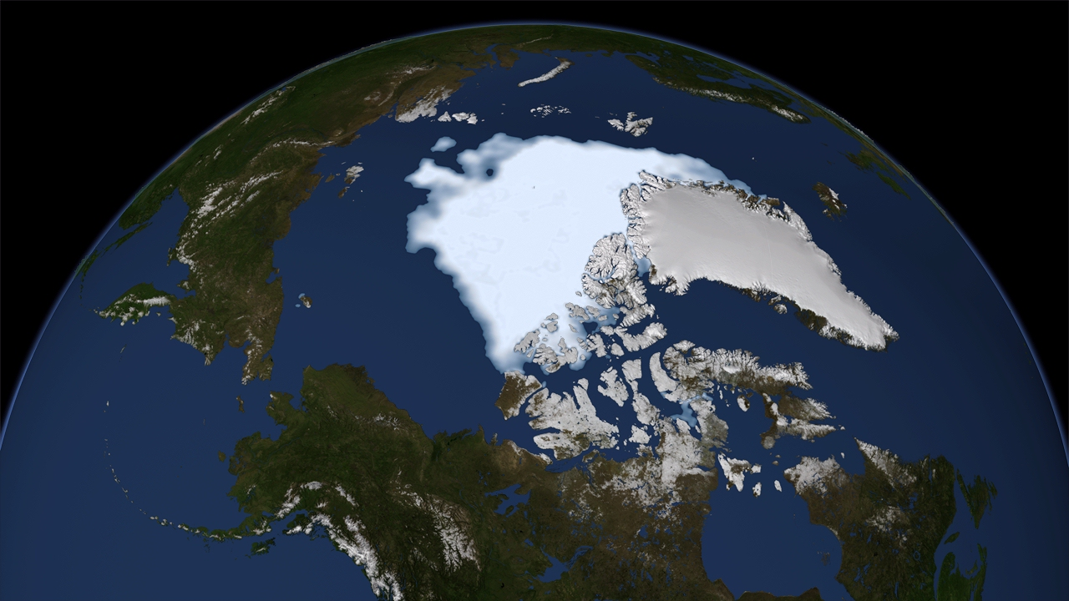
Arctic Sea Ice Cover 1979 - 2012
Minimum Summer Sea Ice in 1979 ~ 7.01 million sq km
Red line outlines extent for reference
Minimum Summer Sea Ice in 2012 ~ 3.44 million sq km
a loss of 51% in 33 years
Significantly lower in 2012 than average minimum
Source http://www.nasa.gov/topics/earth/features/2012-seaicemin.html

Slide 4
NUCLEAR POWER
To combat Climate Change, low carbon electricity generation is needed
Options include:
  Carbon Capture and Sequestration
  Renewable Generation
  Nuclear Power
Generation | gms CO₂ / kWH | Comments
Coal | 900 – 1100 | 750 – 900 with supercritical coal
Coal with CCS | ~ 100
Gas (Steam) | ~ 600
Gas CCGT | 360 – 440
GAS CCGT/CCS | 40
Nuclear | 5 - 20 | Depending on reactor type
Renewables | <10 | Biomass will be higher
Overall UK Average 2014 - 540 gms CO₂ /kWh
Embedded Carbon ~ 10 – 20 gms CO₂ /kWh for all generation types

Slide 5
CO₂ Emissions and Electricity (kg/kWh)
World Average 0.550
UK
France
Overall: UK ~500 gm/kWh: France ~80 gm/kWh Saudi Arabia ~700 gm/kWh
* Extracted from IEA Statistics in Jan 2014 – data relate to 2010
5
Notes:
5

Slide 6
Electricity Generation Mix in selected Countries 2010
Coal Oil Gas Nuclear
Hydro/ Tidal/Wave Other Renewables Biofuels/Waste
Notes:
6

Slide 7
NUCLEAR POWER in the UK
Chart updated 28th Jan 2016
New Build ~s 1 new nuclear reactor is completed each year 2025-2030).
Generation 1: MAGNOX: (Anglo-French design) final reactor closed on 30th December 2015
Generation 2a: Advanced Gas Cooled reactors (unique UK design) – most efficient nuclear power stations ever built - 14 reactors operating.
Generation 2b: Pressurised Water Reactor – most common reactor Worldwide. UK has just one Reactor 1198MW at Sizewell B.

Slide 8
Electricity Generation Futures – with New Nuclear and New Coal
Data for future demand derived from DECC & Climate Change Committee (2011) - allowing for significant deployment of electric vehicles and heat pumps by 2030.
Data for future demand derived from DECC & Climate Change Committee (2011) - allowing for significant deployment of electric vehicles and heat pumps by 2030.
Coal
Nuclear
1 new nuclear station and coal station completed each year after 2025.
1 million homes fitted with PV each year from 2020 40% of homes fitted by 2030
19 GW of onshore wind by 2030 cf 11 GW in 2016: offshore 20GW cf 5.3 GW

Slide 9
Electricity Generation Futures – no New Nuclear or New Coal
Imported Gas
Fracked Gas
UK Gas
Imports
Solar
Coal
Other Renewables

Slide 10
CO₂ Emission Factors for UK Electricity
Closure of Coal Generation
Dash for Gas

Slide 11
CO₂ Emission Factors for UK Electricity

Slide 12
Simplified Schematic of a Power Station
Boiler
Turbine
Generator
Pump
Heat Exchanger
Less electricity produced with CHP, but overall efficiency is higher
Normal Cooling Towers ~ 30ºC Alternative: District Heat Main ~ 90ºC
Combined heat and power can also be used with Nuclear Power
  e.g. Switzerland, Sweden, Russia
Nuclear Power can be used solely as a source of heat
  e.g. some cities in Russia - Novosibirsk

Slide 13
NUCLEAR POWER
Background Introduction
Nature of Radioactivity
  Structure of the Atom
  Radioactive Emissions
  Half Life of Elements
  Fission
  Fusion
  Chain Reactions
  Fertile Materials
Fission Reactors

Slide 14

NATURE OF RADIOACTIVITY (1)
Structure of Atoms.
Matter is composed of atoms which consist primarily of a nucleus of:
  positively charged PROTONS
  and (electrically neutral) NEUTRONS.
The nucleus is surrounded by a cloud of negatively charged ELECTRONS which balance the charge from the PROTONS.
PROTONS and NEUTRONS have approximately the same mass
ELECTRONS are about 0.0005 times the mass of the PROTON.
A NUCLEON refers to either a PROTON or a NEUTRON
+
3p
+
+
4n
Lithium Atom
3 Protons 4 Neutrons

Slide 15
NATURE OF RADIOACTIVITY (2)
Structure of Atoms.
Elements are characterized by the number of PROTONS present
  HYDROGEN nucleus has 1 PROTON
  HELIUM has 2 PROTONS
  OXYGEN has 8 PROTONS
  URANIUM has 92 PROTONS.
Number of PROTONS is the ATOMIC NUMBER (Z)
N denotes the number of NEUTRONS.
The number of neutrons present in any element varies.
3 isotopes of hydrogen all with 1 PROTON:-
  HYDROGEN itself with NO NEUTRONS
  DEUTERIUM (heavy hydrogen) with 1 NEUTRON
  TRITIUM with 2 NEUTRONS.
only TRITIUM is radioactive.
Elements up to Z = 82 (Lead) have at least one isotope which is stable
Symbol D
Symbol T

Slide 16
NATURE OF RADIOACTIVITY (3)
Structure of Atoms.
URANIUM has two main ISOTOPES
²³⁵U which is present in concentrations of 0.7% in naturally occurring URANIUM
²³⁸U which is 99.3% of naturally occurring URANIUM.
Some Nuclear Reactors use Uranium at the naturally occurring concentration of 0.7%
Most require some enrichment to around 2.5% - 5%
Enrichment is energy intensive if using gas diffusion technology, but relatively efficient with centrifuge technology.
Some demonstration reactors use enrichment at around 93%.

Slide 17
NATURE OF RADIOACTIVITY (5)
Radioactive emissions.
FOUR types of radiation:-
1) ALPHA particles (α)
  large particles consisting of 2 PROTONS and 2 NEUTRONS
  the nucleus of a HELIUM atom.
2) BETA particles (β) which are ELECTRONS
3) GAMMA - RAYS. (γ)
  Arise when the kinetic energy of Alpha and Beta particles is lost passing through the electron clouds of atoms. Some energy is used to break chemical bonds while some is converted into GAMMA -RAYS.
4) X - RAYS.
  Alpha and Beta particles, and gamma-rays may temporarily dislodge ELECTRONS from their normal orbits. As the electrons jump back they emit X-Rays which are characteristic of the element which has been excited.

Slide 18
NATURE OF RADIOACTIVITY (6)
α
β
γ
α - particles are stopped by a thin sheet of paper
β – particles are stopped by ~ 3mm aluminium
γ - rays CANNOT be stopped – they can be attenuated to safe limits using thick Lead and/or concrete

Slide 19
NATURE OF RADIOACTIVITY (7)
Radioactive emissions.
UNSTABLE nuclei emit Alpha or Beta particles
If an ALPHA particle is emitted, the new element will have an ATOMIC NUMBER two less than the original.
e
If an ELECTRON is emitted as a result of a NEUTRON transmuting into a PROTON, an isotope of the element ONE HIGHER in the PERIODIC TABLE will result.

Slide 20
NATURE OF RADIOACTIVITY (8)
Radioactive emissions.
²³⁵U consisting of 92 PROTONS and 143 NEUTRONS is one of SIX isotopes of URANIUM
decays as follows:-
alpha
beta
alpha
²³⁵U
²³¹Th
²³¹Pa
²²⁷Ac
URANIUM
THORIUM
PROTACTINIUM
ACTINIUM
Thereafter the ACTINIUM - 227 decays by further alpha and beta particle emissions to LEAD - 207 (²⁰⁷Pb) which is stable.
Two other naturally occurring radioactive decay series exist. One beginning with ²³⁸U, and the other with ²³²Th.
Both also decay to stable (but different) isotopes of LEAD.

Slide 21
NATURE OF RADIOACTIVITY (9)
HALF LIFE.
Time taken for half the remaining atoms of an element to undergo their first decay e.g:-
²³⁸U 4.5 billion years
²³⁵U 0.7 billion years
²³²Th 14 billion years
All of the daughter products in the respective decay series have much shorter half - lives some as short as 10⁻⁷ seconds.
When 10 half-lives have expired,
  the remaining number of atoms is less than 0.1% of the original.
20 half lives
  the remaining number of atoms is less than one millionth of the original

Slide 22
NATURE OF RADIOACTIVITY (10)
HALF LIFE.
From a radiological hazard point of view
short half lives - up to say 6 months have intense radiation, but
decay quite rapidly. Krypton-87 (half life 1.8 hours)- emitted from some gas cooled reactors - the radioactivity after 1 day is insignificant.
For long half lives - the radiation doses are small, and also of little consequence
For intermediate half lives - these are the problem - e.g. Strontium -90
has a half life of about 30 years which means it has a relatively high radiation, and does not decay that quickly.
Radiation only decreases to 30% over 90 years

Slide 23
NATURE OF RADIOACTIVITY (11): Fission
Some very heavy UNSTABLE elements exhibit FISSION e.g. ²³⁵U
n
²³⁵U
⁹³Rb
n
n
This reaction is one of several which might take place. In some cases, 3 daughter products are produced.
¹⁴⁰Cs

Slide 24
NATURE OF RADIOACTIVITY (12)
FISSION
Nucleus breaks down into two or three fragments accompanied by a few free neutrons and the release of very large quantities of energy.
FISSION of 1 kg of URANIUM produces as much energy as burning 3000 tonnes of coal.
Free neutrons are available for further FISSION reactions
Fragments from the fission process usually have an atomic mass number (i.e. N+Z) close to that of iron.
Elements which undergo FISSION following capture of a neutron such as URANIUM - 235 are known as FISSILE.
Diagrams of Atomic Mass Number against binding energy per NUCLEON enable amount of energy produced in a fission reaction to be estimated.
All Nuclear Power Plants currently exploit FISSION reactions

Slide 25
NATURE OF RADIOACTIVITY (13): Fusion
Fusion of light elements e.g. DEUTERIUM and TRITIUM produces even greater quantities of energy per nucleon are released.
Deuterium – Tritium fusion
³H
Tritium
⁴He
Deuterium
²H
(3.5 MeV)
n
(14.1 MeV)
In each reaction 17.6 MeV is liberated or 2.8 picoJoules (2.8 * 10⁻¹⁵J)

Slide 26
NATURE OF RADIOACTIVITY (14): Binding Energy
Atomic Mass Number
0 50 100 150 200 250
Binding Energy per nucleon [MeV]
-2
-4
-6
-8
-10
Fusion Energy release per nucleon
1 MeV per nucleon is equivalent to 96.5 TJ per kg
Uranium 235
Range of Fission Products
Fission Energy release per nucleon
Iron 56
Redrawn from 6th report on Environmental Pollution – Cmnd. 6618 - 1976
The energy released per nucleon in fusion reaction is much greater than the
corresponding fission reaction.
2) In fission there is no single fission product but a broad range as indicated.

Slide 27
NATURE OF RADIOACTIVITY (15): Fusion
Developments at the JET facility in Oxfordshire have achieved the break even point.
Next facility (ITER) is being built in Cadarache in France.
Commercial deployment of fusion from about 2040 onwards
One or two demonstration commercial reactors in 2030s perhaps
No radioactive waste from fuel
Limited radioactivity in power plant itself
8 litres of tap water sufficient for all energy needs of one individual for whole of life at a consumption rate comparable to that in UK.
Sufficient resources for 1 – 10 million years

Slide 28
NATURE OF RADIOACTIVITY (16): Chain Reactions
n
Fast Neutrons are unsuitable for sustaining further reactions
fast neutron
²³⁵U
n
Slow neutron
n
n
²³⁵U
n
fast neutron
n
Slow neutron

Slide 29
NATURE OF RADIOACTIVITY (17)
CHAIN REACTIONS
FISSION of URANIUM - 235 yields 2 - 3 free neutrons.
If exactly ONE of these triggers a further FISSION, then a chain reaction occurs, and continuous power can be generated.
UNLESS DESIGNED CAREFULLY, THE FREE NEUTRONS WILL BE LOST AND THE CHAIN REACTION WILL STOP.
IF MORE THAN ONE NEUTRON CREATES A NEW FISSION THE REACTION WOULD BE SUPER-CRITICAL
  (or in layman's terms a bomb would have been created).

Slide 30
NATURE OF RADIOACTIVITY (18)
CHAIN REACTIONS
IT IS VERY DIFFICULT TO SUSTAIN A CHAIN REACTION,
Most Neutrons are moving too fast
TO CREATE A BOMB, THE URANIUM - 235 MUST BE HIGHLY ENRICHED > 93%,
Normal Uranium is only 0.7% U235
Material must be LARGER THAN A CRITICAL SIZE and SHAPE OTHERWISE NEUTRONS ARE LOST.
Atomic Bombs are made by using conventional explosive to bring two sub-critical masses of FISSILE material together for sufficient time for a SUPER-CRITICAL reaction to take place.
NUCLEAR POWER PLANTS CANNOT EXPLODE LIKE AN ATOMIC BOMB.

Slide 31
NATURE OF RADIOACTIVITY (19)
FERTILE MATERIALS
Some elements like URANIUM - 238 are not FISSILE, but can transmute:-
n
fast neutron
²³⁸U
²³⁹Pu
²³⁹U
e
²³⁹Np
e
+n
beta
²³⁹Np
Neptunium - 239
beta
²³⁹Pu
Plutonium - 239
²³⁸U
Uranium - 238
²³⁹U
Uranium - 239
PLUTONIUM - 239 is FISSILE and may be used in place of URANIUM - 235.
Materials which can be converted into FISSILE materials are FERTILE.

Slide 32
NATURE OF RADIOACTIVITY (20)
FERTILE MATERIALS
URANIUM - 238 is FERTILE as is THORIUM - 232 which can be transmuted into URANIUM - 233.
Naturally occurring URANIUM consists of 99.3% ²³⁸U which is FERTILE and NOT FISSILE, and 0.7% of ²³⁵U which is FISSILE. Normal reactors primarily use the FISSILE properties of ²³⁵U.
In natural form, URANIUM CANNOT sustain a chain reaction: free neutrons are travelling fast to successfully cause another FISSION, or are lost to the surrounds.
MODERATORS are thus needed to slow down/and or reflect the neutrons in a normal FISSION REACTOR.
The Resource Base of ²³⁵U is only decades
But using a Breeder Reactor Plutonium can be produced from non-fissile ²³⁸U producing ²³⁹Pu and extending the resource base by a factor of 50+

Slide 33
NATURE OF RADIOACTIVITY (21): Chain Reactions
Sustaining a reaction in a Nuclear Power Station
n
Fast Neutrons are unsuitable for sustaining further reactions
fast neutron
²³⁵U
n
n
n
n
Slow neutron
fast neutron
n
²³⁵U
n
fast neutron
n
Slow neutron
Insert a moderator to slow down neutrons

Slide 34
NUCLEAR POWER
Background Introduction
Nature of Radioactivity
Fission Reactors
  General Introduction
  MAGNOX Reactors
  AGR Reactors
  CANDU Reactors
  PWRs
  BWRs
  RMBK/ LWGRs
  FBRs
  Generation 3 Reactors
  Generation 3+ Reactors (if time)

Slide 35
FISSION REACTORS (1):
FISSION REACTORS CONSIST OF:-
i) a FISSILE component in the fuel
ii) a MODERATOR
iii) a COOLANT to take the heat to its point of use.
The fuel elements vary between different Reactors
Some reactors use unenriched URANIUM
  i.e. the ²³⁵U in fuel elements is at 0.7% of fuel
  e.g. MAGNOX and CANDU reactors,
ADVANCED GAS COOLED REACTOR (AGR) uses 2.5 – 2.8% enrichment
PRESSURISED WATER REACTOR (PWR) and BOILING WATER REACTOR (BWR) use around 3.5 – 4% enrichment.
RMBK (Russian Rector of Chernobyl fame) uses ~2% enrichment
Some experimental reactors - e.g. High Temperature Reactors (HTR) use highly enriched URANIUM (>90%) i.e. weapons grade.

Slide 36
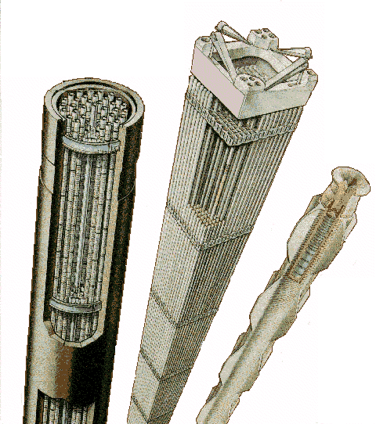
FISSION REACTORS (2): Fuel Elements
PWR fuel assembly:
UO₂ pellets loaded into fuel pins of zirconium each ~ 3 m long in bundles of ~200
AGR fuel assembly:
UO₂ pellets loaded into fuel pins of stainless steel each ~ 1 m long in bundles of 36.
Whole assembly in a graphite cylinder
Magnox fuel rod:
Natural Uranium metal bar approx 35mm diameter and 1m long in a fuel cladding made of MagNox.
Burnable poison

Slide 37
FISSION REACTORS (3):
No need for the extensive coal handling plant.
In the UK, all the nuclear power stations are sited on the coast so there is no need for cooling towers.
Land area required is smaller than for coal fired plant.
In most reactors there are three fluid circuits:-
  1) The reactor coolant circuit (which can become radioactive)
  2) The steam cycle (which will not be radioactive except Boiling Water Reactors)
  3) The cooling water cycle.
ONLY the REACTOR COOLANT will become radioactive
The cooling water is passed through the station at a rate of tens of millions of litres of water and hour, and the outlet temperature is raised by around 10ºC.

Slide 38
FISSION REACTORS (4):
REACTOR TYPES – summary 1
MAGNOX - Original British Design named after the magnesium alloy used as fuel cladding. 8 reactors of this type were built in France, One in each of Italy, Spain and Japan. 26 units were built in UK.
The last MAGNOX reactor closed on 30th December 2015.
Oldbury closed in 2012 after operating life was extended to 45 years. One reactor at Wylfa also closed in 2012 after 41 years operation. All other MAGNOX units are being decommissioned
AGR - ADVANCED GAS COOLED REACTOR - solely British design. 14 units are in use. The original demonstration Windscale AGR is now being decommissioned. The last two stations Heysham II and Torness (both with two reactors), were constructed to time and have operated to expectations.

Slide 39
FISSION REACTORS (5):
REACTOR TYPES - summary
PWR - Originally an American design of PRESSURIZED WATER REACTOR (also known as a Light Water Reactor LWR). Now most common reactor. (Three Mile Island)
BWR - BOILING WATER REACTOR - a derivative of the PWR in which the coolant is allowed to boil in the reactor itself. Second most common reactor in use. (Fukushima)
RMBK - LIGHT WATER GRAPHITE MODERATING REACTOR (LWGR)- a design unique to the USSR which figured in the CHERNOBYL incident. 16 units still in operation in Russian and Lithuania with 9 shut down.
CANDU - A reactor named initially after CANadian DeUterium moderated reactor (hence CANDU), alternatively known as PHWR (pressurized heavy water reactor). 41 currently in use.

Slide 40
FISSION REACTORS (5):
REACTOR TYPES - summary
HTGR - HIGH TEMPERATURE GRAPHITE REACTOR - an experimental reactor. The original HTR in the UK started decommissioning in 1975. The Pebble Bed Modulating Reactor (PBMR) is a development of this and was promoted as a 3+ Generation Reactor by South Africa until 2010 – China now has some interest.
SGHWR - STEAM GENERATING HEAVY WATER REACTOR - originally a demonstration British Design which is a hybrid between the CANDU and BWR reactors.
FBR - FAST BREEDER REACTOR - unlike all previous reactors, this reactor 'breeds' PLUTONIUM from FERTILE 238U to operate, and in so doing extends resource base of URANIUM over 50 times. Mostly experimental at moment with FRANCE, W. GERMANY and UK, Russia and JAPAN having experimented with them.

Slide 41
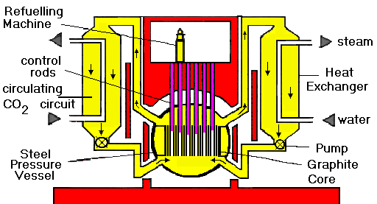
MAGNOX REACTORS (also known as GCR):
FUEL TYPE - unenriched URANIUM METAL clad in Magnesium alloy
MODERATOR - GRAPHITE
COOLANT - CARBON DIOXIDE
DIRECT RANKINE CYCLE
  - no superheat or reheat efficiency ~ 20% to 28%.
ADVANTAGES:-
LOW POWER DENSITY - 1 MW/m³. Thus very slow rise in temperature in fault conditions.
UNENRICHED FUEL
GASEOUS COOLANT
ON LOAD REFUELLING
MINIMAL CONTAMINATION FROM BURST FUEL CANS
VERTICAL CONTROL RODS - fall by gravity in case of emergency.
DISADVANTAGES:-
CANNOT LOAD FOLLOW – [Xe poisoning]
OPERATING TEMPERATURE LIMITED TO ABOUT 250ºC - 360ºC limiting CARNOT EFFICIENCY to ~40 - 50%, and practical efficiency to ~ 28-30%.
LOW BURN-UP - (about 400 TJ per tonne)
EXTERNAL BOILERS ON EARLY DESIGNS.

Slide 42
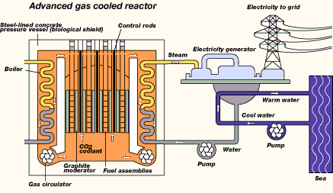
ADVANCED GAS COOLED REACTORS (AGR):
FUEL TYPE - enriched URANIUM OXIDE - 2.3% clad in stainless steel
MODERATOR - GRAPHITE
COOLANT - CARBON DIOXIDE
SUPERHEATED RANKINE CYCLE (with reheat) - efficiency 39 - 41%
ADVANTAGES:-
MODEST POWER DENSITY - 5 MW/m³. slow rise in temperature in fault conditions.
GASEOUS COOLANT (40- 45 BAR cf 160 bar for PWR)
ON LOAD REFUELLING under part load
MINIMAL CONTAMINATION FROM BURST FUEL CANS
RELATIVELY HIGH THERMODYNAMIC EFFICIENCY 40%
VERTICAL CONTROL RODS - fall by gravity in case of emergency.
DISADVANTAGES:-
MODERATE LOAD FOLLOWING CHARACTERISTICS
SOME FUEL ENRICHMENT NEEDED. - 2.3%
OTHER FACTORS:-
MODERATE FUEL BURN-UP - ~ 1800TJ/tonne (c.f. 400TJ/tonne for MAGNOX, 2900TJ/tonne for PWR).
SINGLE PRESSURE VESSEL with pres-stressed concrete walls 6m thick. Pre-stressing tendons can be replaced if necessary.

Slide 43
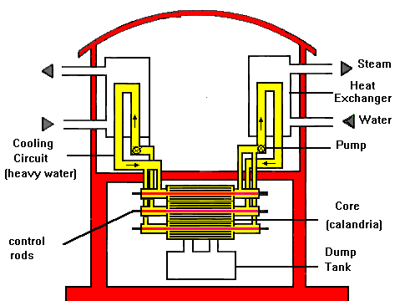
CANDU REACTOR (PHWR):
FUEL TYPE - unenriched URANIUM OXIDE clad in Zircaloy
MODERATOR - HEAVY WATER COOLANT - HEAVY WATER
ADVANTAGES:-
MODEST POWER DENSITY - 11 MW/m3.
HEAVY WATER COOLANT - low neutron absorber hence no need for enrichment.
ON LOAD REFUELLING - and very efficient indeed permits high load factors.
MINIMAL CONTAMINATION from burst fuel can - defective units can be removed without shutting down reactor.
MODULAR: - can be made to almost any size
DISADVANTAGES:-
POOR LOAD FOLLOWING CHARACTERISTICS
CONTROL RODS ARE HORIZONTAL, and therefore cannot operate by gravity in fault conditions.
MAXIMUM EFFICIENCY about 28%
OTHER FACTORS:-
MODERATE FUEL BURN-UP - ~ MODEST FUEL BURN-UP - about 1000TJ/tonne
FACILITIES PROVIDED TO DUMP HEAVY WATER MODERATOR from reactor in fault conditions
MULTIPLE PRESSURE TUBES instead of one pressure vessel.

Slide 44
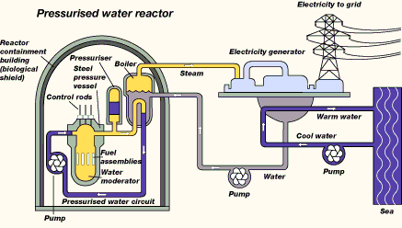
PRESSURISED WATER REACTORS – PWR (WWER):
FUEL TYPE - 3 – 4% enriched URANIUM OXIDE clad in Zircaloy
MODERATOR - WATER
COOLANT - WATER
ADVANTAGES:-
GOOD LOAD FOLLOWING CHARACTERISTICS - claimed for SIZEWELL B. - most PWRs are NOT operated as such.
HIGH FUEL BURN-UP- about 2900TJ/tonne –
VERTICAL CONTROL RODS - drop by gravity in fault conditions.
DISADVANTAGES:-
ORDINARY WATER as COOLANT - pressure to prevent boiling (160 bar). If break occurs then water will flash to steam and cooling will be less effective.
ON LOAD REFUELLING NOT POSSIBLE - reactor must be shut down.
SIGNIFICANT CONTAMINATION OF COOLANT CAN ARISE FROM BURST FUEL CANS - as defective units cannot be removed without shutting down reactor.
FUEL ENRICHMENT NEEDED. - 3-4%.
MAXIMUM EFFICIENCY ~ 31 - 32%
latest designs ~ 34%
OTHER FACTORS:-
LOSS OF COOLANT also means LOSS OF MODERATOR so reaction ceases - but residual decay heat can be large.
HIGH POWER DENSITY - 100 MW/m³, and compact. Temperature can rise rapidly in fault conditions. NEEDS active ECCS.
SINGLE STEEL PRESSURE VESSEL 200 mm thick.

Slide 45
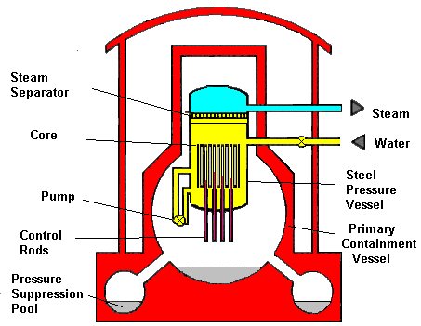
BOILING WATER REACTORS – BWR:
FUEL TYPE - 3% enriched URANIUM OXIDE clad in Zircaloy
MODERATOR - WATER
COOLANT - WATER
ADVANTAGES:-
HIGH FUEL BURN-UP- about 2600TJ/tonne
STEAM PASSED DIRECTLY TO TURBINE therefore no heat exchangers needed. BUT SEE DISADVANTAGES..
DISADVANTAGES:-
ORDINARY WATER as COOLANT – but designed to boil: pressure ~ 75 bar.
CONTROL RODS MUST BE DRIVEN UPWARDS - SO NEED POWER IN FAULT CONDITIONS. Provision made to dump water (moderator in such circumstances).
ON LOAD REFUELLING NOT POSSIBLE - reactor must be shut down.
SIGNIFICANT CONTAMINATION OF COOLANT CAN ARISE FROM BURST FUEL CANS - as defective units cannot be removed without shutting down reactor. ALSO IN SUCH CIRCUMSTANCES RADIOACTIVE STEAM WILL PASS DIRECTLY TO TURBINES.
FUEL ENRICHMENT NEEDED. - 3%.
MAXIMUM EFFICIENCY ~ 34-35%
OTHER FACTORS:-
LOSS OF COOLANT also means LOSS OF MODERATOR so reaction ceases - but residual decay heat can be large.
HIGH POWER DENSITY - 100 MW/m³, and compact. Temperature can rise rapidly in fault conditions. NEEDS active ECCS.
SINGLE STEEL PRESSURE VESSEL 200 mm thick.

Slide 46
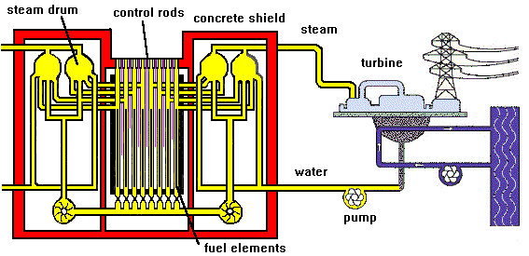
RMBK (LWGR): (involved in Chernobyl incident)
FUEL TYPE - 2% enriched URANIUM OXIDE clad in Zircaloy
MODERATOR - GRAPHITE
COOLANT - WATER
ADVANTAGES:-
ON LOAD REFUELLING
VERTICAL CONTROL RODS which can drop by GRAVITY in fault conditions.
NO THEY CANNOT!!!!
See the YouTube Video on exactly what happened at Chernobyl – link given in handout
DISADVANTAGES:-
ORDINARY WATER as COOLANT - flashes to steam in fault conditions hindering cooling.
POSITIVE VOID COEFFICIENT !!! - positive feed back possible in some fault conditions -other reactors have negative voids coefficient in all conditions.
IF COOLANT IS LOST moderator will keep reaction going.
FUEL ENRICHMENT NEEDED. - 2%
PRIMARY COOLANT passed directly to turbines. This coolant can be slightly radioactive.
MAXIMUM EFFICIENCY ~30% ??
OTHER FACTORS:-
MODERATE FUEL BURN-UP - ~ MODEST FUEL BURN-UP - about 1800TJ/tonne
LOAD FOLLOWING CHARACTERISTICS UNKNOWN
POWER DENSITY probably MODERATE?
MULTIPLE PRESSURE TUBES

Slide 47
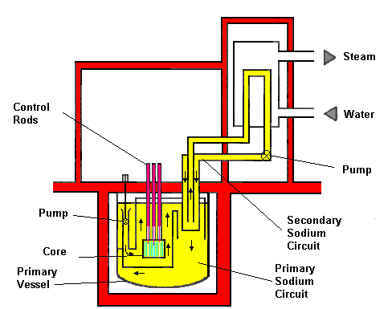
FAST BREEDER REACTORS (FBR or LMFBR)
FUEL TYPE - depleted Uranium or UO₂ surround PU in centre of core. All elements clad in stainless steel.
MODERATOR - NONE
COOLANT - LIQUID METAL
ADVANTAGES:-
LIQUID METAL COOLANT - at ATMOSPHERIC PRESSURE. Will even cool by natural convection in event of pump failure.
BREEDS FISSILE MATERIAL from non-fissile 238U – increases resource base 50+ times.
HIGH EFFICIENCY (~ 40%)
VERTICAL CONTROL RODS drop by GRAVITY in fault conditions.
DISADVANTAGES:-
DEPLETED URANIUM FUEL ELEMENTS MUST BE REPROCESSED to recover PLUTONIUM and sustain the breeding of more plutonium for future use.
CURRENT DESIGNS have SECONDARY SODIUM CIRCUIT
WATER/SODIM HEAT EXCHANGER. If water and sodium mix a significant CHEMICAL explosion may occur which might cause damage to reactor itself.
OTHER FACTORS:-
VERY HIGH POWER DENSITY - 600 MW/m³ but rise in temperature in fault conditions limited by natural circulation of sodium.

Slide 48
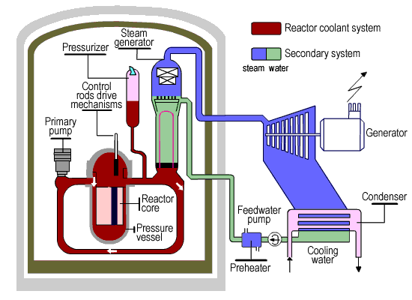
GENERATION 3 REACTORS: the EPR1300
Schematic of Reactor is very similar to later PWRs (SIZEWELL) with 4 Steam Generator Loops.
Main differences? from earlier designs.
  Output power ~1600 MW from a single turbine
      (cf 2 turbines for 1188 MW at Sizewell).
  Each of the safety chains is housed in a separate building.
Efficiency claimed at 37%
But no actual experience and likely to be less
Construction is under way at Olkiluoto, Finland.
Second reactor under construction in Flammanville, France
Possible contender for new UK generation

Slide 49
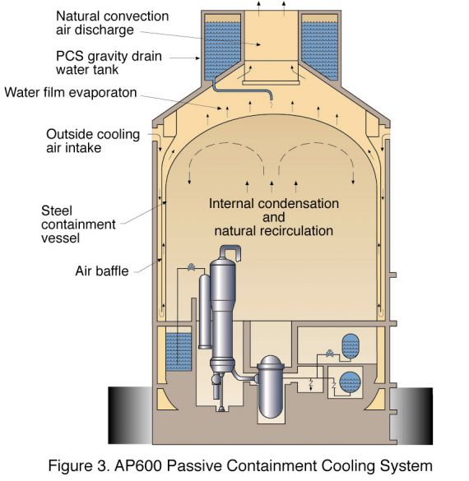
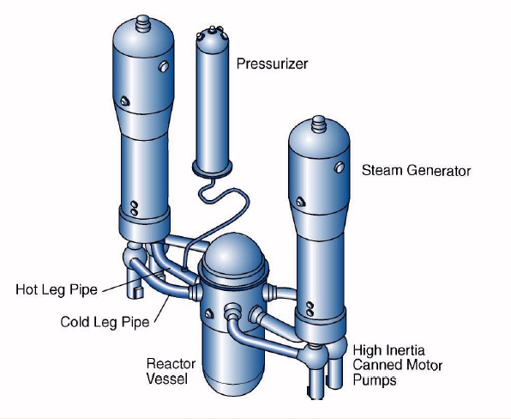
GENERATION 3 REACTORS: the AP1000
A development from SIZEWELL
Power Rating comparable with SIZEWELL
Possible Contender for new UK reactors
Will two turbines be used ??
Passive Cooling – water tank on top – water falls by gravity
Two loops (cf 4 for EPR)
Significant reduction in components e.g. pumps etc.

Slide 50
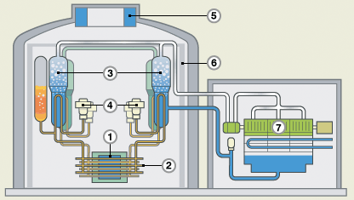
GENERATION 3 REACTORS: the ACR1000
A development from CANDU with added safety features less Deuterium needed
Passive emergency cooling as with AP1000
See Video Clip of on-line refuelling

Slide 51
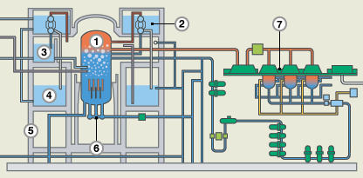
ESBWR: Economically Simple BWR
A derivative of Boiling Water Reactor for which it is claimed has several safety features but which inherently has two disadvantages of basic design
  Vertical control rods which must be driven upwards
  Steam in turbines can become radioactive

Slide 52
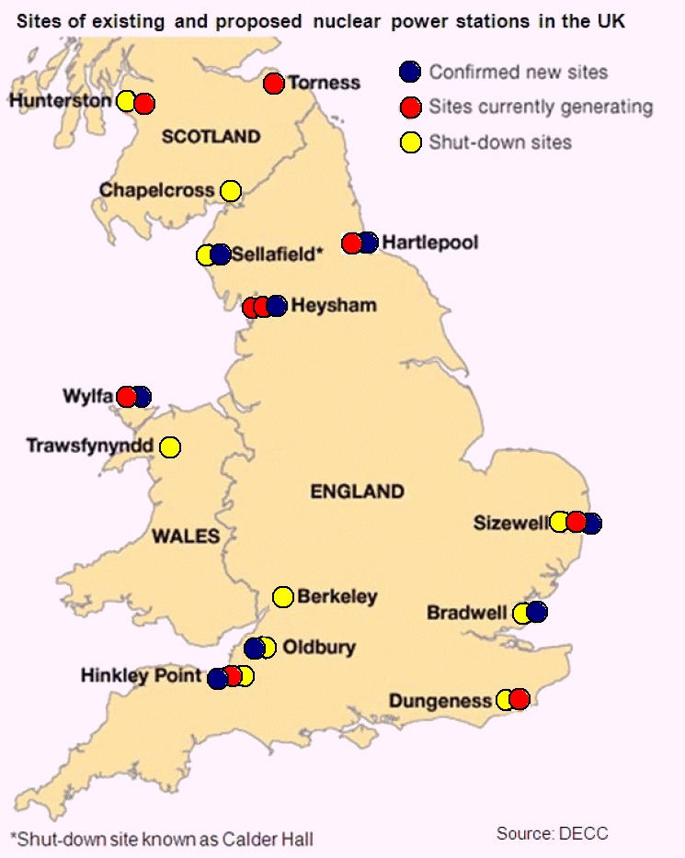
Possible Locations of New Nuclear Stations in UK

Slide 53
Generic Design Assessment
All Nuclear Reactors for use in UK must undergo a Generic Design Assessment which typically lasts up to 5 years. Primarily aimed at the Generic Design.
Involves 5 Stages with an opportunity for the Public and others to participate in Consultations
Coordinated by the Environment Agency and Office of Nuclear Regulation
Most thorough assessment anywhere in the World
Separate from any Planning Permission which is site specific.
To date only the EPR Reactor has achieved approval from this process

Slide 54
New Nuclear Stations – UK – Hinkley Point C
Hinkley Point C (HPC) - Two 1600MW Reactors of EPR design now under construction (as of September 2016).
Adjacent to Hinkley Point A a MAGNOX Station closed in 2000, and Hinkley Point B an AGR, commissioned in late 1976.
Same design as
Olkiluto, Finland – began construction in 2005 for scheduled completion in 2010, -will not start operating until 2018.
Flammanville, France – began construction in 2007 for completion in 2012, will not start operating until late 2018/early 2019.
Operation of Hinkley Point C not expected until 2026.
Both Olkiluoto and Flammanville have also seen significant cost over runs.
UK Government has guaranteed a price of generation at HPC or £92.50/MWh (9.25p/kWh) compared to current price for Onshore wind of ~£80/MWh and a current wholesale price of ~ £45/MWh

Slide 55
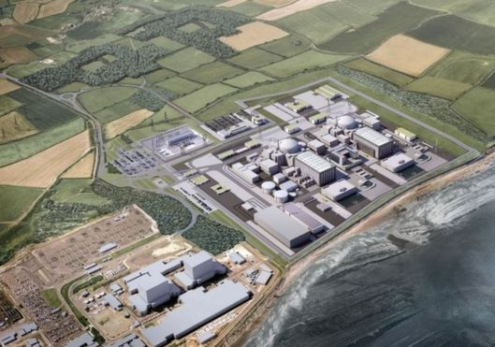
Hinkley Point C
Artists impression of Hinkley Point C with Hinkley Point B in foreground

Slide 56
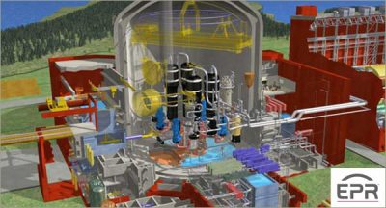
Hinkley Point C
December 2013. EPR Reactor gains approval for use in UK in the Generic Design Assessment after 5 years of detailed study
http://www.world-nuclear-news.org/NN-EPR_reactor_design_meets_UK_approval-1312127.html

Slide 57
Generic Design Assessment Timeline
Year | 2007 |  |  |  | 2008 |  |  |  | 2009 |  |  |  | 2010 |  |  |  | 2011 |  |  |  | 2012
Quarter | 1 | 2 | 3 | 4 | 1 | 2 | 3 | 4 | 1 | 2 | 3 | 4 | 1 | 2 | 3 | 4 | 1 | 2 | 3 | 4 | 1 | 2 | 3 | 4
UK EPR |  | S1 |  | S2 |  |  | S3 |  |  |  |  |  | S4 |  |  |  |  |  |  |  | Closure
AP 1000 |  | S1 |  | S2 |  |  | S3 |  |  |  |  |  | S4 |  |  |  |  |  |  |  | Paused
UK ABWR
UK HPR1000
Year | 2013 |  |  |  | 2014 |  |  |  | 2015 |  |  |  | 2016 |  |  |  | 2017
Quarter | 1 | 2 | 3 | 4 | 1 | 2 | 3 | 4 | 1 | 2 | 3 | 4 | 1 | 2 | 3 | 4 | 1 | 2 | 3 | 4
UK EPR
AP 1000 | Paused |  |  |  |  |  | Closure
UK ABWR |  | S1 |  |  | S2 |  |  | S3 |  |  |  | S4
UK HPR1000 |  |  |  |  |  |  |  |  |  |  |  |  |  |  |  |  | S1
S1 - Stage 1 Assessment
S2 - Stage 2 Assessment
S3 - Stage 3 Assessment
S4 - Stage 4 Assessment
GDA for CANDU ACR1000 currently in abeyance

Slide 58

Other Reactors under consideration - 2017
Sizewell C will be identical to Hinkley Point C
  Stage 2 Consultation end on Friday 3rd February 2017
  Construction unlikely to start before 2019 and possible generation from 2030+ onwards.
  By 2030 only Sizewell B and potentially Hinkley Point C will be operating as all other nuclear plant in UK will have been shut down.
Bradwell:
  The main contender for this the Chinese CGN HPR1000 Reactor

Slide 59
CHINESE HPR1000 – a possible reactor for Bradwell
A development of a design by China General Nuclear (CGN) and EdF
Jesse Norman
Parliamentary Under-Secretary (Department for Business, Energy and Industrial Strategy)
I have today asked the UK’s independent nuclear regulators, the Office for Nuclear Regulation, and the Environment Agency, to begin a Generic Design Assessment of the UK HPR1000 reactor.

Slide 60
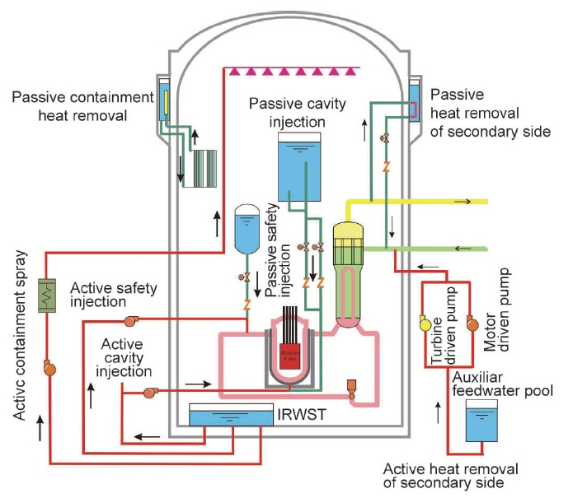
HPR 1000 Reactor
IRWST
In - containment
Refuelling Water Storage Tank

Slide 61
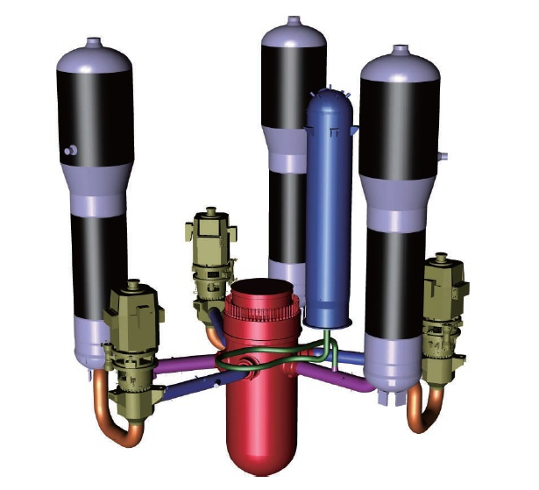
HPR 1000 Reactor
Arrangement of 3 Steam Generation Loops and Reactor (red)

Slide 62
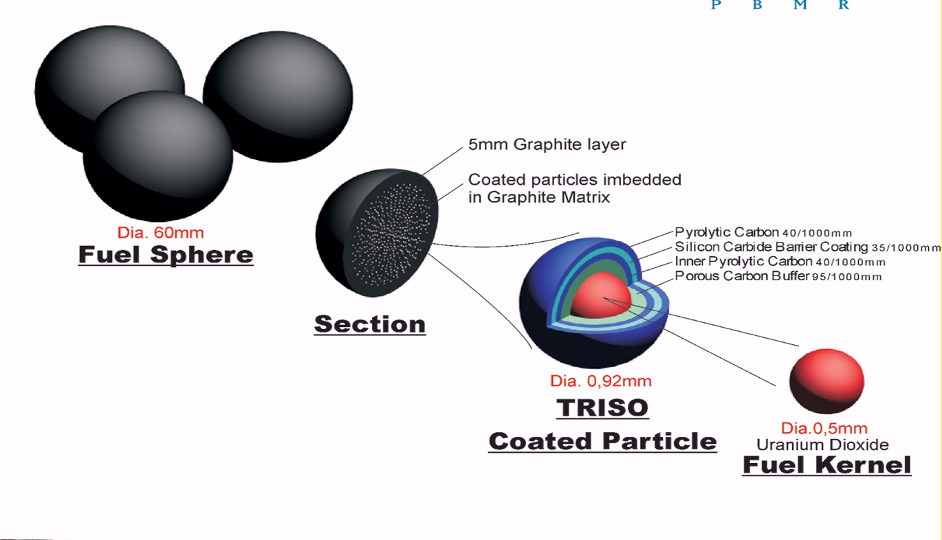
Generation 3+/4 Reactors : the PBMR
Pebble Bed Modulating Reactors are a development from Gas Cooled Reactors.
Sand sized pellets of Uranium each coated in layers of graphite/silicon carbide and aggregated into pebbles 60 mm in diameter.
Coolant: Helium
Connected directly to closed circuit gas turbine
Efficiency ~ 39 – 40%, but possibility of CCGT??
Graphite/silicon carbide effective cladding – thus very durable to high temperatures

Slide 63
Generation 3+/4 Reactors : the PBMR
Unlike other Reactors, the PBMR uses a closed circuit high temperature gas turbine operating on the Brayston Cycle for Power. This cycle is similar to that in a JET engine or the gas turbine section of a CCGT.
Normal cycles exhaust spent gas to atmosphere.
In this version the helium is in a closed circuit.
Fuel In
PBM Reactor
Combustion Chamber
Turbine
Compressor
Generator
Open Brayston Cycle
Closed Brayston Cycle
Heat Exchanger
Exhaust
Air In

Slide 64
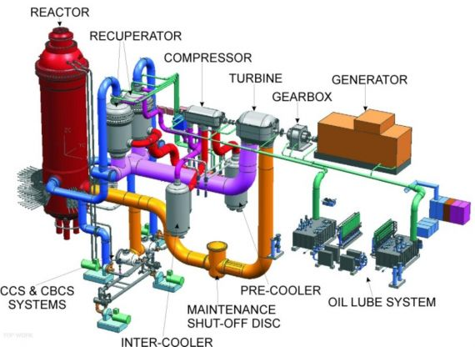
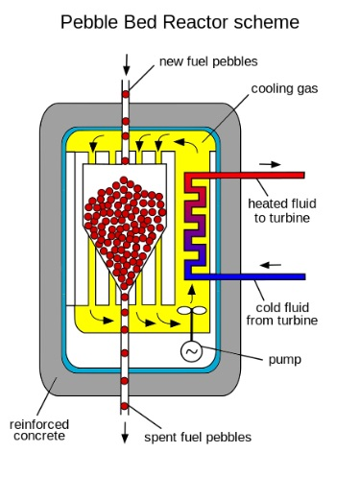
Generation 3+/4 Reactors : the PBMR
Efficiency of around 38 – 40%, but possibility of CCGT???
Helium passes directly from reactor to turbine
Pebbles are continuously fed into reactor and collected.
Tested for burn up and recycled as appropriate ~ typically 6 times

Slide 65
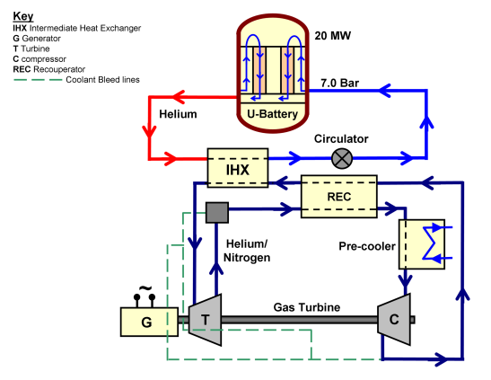
Generation 3+/4 Reactors U2 Battery
G – Generator
T – Turbine
C - Compressor
REC – Recuporator
IHX - Intermediate Heat Exchanger
Uses PBMR principle for fuel
Much smaller than conventional reactors @ 10MWe.
Could be truck mounted for deployment in remote areas
U2-Battery Small 20 MW_{th} / 10 MW_{e} Nuclear Plant
Using closed Brayton Cycle
Deployment from late 2020s???

Slide 66
Supplementary Slides on Fusion which will only be shown if time permits

Slide 67
Nuclear Fusion
Fusion of light elements e.g. DEUTERIUM and TRITIUM produces even greater quantities of energy per nucleon are released.
Deuterium – Tritium fusion
³H
Tritium
⁴He
Deuterium
²H
(3.5 MeV)
n
(14.1 MeV)
In each reaction 17.6 MeV is liberated or 2.8 picoJoules (2.8 * 10⁻¹⁵J)

Slide 68
Nuclear Fusion
The basic reaction for D - T fusion is
D + T ----→ He + n
Where waste product is Helium an inert gas
To generate tritium, two further reactions are needed
⁶Li + n = T + He
and ⁷Li + n = T + He + n
In operation the Deuterium and Trition must be as a Plasma
The performance of Fusion and how close it is to sustained power output is measured as the Triple Product of:
  Ion plasma density,
  The temperature – at least 10 million degrees Celcius
  The confinement time

Slide 69
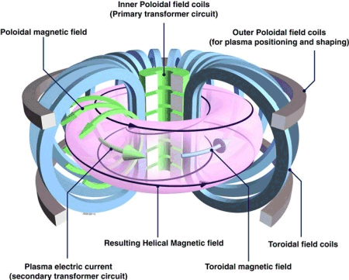
Nuclear Fusion

Slide 70
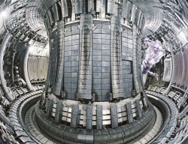
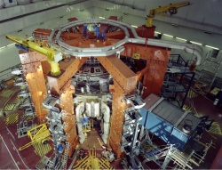
Nuclear Fusion
Photographs of JET Culham Reactor
Reactor achieved Break Even in mid 1990s
– i.e. amount of Energy Out = amount of Energy
ITER Reactor, under construction in Cadarache should generate up to 500MWe of thermal power
DEMO Reactor to provide electricity to Grid, planned from 2030
COMMERCIAL OPERATION from late 2040s

Slide 71
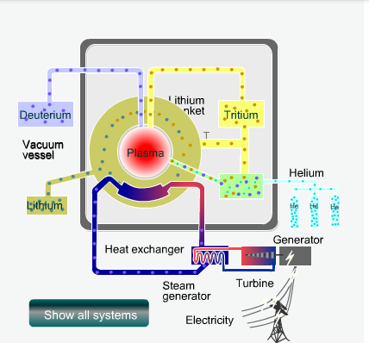
Nuclear Fusion
Possible Configuration of DEMO

Slide 72
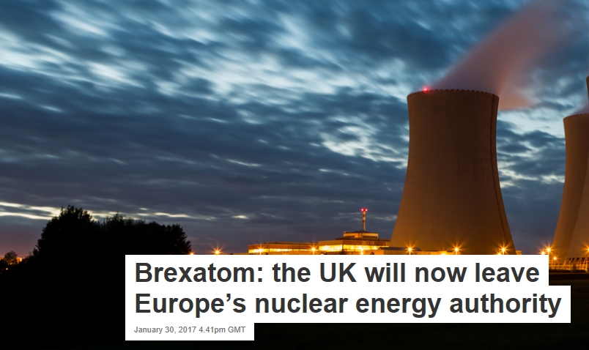
Nuclear Fusion
STOP PRESS: 30th January 2017

