Slide 1
ENV-5022B Low Carbon Energy 2016 - 17
Fracking
A solution to the UK Energy Problems
or
An unacceptable step too far?
February 2nd 2017
Keith Tovey (杜伟贤)
Reader Emeritus in Environmental Sciences, University of East Anglia
Past President Rotary Club of Norwich
District 1080 Environment Officer
RIBI Environment Resource Group Member

Slide 2
FRACKING
Definitions
“ a method of mining in which cracks are created in subteranean rocks to obtain gas, oil, or other liquids”.
Hydraulic Fracturing using high pressure liquids is usual way of creating cracks
Fracking is the slang term for Hydraulic Fracturing
Today’s Talk
What is Fracking? Physical Resource and Definitions
Fracking – technical issues and examples
Impact of Fracking on UK Energy Supply
Fracking – Environmental Impacts [seismic etc]

Slide 3
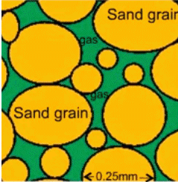
Fracking: Some Definitions
Conventional Gas: - predominantly methane with other hydrocarbons, carbon dioxide, nitrogen, hydrogen sulphide etc,
.
Unconventional Gas:
Tight Gas: -found in relatively low permeability rocks such as sandstones and limestone. Some fracturing may be needed to enhance extraction
Found trapped in relatively porous media capped by an impermeable stratum. Gas migrates upwards to a capped area.
Shale Gas: - found in ultra low permeability shales. Extensive hydro fracturing needed to extract gas

Slide 4
Schematic geology of natural gas resources
Land Surface
Conventional Non-associated Gas
Coal Bed Methane
Conventional Associated Gas
Sandstone
Seal
oil
Tight Sand Gas
Gas rich Shale
Diagram based on US Energy Information Administration

Slide 5
Fracking: Some Definitions
Dry Gas: - predominantly methane with little if any co-products such as ethane, propane etc.
Wet Gas: contains appreciable proportions co-products of hydrocarbon such as ethane, propane, and butane which may be in liquid or gaseous form.
Co-products may be liquefied as LPG or converted into petrol and add value to gas produced.
WET GAS is defined as having more than 0.1 US gal of condensate per 1000 cuft.
Reserve: Total Amount of gas in Reservoir:
Three figures: Proven, Probable, Possible
Resource: Amount of gas which can Technically and/or
Economically be extracted - typically 10-20% of Reserve

Slide 6
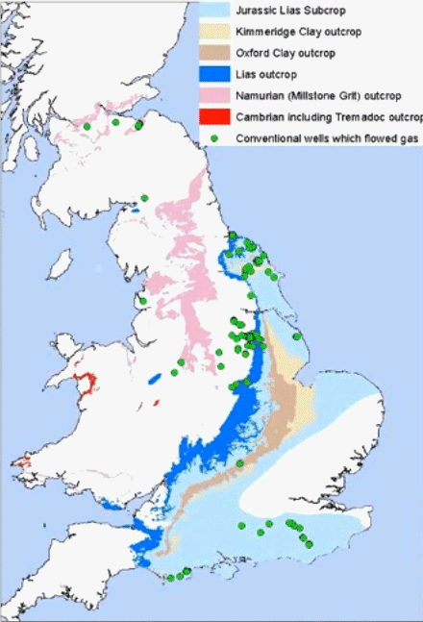
Where Shales are located in UK
Biological decay of organic at shallow depths
Biogenic methane
1.5 – 2 km
Organic matter
“cooked” at depth and pressure
Thermogenic methane in Shale
Biogenic and Thermogenic methane can be distinguished by isotopic means

Slide 7
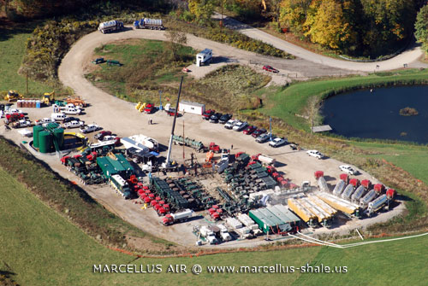
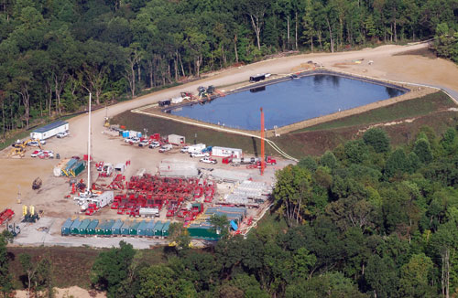
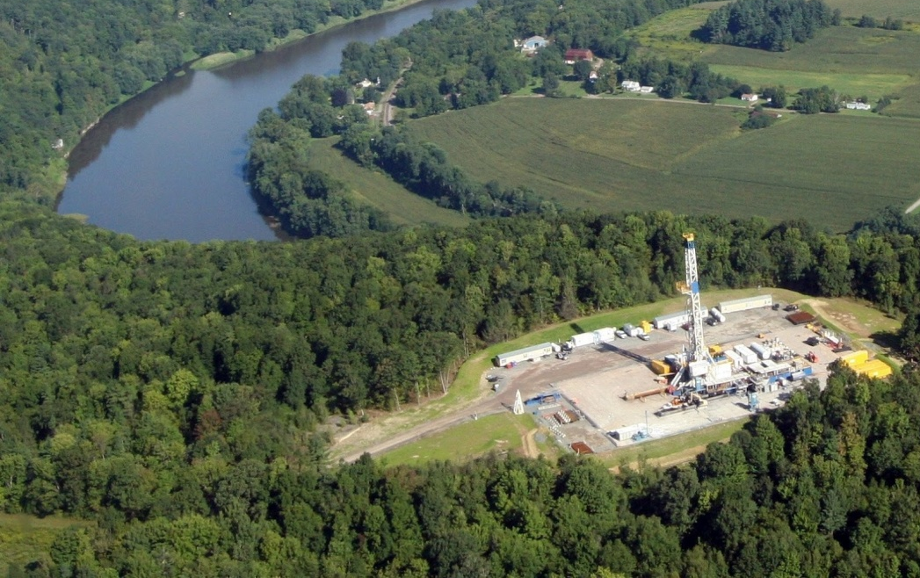
Typical Fracking Installations
Large ponds (0.5 – 1ha) are needed to hold Flowback Water.
A single Fracking Well in Pennsylvania

Slide 8
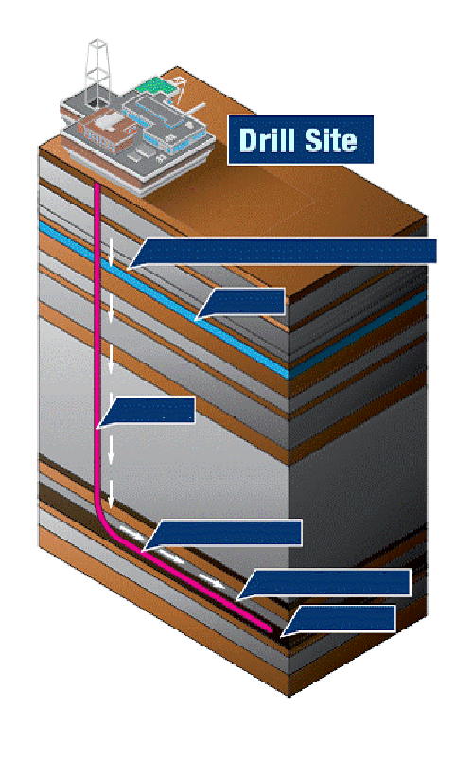
Schematic of a Shale Gas Well
Aquifer
Cemented Steel Casing
Drilling through Aquifer & Rock Layers
Aquifer
Borehole
Cement pumped through borehole to surround casing
Horizontal Drilling
Hydraulic Fracturing
Shale
Shale Formation

Slide 9
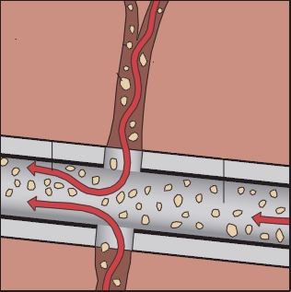
Schematic of a Shale Gas Well
High pressure fluid mixture creates numerous paper-thin fractures throughout shale.
Small fractures free trapped gas which flows into perforated casing and up to surface.
Fracturing fluids contain ~ 94% water, 5% sand and up to 1% of additives such as ACID, SCALE INHIBITORS, BIOCIDES, FRICTION REDUCERS AND SURFACTANTS.
Fluid is injected under pressure to stimulate cracking of the Shale. The sand props the cracks open to promote gas flow.
Diagrams based on Tyndall Report (2001b) and Royal Society Report (2012)

Slide 10
Well and Pad Configurations
In US, typically up to 6 wells per Pad
1 – 2km
Pad
Cuadrilla are proposing up to 10 wells per Pad

Slide 11
Output from a Single Shale Gas Well
Output declines by 95% over first 3-4 years
Total output over 20 years is equivalent to two 3 MW wind turbines

Slide 12
Estimated Gas Production: Cuadrilla Scenarios for Bowland-Hodder Shale (2014–2040)
 | Low | Medium | High
Cumulative Production (bcm) | 19.7 | 40.3 | 76.7
Wells | 190 | 400 | 810
Well Pads | 19 | 40 | 81
Average annual production (bcm) | 0.73 | 1.49 | 2.84
Average annual production as a percentage of UK consumption (91bcm) | 0.8% | 1.7% | 3.2%
Water volume (m3) | 1,679,800 | 3,359,600 | 6,719,200
Flowback Water (m3) – for treatment | 785,838 | 1,571,675 | 3,143,350
Truck Visits | 181,750 | 363,500 | 720,000
Average Truck Visits per weekday | 26 | 53 | 106
Production in single year (bcm) | 0.29 -2.12 | 0.58 -3.57 | 0.58 -4.90
Average household consumption of water ~ 180 m³/year
Maximum Cumulative Production from Blackpool Area would be ~76 bcm or 10 months current UK supply
From Tables 2.13 – 2.14 of Tyndall (2011b) Report

Slide 13
Gas Production and demand in UK
Impact of temporary switch to coal generation
Import Gap
Gas supply has become critical at times – e.g. at end of March 2013 – down to 6 hours supply following technical problems on Norwegian Pipeline.

Slide 14
Wholesale Cost of Electricity
Oil reaches $130 a barrel
Severe Cold Spells
UK no longer self sufficient in gas
Langeled Line to Norway
Stop Press!
Wholesale Gas Prices have risen 52% since August
Bloomberg Press: 17th October 2016 – 11:08
UK Government Projection in 2003 for 2020
wholesale prices updated to 18th July 2016
Weekly volume weighted average Wholesale Prices
Wholesale prices are twice what they were in 2004 and rise represents
Support for renewables accounts for less than 10% of unit price of increase electricity

Slide 15
Sharp Rises in Wholesale Prices 9th – 18th September 2016
Range of Typical Retail Prices

Slide 16
What are causes of price rises in recent years?
In period 2004-15, Electricity Bills for average household have risen from ~ £288 to around ~£577 or ~100% *
How much can be attributed to support for Renewables under the Renewable obligation?
Support for All Renewables in 2014-15 was ~ £3.95 billion **.
However 304,500,000 MWh was supplied
representing an increase of 1.29 p/kWh in retail price of electricity
At typical domestic unit prices of 13.4p per kWh this represents and increase of just 9.2%.
Of this the impact of onshore wind on bills in 2014-15 was 0.384p per kWh or ~ 2.9%. For offshore the figures are 0.484p and 3.7% respectively.
* Data from Quarterly Energy Prices from DECC Website
** OFGEM Annual Report

Slide 17
What are causes of price rises in recent years?
In period 2004-15, Electricity Bills for average household have risen from ~ £288 to around ~£577 or ~100% *
Wholesale prices have doubled since 2004
Recent wholesale price spikes have occurred in recent months
Leading to current round of increases
However, Only a small part of increases (<10%) comes from support for renewables.
Electricity supply industry implies Renewables are the major cause of increase. Other causes are more important
Increased dependence on Imported Gas (and volatile prices)
Profit margin of utilities?
* Data from Quarterly Energy Prices from DECC Website
** OFGEM Annual Report

Slide 18
Estimates of Total UK Production of Fracked Gas
The most optimistic scenario data from above are used
Electricity Scenario assumes
similar split of gas use for electricity / non-electricity demand
5% improvement in efficiency for CCGT generation plant
Maximum generation from Fracked gas = ~36.5 TWh by 2030
Based on Figure 3.1 in Tyndall (2011b) Report

Slide 19
Electricity Generation Futures – with New Nuclear and New Coal
Fracked Gas
Imported Gas
UK Gas
Imports
Offshore Wind
Oil
Onshore Wind
Existing Coal
Other Renewables
New Coal ?
Existing Nuclear
New Nuclear?
1 new nuclear station and coal station completed each year after 2025.
1 million homes fitted with PV each year from 2020 40% of homes fitted by 2030
19 GW of onshore wind by 2030 cf 8 GW now
Data for demand derived from DECC & Climate Change Committee (2011)
- allowing for significant deployment of electric vehicles and heat pumps by 2030.
19

Slide 20
Fracking: Carbon Emissions
Climate Change issues
Fugitive emissions from shale gas exploitation will be higher than conventional gas extraction (North Sea, Norway, Russia).
Direct use of gas
Conventional: 199–207g/kWh* ;LNG (Qatar): 250-260 g/kWh
Fracked gas: 210 – 253 g/kWh* depending on regulation
Electricity generation
Conventional gas using CCGT ~ 360 – 430 g/kWh
Shale gas using CCGT ~ 423 – 535 g/kWh *
LNG using CCGT ~ 460 – 550 g/kWh
Coal ~ 837 – 1130g/kWh *
Fracked gas would help in decarbonising electricity supply in comparison to coal – marginally in case of LNG
BUT coal use in generation is set to decline significantly.
Fracked gas is worse than conventional gas and much worse than nuclear or renewables and increase in gas use would jeopardize decarbonisation of Energy Supply.
* Data from Mackay& Stone (DECC 9th September 2013).

Slide 21
Fracking: Seismic Issues
Richter scale (ML) is a logarithmic scale
An increase by 1 indicates an amplitude increase of 10 times
Fracking induced events in Lancashire caused earthquakes of magnitude 1.5 and 2.3. [traffic can cause magnitudes of up to 1.0].
Christchurch earthquake was 640 thousand times larger
Fukushima earthquake was 400 million times larger
Consequences of Lancashire incidents
Small events up to 0.5 occurred during Fracking. The 1.5 & 2.3 events occurred 10 hours after Fracking ceased - below level of the occasional earthquake in UK.
[some damage reported at base of well, but no damage to casing through aquifer].

Slide 22
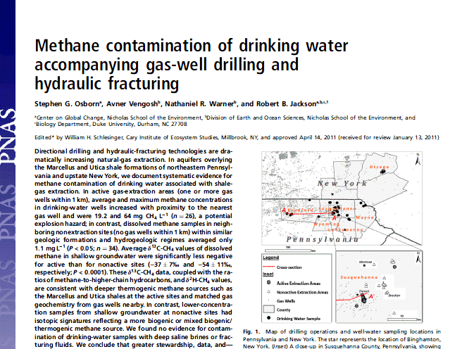
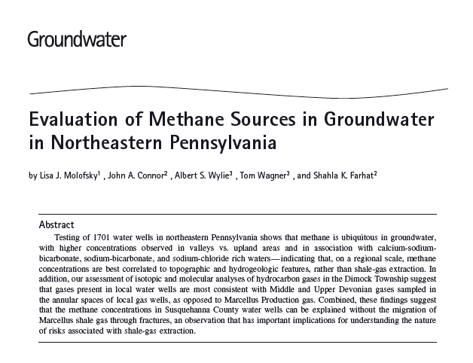
Methane Contamination of Groundwater
These are Peer Reviewed Journals
The dramatic videos on You-Tube of tap water igniting were claimed to be caused by Fracking. Naturally occurring biogenic methane was the cause in most cases, and not FRACKING.

Slide 23
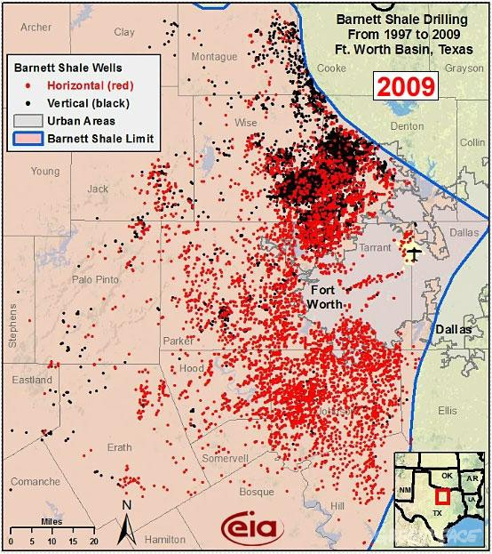
Impact of Large Scale Development of Fracking
If US model is followed
UK may require several tens of thousands of wells to make a substantial contribution to Energy Supply.
Distribution of Fracking Wells in Dallas – Fort Worth Area

Slide 24
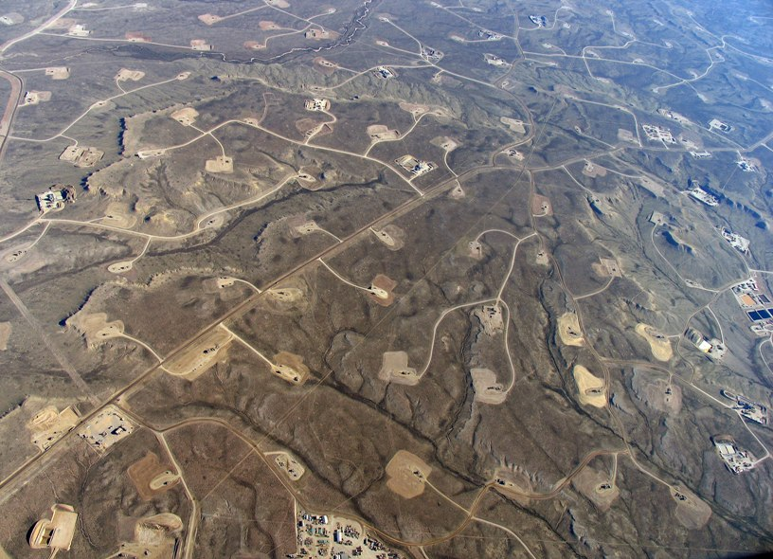
Aftermath of extensive drilling in Wyoming

Slide 25
Summary of Key Issues (1)
There are significant Reserves of Shale Gas in UK
But do not confuse Reserves with Resource
Most optimistic Resource extraction would potentially provide between 7.5 & 10% of electricity generation by 2030, although could be 2 – 2.5 times that figure by 2050
But there are more important issues in Energy Security, Climate Change and Affordability to address post 2015
Developers are evasive in giving an actual maximum cost per GWh gas produced. Unless this is no more than current wholesale price, Statements such as
“Fracking will result in cheaper Gas”
cannot be justified and are extremely misleading.
Output from a single well drops by 80+% in first 2 years of operation. Large scale extraction in UK could lead to tens of thousands of wells in UK.

Slide 26
Summary of Key Issues (2)
Seismic Risk is very small indeed
Contamination of ground water by methane / other chemicals might occur in a well failure or spillage for surface facilities.
Over dramatic videos of ignition of water from taps are misleading as these are often of biogenic methane
Adequate Regulation needed, but this will increase costs.
Large quantities of water are needed
Sand and Additives (some of which are toxins) are added.
Correct disposal of Flowback Fluid is needed.

Slide 27
In Summary
The UK has lacked a rational and consistent energy Policy over the last few decades. This needs to change
Fracking could marginally help to improve Energy Security
Questionable whether it would in fact be cheaper than at present
Climate Change Targets would be jeopardized if there were a consequential shift from Renewables and Nuclear
And Finally
Keith Tovey (杜伟贤)
“If you do not change direction, you may end up where you are heading.”
Lao Tzu (604-531 BC) Chinese Artist and Taoist philosopher

Slide 29
Perception of Seismic Events
Seismic effects of Fracking usually have magnitude ~ 0.5 to 1.0. One Lancashire event reached 2.3
Magnitude | UK frequency | Impact at surface
1.0 | 100s per year | Not felt, except by a very few under especially favourable conditions.
2.0 | ~ 25 per year | Not felt, except by a very few under especially favourable conditions.
3.0 | ~ 3 per year | Felt by few people at rest or in the upper floors of buildings; similar to the passing of a heavy truck.
4.0 | ~ 1 every 3–4 years | Felt by many people, often up to tens of kilometres away; some dishes broken; pendulum clocks may stop.
5.0 | 1 every 20+ years | Felt by all people nearby; damage negligible in buildings of good design and construction; few instances of fallen plaster; some chimneys broken.

Slide 30
What are causes of price rises in recent years?
In period 2004-13, Electricity Bills for average household have risen from ~ £288 to around ~£577 or ~100% *
How much can be attributed to support for Renewables under the Renewable obligation?
Support for All Renewables in 2013-14 was £2.60 billion **.
However 304,500,000 MWh was supplied
representing an increase of 0.853 p/kWh in retail price of electricity
At typical domestic unit prices of 13.4p per kWh this represents and increase of just 6.4%.
Of this the impact of onshore wind on bills in 2013-14 was 0.254p per kWh or ~ 1.9%. For offshore the figures are 0.325p and 2.4% respectively.
Wholesale prices had risen from 2p in 2004 to 4.5p per kWh by end of 2014.
* Data from Quarterly Energy Prices from DECC Website
** OFGEM Annual Report

