Slide 1
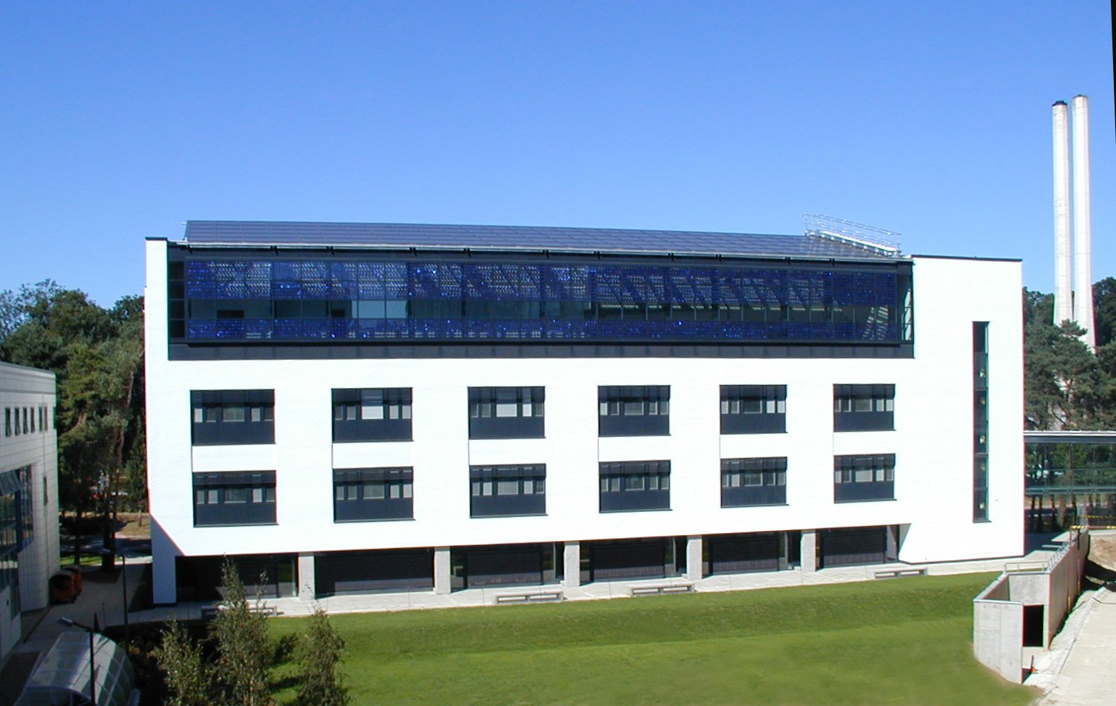
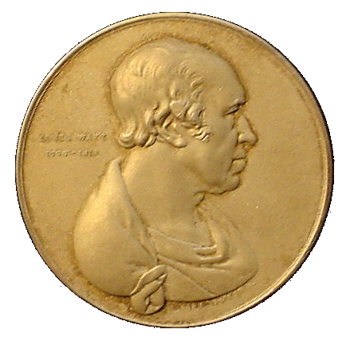
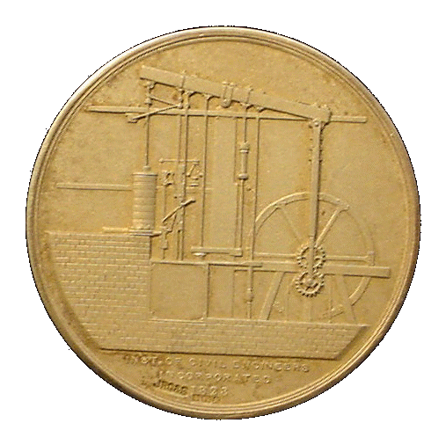
ENV-5022B/ENVK5023B Low Carbon Energy
Low Carbon Strategies at the University of East Anglia
http://www2.env.uea.ac.uk/energy/energy.htm
http://www.uea.ac.uk/~e680/energy/energy.htm
Recipient of James Watt Gold Medal
Keith Tovey (杜伟贤) M.A., PhD, CEng, MICE, CEnv

Slide 2
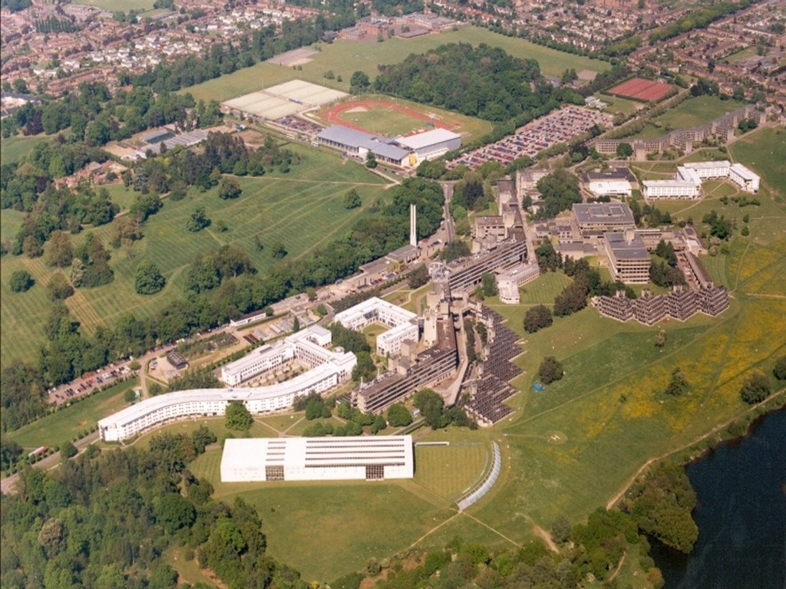
Nelson Court
Constable Terrace
2
2
Notes:
2
2

Slide 3
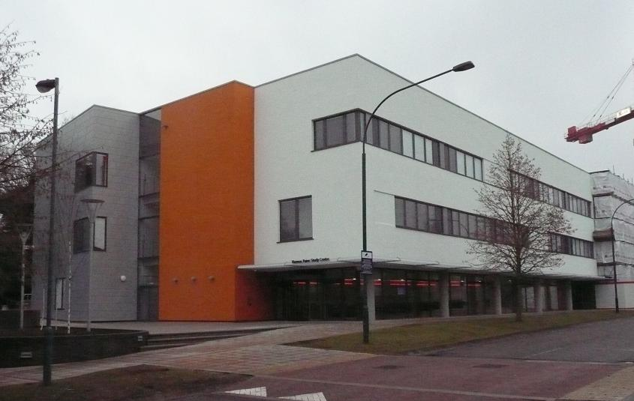
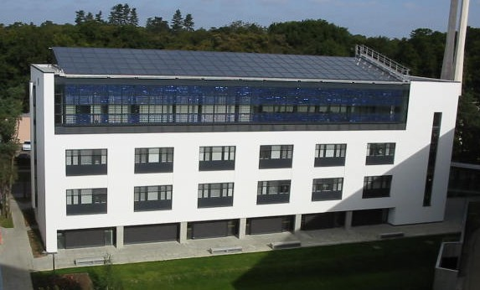
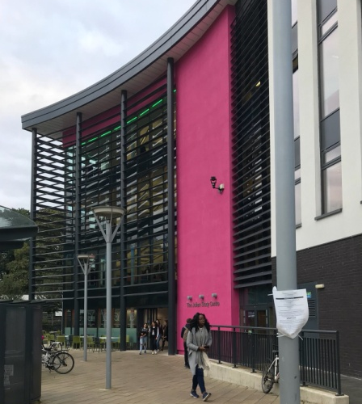

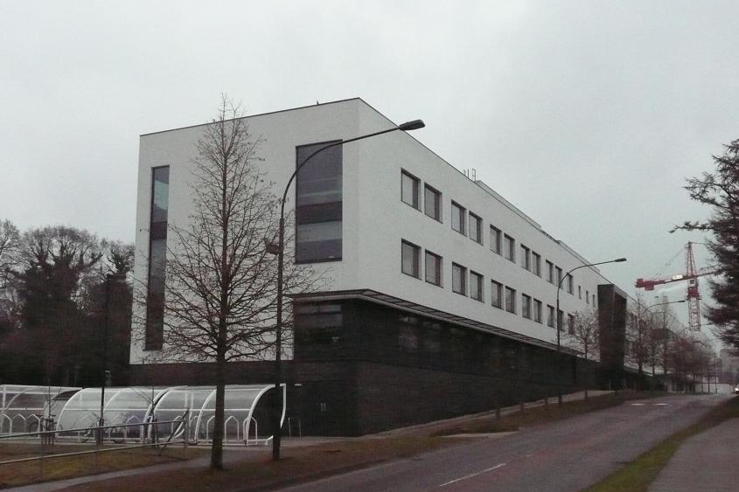
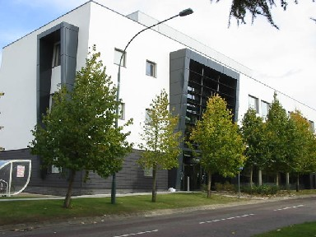
Low Energy Educational Buildings
Nursing and Midwifery School
Thomas Paine Study Centre
ZICER
Elizabeth Fry Building
3
Medical School Phase 2
3
Medical School
Notes:
3
3
You can see that the University has expanded in size
In recent years 4 educational building have been built on the campus to strenuous green design guidelines – all of which have the same construction type
EFRY – 1995
Medical School – 2001
ZICER – 2003
Nursing and Midwifery – 2005
This talk focuses on the third building – the ZICER building

Slide 4
Elizabeth Fry: Conservation: management improvements
Careful Monitoring and Analysis can reduce energy consumption.
Building cost ~ 6% more but has heating requirement ~25% of average building at time.
Building Regulations have been updated: 1994, 2002, 2006, 2010 but building outperforms all of these.

Slide 5
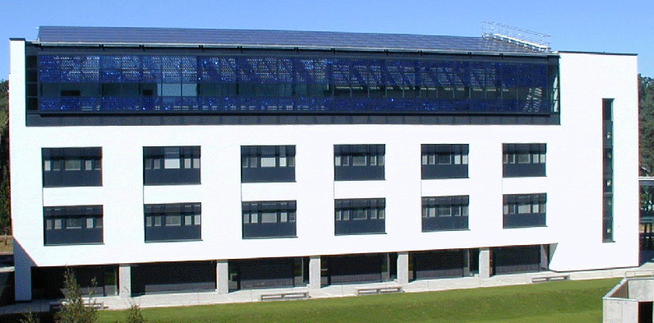

ZICER Building
Won the Low Energy Building of the Year Award 2005
Heating Energy consumption as new in 2003 was reduced by further 57% by careful record keeping, management techniques and an adaptive approach to control.
Incorporates 34 kW of Solar Panels on top floor

Slide 6
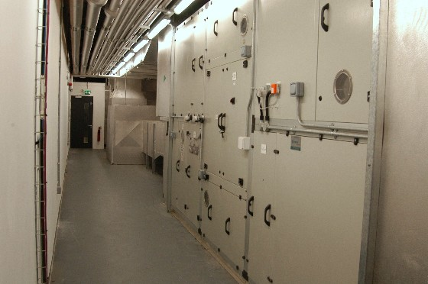
Operation of Main Building
Mechanically ventilated that utilizes hollow core ceiling slabs as supply air ducts to the space
Regenerative heat exchanger
Incoming air into the AHU

Slide 7
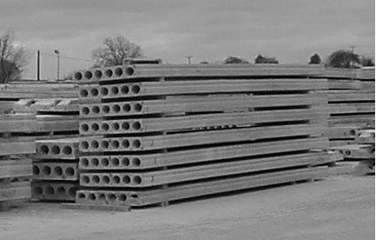
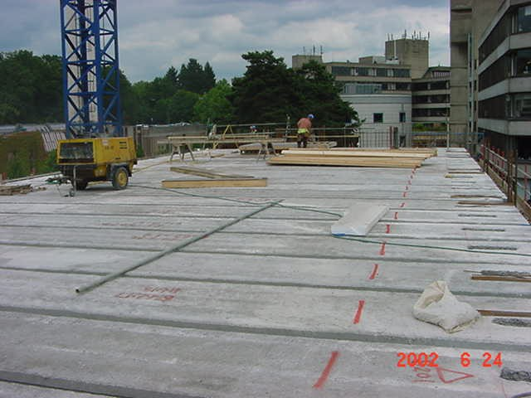
Operation of Main Building
Filter
过滤器
Heater
加热器
Air passes through hollow cores in the ceiling slabs
空气通过空心的板层
Air enters the internal occupied space
空气进入内部使用空间

Slide 8
Operation of Main Building
Recovers 87% of Ventilation Heat Requirement.
Space for future chilling
将来制冷的空间
Out of the building
出建筑物
The return air passes through the heat exchanger
空气回流进入热交换器
Return stale air is extracted from each floor 从每层出来的回流空气

Slide 9
Fabric Cooling: Importance of Hollow Core Ceiling Slabs
Hollow core ceiling slabs store heat and cool at different times of the year providing comfortable and stable temperatures
Warm air
Heat is transferred to the air before entering the room
Slabs store heat from appliances and body heat.
热量在进入房间之前被传递到空气中
板层储存来自于电器以及人体发出的热量
Air Temperature is same as building fabric leading to a more pleasant working environment
Winter Day
Warm air

Slide 10
Fabric Cooling: Importance of Hollow Core Ceiling Slabs
Hollow core ceiling slabs store heat and cool at different times of the year providing comfortable and stable temperatures
Cold air
In late afternoon heating is turned off.
Heat is transferred to the air before entering the room
Slabs also radiate heat back into room
热量在进入房间之前被传递到空气中
板层也把热散发到房间内
Winter Night
Cold air

Slide 11
Fabric Cooling: Importance of Hollow Core Ceiling Slabs
Hollow core ceiling slabs store heat and cool at different times of the year providing comfortable and stable temperatures
Cool air
Draws out the heat accumulated during the day
Cools the slabs to act as a cool store the following day
把白天聚积的热量带走。
冷却板层使其成为来日的冷存储器
night ventilation/
free cooling
Summer night
Cool air

Slide 12
Fabric Cooling: Importance of Hollow Core Ceiling Slabs
Hollow core ceiling slabs store heat and cool at different times of the year providing comfortable and stable temperatures
Warm air
Slabs pre-cool the air before entering the occupied space
concrete absorbs and stores heat less/no need for air-conditioning
空气在进入建筑使用空间前被预先冷却
混凝土结构吸收和储存了热量以减少/停止对空调的使用
Summer day
Warm air

Slide 13
Good Management has reduced Energy Requirements
Space Heating Consumption reduced by 57%
能源消耗（kWh/天）
800
350
原始供热方法 新供热方法

Slide 14
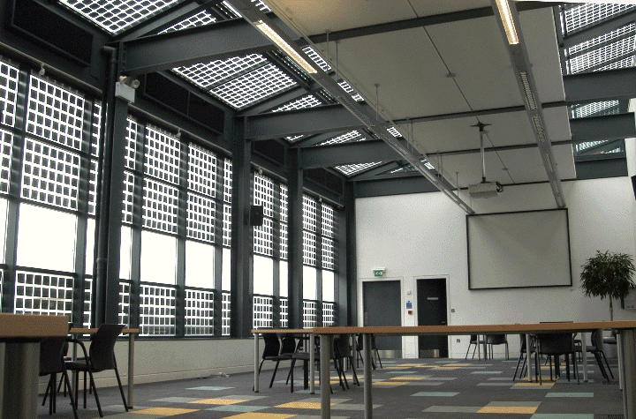
ZICER Building
Photo shows only part of top Floor
Mono-crystalline PV on roof ~ 27 kW in 10 arrays
Poly- crystalline on façade ~ 6.7 kW in 3 arrays

Slide 15
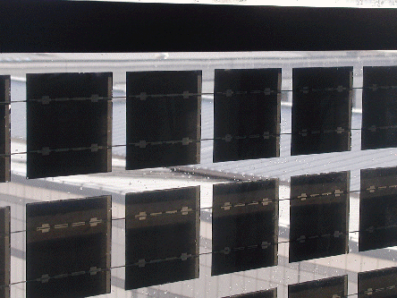


Arrangement of Cells on Facade
Individual cells are connected horizontally
Cells active
Cells inactive even though not covered by shadow
As shadow covers one column all cells are inactive
If individual cells are connected vertically, only those cells actually in shadow are affected.
15
15
15
Notes:
15

Slide 16
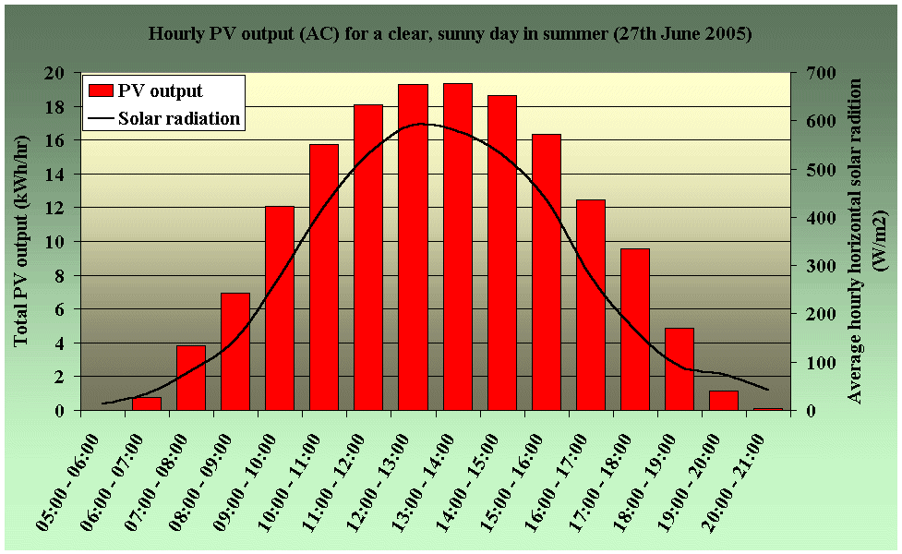
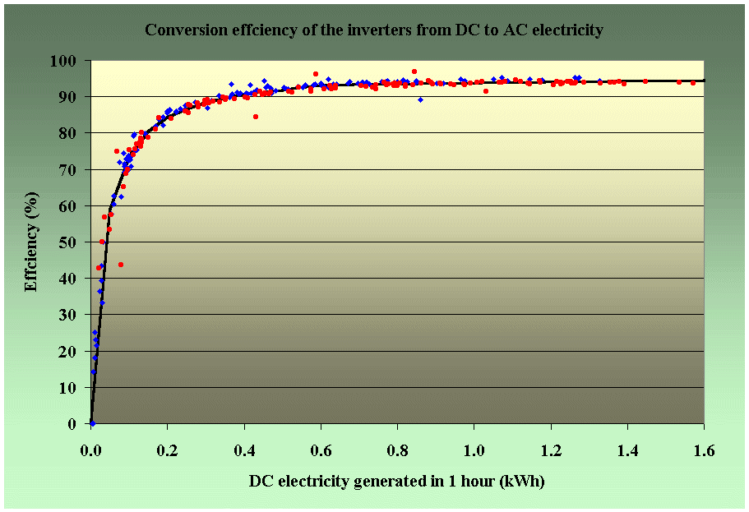
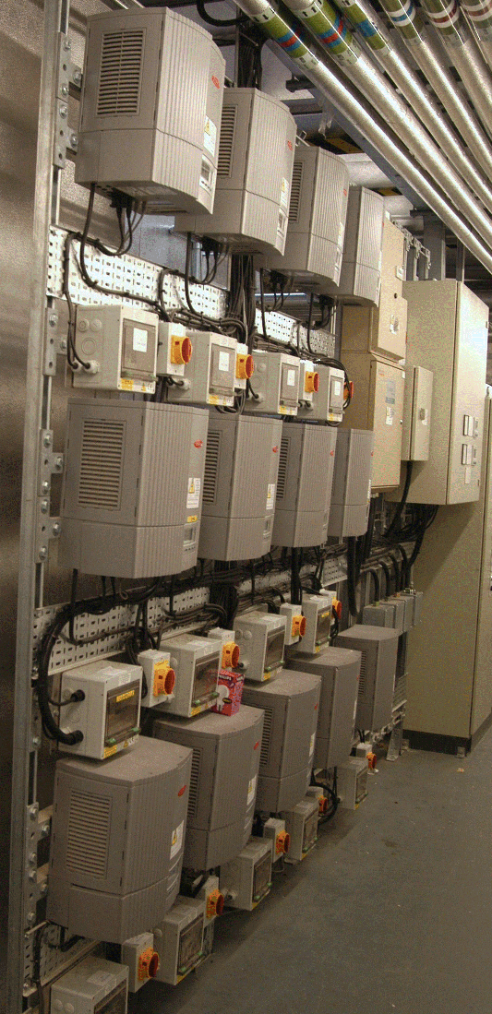
Use of PV generated energy
Peak output is 34 kW 峰值34 kW
Sometimes electricity is exported
Inverters are only 91% efficient
Most use is for computers
DC power packs are inefficient typically less than 60% efficient
Need an integrated approach
16
Notes:
16

Slide 17


Conversion efficiency improvements – Building Scale CHP
3% Radiation Losses
Localised generation makes use of waste heat.
Reduces conversion losses significantly
11% Flue Losses
36%
61% Flue Losses
86%
Gas
Exhaust Heat Exchanger
Engine
Generator
Heat Exchanger
36% Electricity
50% Heat

Slide 18
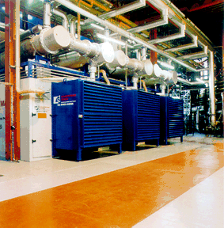
UEA’s Combined Heat and Power
3 units each generating up to 1.0 MW electricity and 1.4 MW heat

Slide 19
Conversion efficiency improvements
Before installation
1997/98 |  | electricity | gas | oil | Total
 | MWh | 19895 | 35148 | 33
Emission factor | kg/kWh | 0.46 | 0.186 | 0.277
Carbon dioxide | Tonnes | 9152 | 6538 | 9 | 15699
 |  | Electricity |  |  |  | Heat
1999/ 2000 |  | Total site | CHP generation | export | import | boilers | CHP | oil | total
 | MWh | 20437 | 15630 | 977 | 5783 | 14510 | 28263 | 923
Emission factor | kg/kWh |  |  | -0.46 | 0.46 | 0.186 | 0.186 | 0.277
CO₂ | Tonnes |  |  | -449 | 2660 | 2699 | 5257 | 256 | 10422
After installation
This represents a 33% saving in carbon dioxide
19

Slide 20
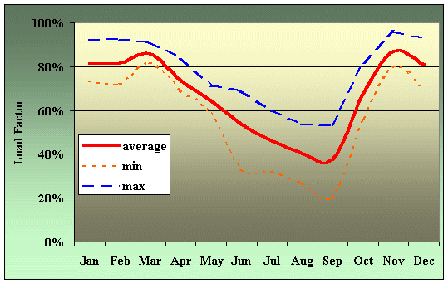
Conversion efficiency improvements
Load Factor of CHP Plant at UEA
Demand for Heat is low in summer: plant cannot be used effectively
More electricity could be generated in summer
20
20

Slide 21
绝热
Heat rejected
高温高压
High Temperature
High Pressure
冷凝器
Compressor
节流阀
Condenser
Throttle Valve
蒸发器
低温低压
Evaporator
压缩器
Low Temperature
Low Pressure
为冷却进行热提取
Heat extracted for cooling
A typical Air conditioning/Refrigeration Unit

Slide 22
Absorption Heat Pump
外部热
Heat from external source
绝热
Heat rejected
高温高压
High Temperature
High Pressure
吸收器
Desorber
冷凝器
节流阀
Condenser
热交换器
Throttle Valve
Heat Exchanger
蒸发器
低温低压
Evaporator
Low Temperature
Low Pressure
W ~ 0
为冷却进行热提取
吸收器
Heat extracted for cooling
Absorber
Adsorption Heat pump reduces electricity demand and increases electricity generated

Slide 23
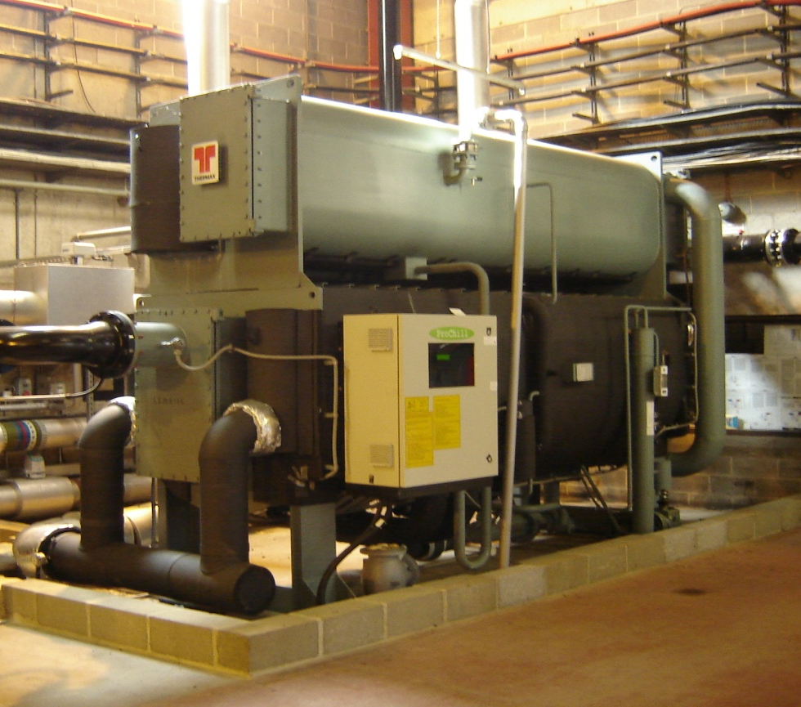
A 1 MW Adsorption chiller
1 MW 吸附冷却器
Uses Waste Heat from CHP
provides most of chilling requirements in summer
Reduces electricity demand in summer
Increases electricity generated locally
Saves ~500 tonnes Carbon Dioxide annually

Slide 24


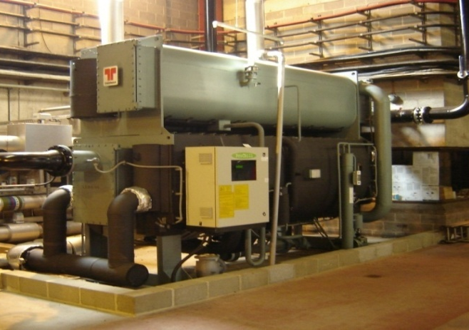
Trailblazing to a Low Carbon Future
Efficient CHP
Absorption Chilling
 | 1990 | 2006 | Change since 1990 | 2015 | Change since 1990
Students | 5570 | 14047 | +152% | 16000 | +187%
Floor Area (m²) | 138000 | 207000 | +50% | 220000 | +159%
CO₂ (tonnes) | 19420 | 21652 | +11% | 14000 | -28%
CO₂ kg/m² | 140.7 | 104.6 | -25.7% | 63.6 | -54.8%
CO₂ kg/student | 3490 | 1541 | -55.8% | 875 | -74.9%
24
24
24
Notes:
24
24

