Slide 1
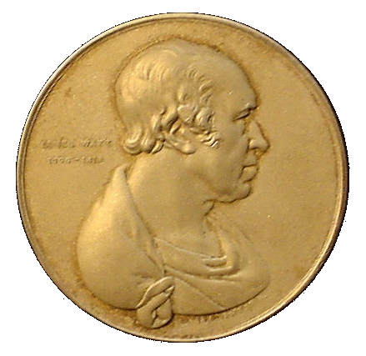
Institution of Civil Engineers– October 5th 2011: Ipswich
The Challenges facing the UK in achieving a
sustainable Energy Future
Recipient of James Watt Gold Medal for Energy Conservation
Keith Tovey (杜伟贤) M.A., PhD, CEng, MICE, CEnv
Reader Emeritus: University of East Anglia k.tovey@uea.ac.uk
Member of ICE Energy Panel

Slide 2
Overview of Presentation
ICE Energy Panel
ICE Energy Panel
Overview of the Three Challenges facing the UK Energy scene. Carbon Reduction, Energy Security and Cost of our Future Energy Supplies
Options for Electricity generation
The Energy Security Questions for 2020 and 2050
Energy Management and Awareness Issues
Some challenges and opportunities for renewable energy and energy conservation
Conclusions

Slide 3
The Triple Challenges of Carbon Reduction, Energy Security and Cost of our Future Energy Supplies
UK Businesses and Individuals are faced with three challenges associated with Energy Use:
Increasing Evidence of Anthropogenic Climate Change
– and consequential legislation
Issues of Energy Security – particularly in UK
The need to minimise cost exposures to price fluctuations in Energy
These Challenges can be addressed by:
Moving to Low Carbon Energy Supply
Employing Technical Solutions to improve efficiency of End-Use Energy.
Promoting Effective Energy Management and Awareness among users.

Slide 4
Energy Security is a potentially critical issue for the UK
Gas Production and Demand in UK
On 7th/8th December 2010: UK Production was only 39%: 12% from storage and 49% from imports
Import Gap
Prices have become much more volatile since UK is no longer self sufficient in gas.
Completion of Langeled Gas Line to Norway
UK becomes net importer of gas
Oil reaches $140 a barrel

Slide 5
What is the magnitude of the CO₂ problem?
How does UK compare with other countries?
Why do some countries emit more CO₂ than others?
UK
France
Per capita Carbon Emissions
5
Notes:
5

Slide 6
Impact of Electricity Generation on Carbon Emissions.
Approximate Carbon Emission factors during electricity generation including fuel extraction, fabrication and transport.
Fuel | Approximate emission factor per kWh | Comments
Coal | ~900 – 1000g | Depending on grade and efficiency of power station
Oil | ~800-900 | Depending on grade and efficiency of power station
Gas (Steam) | ~600g
Gas (CCGT) | 400 – 430g | Assuming CCGT – lower value for Yarmouth
Nuclear | 5 – 10g | Depending on reactor type
Renewables | ~ 0 | For wind, PV, hydro
Transmission/Distribution losses in UK ~ 8-8.5%
In India ~ 20 – 25%

Slide 7
Carbon Emissions and Electricity
UK
France
Coal ~ 900 - 1000 g / kWh
Oil ~ 800 – 900 g/kWh
Gas (CCGT) ~ 400 - 430 kg/kWh
Nuclear ~ 5 – 20 g/kWh
Current UK mix ~ 540 g/kWh
7
Notes:
7

Slide 8
Electricity Generation i n selected Countries
8
Notes:
8

Slide 9
Overview of Presentation
ICE Energy Panel
Overview of the Three Challenges facing the UK Energy scene. Carbon Reduction, Energy Security and Cost of our Future Energy Supplies
Options for Electricity generation
The Challenges for 2020
Energy Management and Awareness Issues
Some challenges and opportunities for renewable energy and energy conservation
Conclusions

Slide 10
Options for Electricity Generation in 2020 - Non-Renewable Methods
 | Potential contribution to electricity supply in 2020 and drivers/barriers/costs | Energy Review 2002 | New Predictions 9th May 2011 (*)
Gas CCGT | 0 - 80% (at present 45-50%) | Available now (but gas is running out – imported prices much higher) | ~2p + | 8.0p [5 - 11]
nuclear fission (long term) | 0 - 15% (France 80%) - (currently 18% and falling) | new inherently safe designs - some development needed | 2.5 - 3.5p | 7.75p [5.5 - 10]
nuclear fusion | unavailable | not available until 2040 at earliest not until 2050 for significant impact
Nuclear New Build assumes one new station is completed each year after 2020.
"Clean Coal" | Coal currently ~40% but scheduled to fall | Available now: Not viable without Carbon Capture & Sequestration | 2.5 - 3.5p | [7.5 - 15]p - unlikely before 2025
?
Carbon sequestration either by burying it or using methanolisation to create a new transport fuel will not be available at scale required until mid 2020s so cannot help short term.
* Energy Review 2011 – Climate Change Committee May 2009

Slide 11
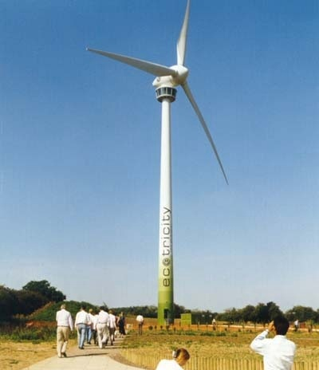
Options for Electricity Generation in 2020 - Renewable
 | Potential contribution to electricity supply in 2020 and drivers/barriers | 2002 (Gas ~ 2p) | Predictions May 2011 (Gas ~ 8.0p) *
On Shore Wind | ~25% [~15000 x 3 MW turbines] | available now for commercial exploitation | ~ 2+p
~8.2p +/- 0.8p
1.5MW Turbine
At peak output provides sufficient electricity for 3000 homes
On average has provided electricity for 700 – 850 homes depending on year
Future prices from
* Renewable Energy Review – 9th May 2011 Climate Change Committee

Slide 12
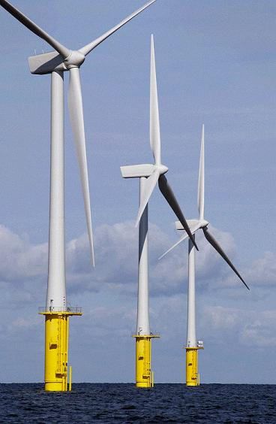
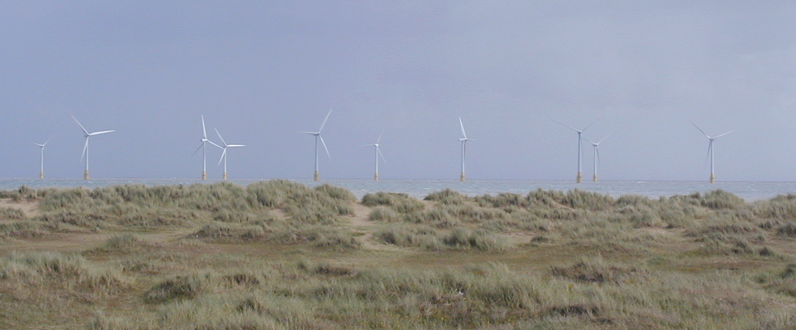
Options for Electricity Generation in 2020 - Renewable
 | Potential contribution to electricity supply in 2020 and drivers/barriers | 2002 (Gas ~ 2p) | Predictions May 2011 (Gas ~ 8.0p) *
On Shore Wind | ~25% [~15000 x 3 MW turbines] | available now for commercial exploitation | ~ 2+p
~8.2p +/- 0.8p
Off Shore Wind | 25 - 50% | some technical development needed to reduce costs. | ~2.5 - 3p
12.5p +/- 2.5
Climate Change Committee (9th May 2011) see offshore wind as being very expensive and recommends reducing planned expansion by 3 GW and increasing onshore wind by same amount
Scroby Sands has a Load factor of 28.8% - 30% but nevertheless produced sufficient electricity on average for 2/3rds of demand of houses in Norwich. At Peak time sufficient for all houses in Norwich and Ipswich

Slide 13
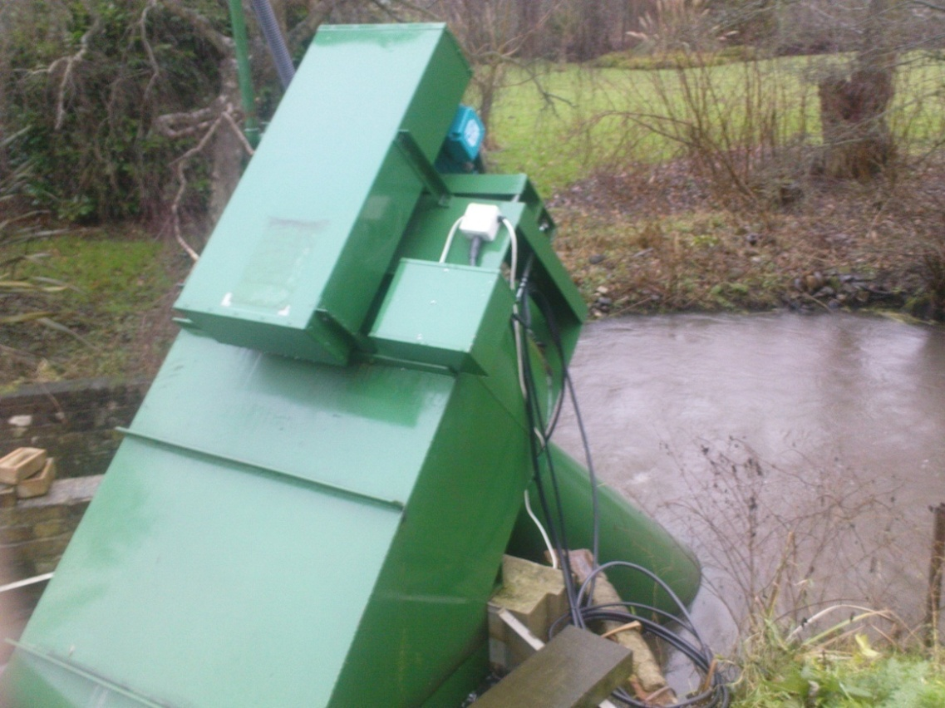
Options for Electricity Generation in 2020 - Renewable
 | Potential contribution to electricity supply in 2020 and drivers/barriers | 2002 (Gas ~ 2p) | Predictions May 2011 (Gas ~ 8.0p) *
On Shore Wind | ~25% [~15000 x 3 MW turbines] | available now for commercial exploitation | ~ 2+p
~8.2p +/- 0.8p
Off Shore Wind | 25 - 50% | some technical development needed to reduce costs. | ~2.5 - 3p
12.5p +/- 2.5
Micro Hydro Scheme operating on Siphon Principle installed at Itteringham Mill, Norfolk.
Rated capacity 5.5 kW
Hydro (mini - micro) | 5% | technically mature, but limited potential | 2.5 - 3p
11p for <2MW projects
Future prices from Climate Change Report (May 2011) or RO/FITs where not otherwise specified

Slide 14
Options for Electricity Generation in 2020 - Renewable
 | Potential contribution to electricity supply in 2020 and drivers/barriers | 2002 (Gas ~ 2p) | Predictions May 2011 (Gas ~ 8.0p) *
On Shore Wind | ~25% [~15000 x 3 MW turbines] | available now for commercial exploitation | ~ 2+p
~8.2p +/- 0.8p
Climate Change Report suggests that 1.6 TWh (0.4%) might be achieved by 2020 which is equivalent to ~ 2.0 GW.
Off Shore Wind | 25 - 50% | some technical development needed to reduce costs. | ~2.5 - 3p
12.5p +/- 2.5
Hydro (mini - micro) | 5% | technically mature, but limited potential | 2.5 - 3p
11p for <2MW projects
Photovoltaic | <<5% even assuming 10 GW of installation | available, but much further research needed to bring down costs significantly | 15+ p
25p +/-8
Future prices from Climate Change Report (May 2011) or RO/FITs where not otherwise specified

Slide 15
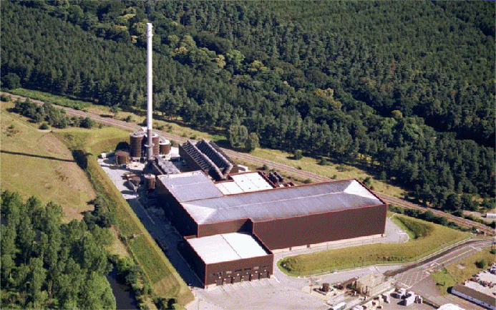
Options for Electricity Generation in 2020 - Renewable
 | Potential contribution to electricity supply in 2020 and drivers/barriers | 2002 (Gas ~ 2p) | Predictions May 2011 (Gas ~ 8.0p) *
On Shore Wind | ~25% [~15000 x 3 MW turbines] | available now for commercial exploitation | ~ 2+p
~8.2p +/- 0.8p
Off Shore Wind | 25 - 50% | some technical development needed to reduce costs. | ~2.5 - 3p
12.5p +/- 2.5
Hydro (mini - micro) | 5% | technically mature, but limited potential | 2.5 - 3p
11p for <2MW projects
Photovoltaic | <<5% even assuming 10 GW of installation | available, but much further research needed to bring down costs significantly | 15+ p
25p +/-8
Sewage, Landfill, Energy Crops/ Biomass/Biogas | ??5% | available, but research needed in some areas e.g. advanced gasification | 2.5 - 4p
7 - 13p depending on technology
To provide 5% of UK electricity needs will require an area the size of Norfolk and Suffolk devoted solely to biomass
Future prices from Climate Change Report (May 2011) or RO/FITs where not otherwise specified

Slide 16
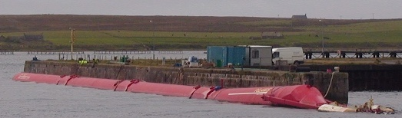
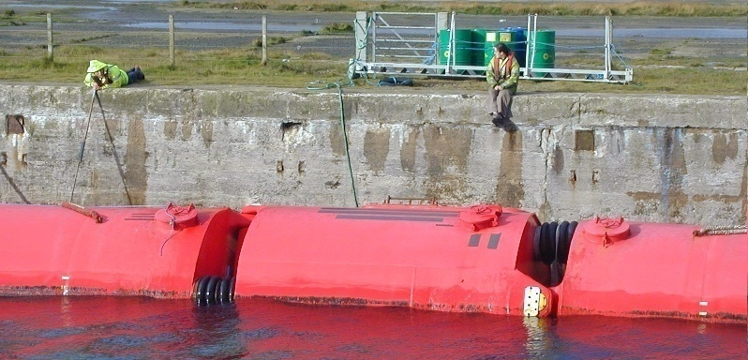
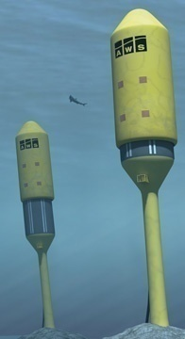
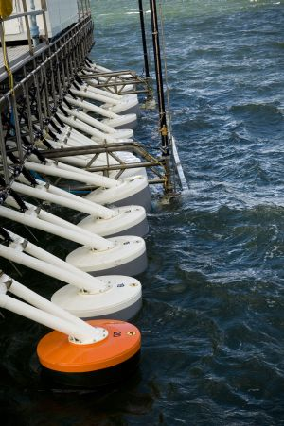
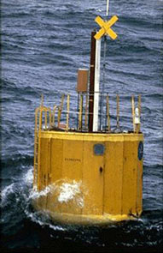
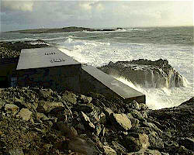
Options for Electricity Generation in 2020 - Renewable
Potential contribution to electricity supply in 2020 and drivers/barriers |  |  | 2002 (Gas ~ 2p) | Predictions May 2011 (Gas ~ 8.0p)
On Shore Wind | ~25% | available now | ~ 2+p | ~8.2p +/- 0.8p
Off Shore Wind | 25 - 50% | available but costly | ~2.5 - 3p | 12.5p +/- 2.5
Small Hydro | 5% | limited potential | 2.5 - 3p | 11p for <2MW projects
Photovoltaic | <<5% | available, but very costly | 15+ p | 25p +/-8
Biomass | ??5% | available, but research needed | 2.5 - 4p | 7 - 13p
Wave/Tidal Stream | currently < 10 MW may be 1000 - 2000 MW (~0.1%) | technology limited - major development not before 2020 | 4 - 8p
19p +/- 6 Tidal 26.5p +/- 7.5p Wave
Future prices from Climate Change Report (May 2011) or RO/FITs where not otherwise specified

Slide 17
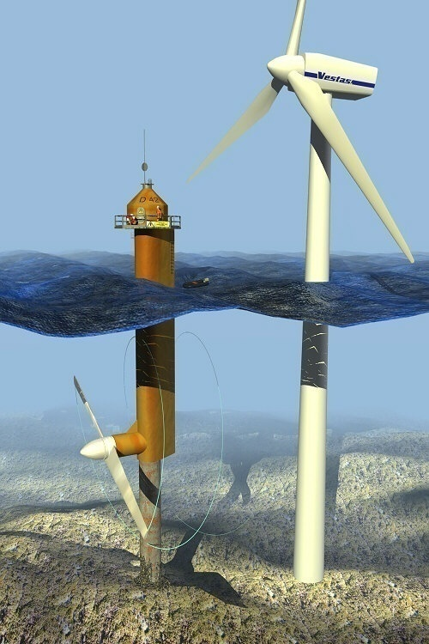
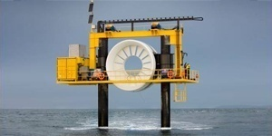
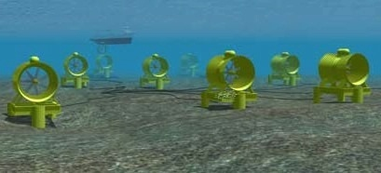
Options for Electricity Generation in 2020 - Renewable
Potential contribution to electricity supply in 2020 and drivers/barriers |  |  | 2002 (Gas ~ 2p) | Predictions May 2011 (Gas ~ 8.0p)
On Shore Wind | ~25% | available now | ~ 2+p | ~8.2p +/- 0.8p
Off Shore Wind | 25 - 50% | available but costly | ~2.5 - 3p | 12.5p +/- 2.5
Small Hydro | 5% | limited potential | 2.5 - 3p | 11p for <2MW projects
Photovoltaic | <<5% | available, but very costly | 15+ p | 25p +/-8
Biomass | ??5% | available, but research needed | 2.5 - 4p | 7 - 13p
Wave/Tidal Stream | currently < 10 MW may be 1000 - 2000 MW (~0.1%) | techology limited - major development not before 2020 | 4 - 8p
19p +/- 6 Tidal 26.5p +/- 7.5p Wave
Future prices from Climate Change Report (May 2011) or RO/FITs where not otherwise specified

Slide 18
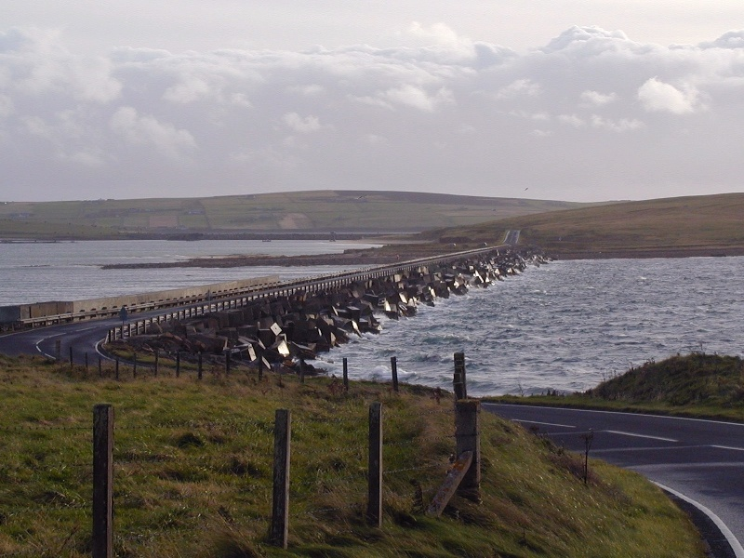
Options for Electricity Generation in 2020 - Renewable
Potential contribution to electricity supply in 2020 and drivers/barriers |  |  | 2002 (Gas ~ 2p) | Predictions May 2011 (Gas ~ 8.0p)
On Shore Wind | ~25% | available now | ~ 2+p | ~8.2p +/- 0.8p
Off Shore Wind | 25 - 50% | available but costly | ~2.5 - 3p | 12.5p +/- 2.5
Small Hydro | 5% | limited potential | 2.5 - 3p | 11p for <2MW projects
Photovoltaic | <<5% | available, but very costly | 15+ p | 25p +/-8
Biomass | ??5% | available, but research needed | 2.5 - 4p | 7 - 13p
Severn Barrage/ Mersey Barrages have been considered frequently
e.g. pre war – 1970s, 2009
Severn Barrage could provide 5-8% of UK electricity needs
In Orkney – Churchill Barriers
Output ~80 000 GWh per annum - Sufficient for 13500 houses in Orkney but there are only 4000 in Orkney. Controversy in bringing cables south.
Would save 40000 tonnes of CO₂
Wave/Tidal Stream | currently < 10 MW may be 1000 - 2000 MW (~0.1%) | technology limited - major development not before 2020 | 4 - 8p
19p +/- 6 Tidal 26.5p +/- 7.5p Wave
Tidal Barrages | 5 - 15% | technology available but unlikely for 2020. Construction time ~10 years. In 2010 Government abandoned plans for development
26p +/-5
Future prices from Climate Change Report (May 2011) or RO/FITs where not otherwise specified

Slide 19
Options for Electricity Generation in 2020 - Renewable
Potential contribution to electricity supply in 2020 and drivers/barriers |  |  | 2002 (Gas ~ 2p) | Predictions May 2011 (Gas ~ 8.0p)
On Shore Wind | ~25% | available now | ~ 2+p | ~8.2p +/- 0.8p
Off Shore Wind | 25 - 50% | available but costly | ~2.5 - 3p | 12.5p +/- 2.5
Small Hydro | 5% | limited potential | 2.5 - 3p | 11p for <2MW
Photovoltaic | <<5% | available, but very costly | 15+ p | 25p +/-8
Biomass | ??5% | available, but research needed | 2.5 - 4p | 7 - 13p
Wave/Tidal Stream | currently < 10 MW ??1000 - 2000 MW (~0.1%) | technology limited - major development not before 2020 | 4 - 8p | 19p Tidal 26.5p Wave
Tidal Barrages | 5 - 15% | In 2010 Government abandoned plans for development |  | 26p +/-5
Geothermal | unlikely for electricity generation before 2050 if then -not to be confused with ground sourced heat pumps which consume electricity
Future prices from Climate Change Report (May 2011) or RO/FITs where not otherwise specified

Slide 20
Options for Electricity Generation in 2020 - Renewable
Potential contribution to electricity supply in 2020 and drivers/barriers |  |  | 2002 (Gas ~ 2p) | Predictions May 2011 (Gas ~ 8.0p)
On Shore Wind | ~25% | available now | ~ 2+p | ~8.2p +/- 0.8p
Off Shore Wind | 25 - 50% | available but costly | ~2.5 - 3p | 12.5p +/- 2.5
Small Hydro | 5% | limited potential | 2.5 - 3p | 11p for <2MW
Photovoltaic | <<5% | available, but very costly | 15+ p | 25p +/-8
Biomass | ??5% | available, but research needed | 2.5 - 4p | 7 - 13p
Wave/Tidal Stream | currently < 10 MW ??1000 - 2000 MW (~0.1%) | technology limited - major development not before 2020 | 4 - 8p | 19p Tidal 26.5p Wave
Tidal Barrages | 5 - 15% | In 2010 Government abandoned plans for development |  | 26p +/-5
Geothermal | unlikely for electricity generation before 2050 if then -not to be confused with ground sourced heat pumps which consume electricity
Demonstrates importance of on shore wind for next decade or so
Future prices from Climate Change Report (May 2011) or RO/FITs where not otherwise specified

Slide 21
Overview of Presentation
ICE Energy Panel
Overview of the Three Challenges facing the UK Energy scene. Carbon Reduction, Energy Security and Cost of our Future Energy Supplies
Options for Electricity generation
The Challenges for 2020
Energy Management and Awareness Issues
Some challenges and opportunities for renewable energy and energy conservation
Conclusions

Slide 22
Our Choices: They are difficult
Do we want to exploit available renewables i.e onshore/offshore wind and biomass?.
Photovoltaics, tidal, wave are not options for next 10 - 20 years.
[very expensive or technically immature or both]
If our answer is NO
Do we want to see a renewal of nuclear power ?
Are we happy with this and the other attendant risks?
If our answer is NO
Do we want to return to using coal?
then carbon dioxide emissions will rise significantly
unless we can develop carbon sequestration within 10 years UNLIKELY – confirmed by Climate Change Committee
[9th May 2011]
If our answer to coal is NO
Do we want to leave things are they are and see continued exploitation of gas for both heating and electricity generation? >>>>>>

Slide 23
Our Choices: They are difficult
If our answer is YES
By 2020
we will be dependent on GAS
for around 70% of our heating and electricity
imported from countries like Russia, Iran, Iraq, Libya, Algeria
Are we happy with this prospect? >>>>>>
If not:
We need even more substantial cuts in energy use.
Or are we prepared to sacrifice our future to effects of Global Warming? - the North Norfolk Coal Field?
Do we wish to reconsider our stance on renewables?
Inaction or delays in decision making will lead us down the GAS option route and all the attendant Security issues that raises.
We must take a coherent integrated approach in our decision making – not merely be against one technology or another

Slide 24
Our looming over-dependence on gas for electricity generation
1 new nuclear station completed each year after 2020.
1 new coal station fitted with CCS each year after 2020
1 million homes fitted with PV each year from 2020 - 40% of homes fitted by 2030
19 GW of onshore wind by 2030 cf 4 GW now
Imported Gas
UK Gas
Offshore Wind
Onshore Wind
Oil
Other Renewables
Existing Coal
New Coal
New Nuclear
Existing Nuclear
Data for modelling derived from DECC & Climate Change Committee (2011) - allowing for significant deployment of electric vehicles and heat pumps by 2030.

Slide 25
Overview of Presentation
ICE Energy Panel
Overview of the Three Challenges facing the UK Energy scene. Carbon Reduction, Energy Security and Cost of our Future Energy Supplies
Options for Electricity generation
The Challenges for 2020
Energy Management and Awareness Issues
Some challenges and opportunities for renewable energy and energy conservation
Conclusions

Slide 26
The Behavioural Dimension: Awareness raising
Social Attitudes towards energy consumption have a profound effect on actual consumption
Data collected from 114 houses in Norwich between mid November 2006 and mid March 2007
For a given size of household electricity consumption for appliances [NOT HEATING or HOT WATER] can vary by as much as 9 times.
When income levels are accounted for, variation is still 6 times
26

Slide 27
Performance of ZICER Building
Good Management has reduced Energy Requirements
800
350
Space Heating Consumption reduced by 57%
CO₂ emissions reduced by 17.5 tonnes per annum.
27
27

Slide 28
Electricity Consumption in an Office Building in East Anglia
Low Energy Lighting Installed
Consumption rose to nearly double level of early 2005.
Malfunction of Air-conditioning plant.
Extra fuel cost £12 000 per annum ~£1000 to repair fault
Additional CO₂ emitted ~ 100 tonnes.

Slide 29
Average Domestic Electricity Consumption in Norfolk and Suffolk
 | kWh | % cost | Rank | % Renewables
Norwich | 3,535 | 79% | 6 | 0.0%
Ipswich | 4,349 | 97% | 159 | 0.0%
Waveney | 4,417 | 99% | 181 | 1.9%
Broadland | 4,618 | 103% | 231 | 3.0%
Great Yarmouth | 4,699 | 105% | 252 | 30.0%
St Edmundsbury | 4,869 | 109% | 280 | 1.0%
Breckland | 5,028 | 112% | 312 | 31.8%
Forest Heath | 5,174 | 116% | 336 | 0.0%
Babergh | 5,252 | 117% | 343 | 0.1%
South Norfolk | 5,347 | 119% | 358 | 5.0%
Suffolk Coastal | 5,371 | 120% | 360 | 1.0%
North Norfolk | 5,641 | 126% | 385 | 1.3%
Mid Suffolk | 5,723 | 128% | 390 | 18.3%
King's Lynn and West Norfolk | 5,731 | 128% | 393 | 2.5%
UK Average | 4478
% of average cost of electricity bills compared to National Average
Rank position in UK out of 408 Local Authorities
Average house in Norwich emits 1.87 tonnes of CO₂ from electricity consumption
in Kings Lynn 3.04 tonnes of CO₂ (based on UK emission factors)
Average household electricity bill in Norwich is 64% that in Kings Lynn
Notes:
29

Slide 30
Impact of Electricity Generation on Carbon Emissions.
Approximate Carbon Emission factors during electricity generation including fuel extraction, fabrication and transport.
Fuel | Approximate emission factor | Comments
Coal | 900 – 1000g | Depending on grade and efficiency of power station
Gas | 400 – 430g | Assuming CCGT – lower value for Yarmouth
Nuclear | 5 – 10g | Depending on reactor type
Renewables | ~ 0 | For wind, PV, hydro
Overall UK | ~540g | Varies on hour by hour basis depending on generation mix
Suffolk & Norfolk (2009) | ~83g | Sizewell B, Yarmouth and existing renewables
In 2009 Norfolk and Suffolk was a very low carbon zone in UK
But current accounting procedures do not allow regions to promote this.
A firm in Norfolk / Suffolk would have only 16% of carbon emissions from electricity consumption

Slide 31
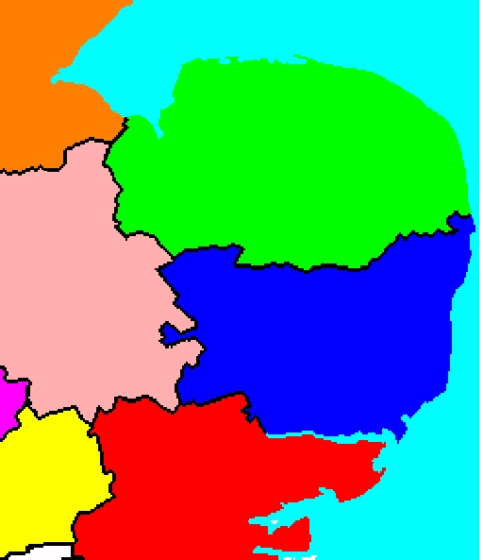
Electricity Supply in Norfolk and Suffolk (GWh)
Existing Renewables
Total generation in Norfolk and Suffolk (allowing for losses) ~ 11000 GWh
Total demand in Norfolk and Suffolk
= 7803 GWh
Net export to remainder of UK ~ 3200 GWh
Great Yarmouth
Sizewell B
2009 Data for Renewables and Sizewell
Other Data based on typical load factors
At £12.50 per tonne (current EU-ETS price), this represents a benefit of £18 million to rest of UK in carbon saved.
Export of Electricity to rest of UK

Slide 32
Overview of Presentation
ICE Energy Panel
Overview of the Three Challenges facing the UK Energy scene. Carbon Reduction, Energy Security and Cost of our Future Energy Supplies
Options for Electricity generation
The Challenges for 2020
Energy Management and Awareness Issues
Some challenges and opportunities for renewable energy and energy conservation
Conclusions

Slide 33
Low Carbon Strategies: making efficient use of technology
e.g. UEA’s Combined Heat and Power
3 units each generating 1.0 MW electricity and 1.4 MW heat
Improved insulation, improved appliance efficiency, (power packs, lighting etc, etc). Energy conserving technologies e.g. heat pumps, CHP etc.

Slide 34
Significant Savings in CO2 emissions are possible with CHP
Before installation
1997/98 |  | electricity | gas | oil | Total
 | MWh | 19895 | 35148 | 33
Emission factor | kg/kWh | 0.46 | 0.186 | 0.277
Carbon dioxide | Tonnes | 9152 | 6538 | 9 | 15699
After installation
 |  | Electricity |  |  |  | Heat
1999/ 2000 |  | Total site | CHP generation | export | import | boilers | CHP | oil | total
 | MWh | 20437 | 15630 | 977 | 5783 | 14510 | 28263 | 923
Emission factor | kg/kWh |  |  | -0.46 | 0.46 | 0.186 | 0.186 | 0.277
CO₂ | Tonnes |  |  | -449 | 2660 | 2699 | 5257 | 256 | 10422
This represents a 33% saving in carbon dioxide
34

Slide 35
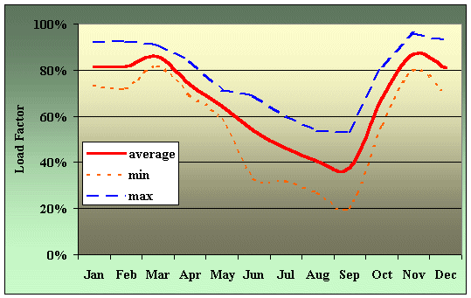
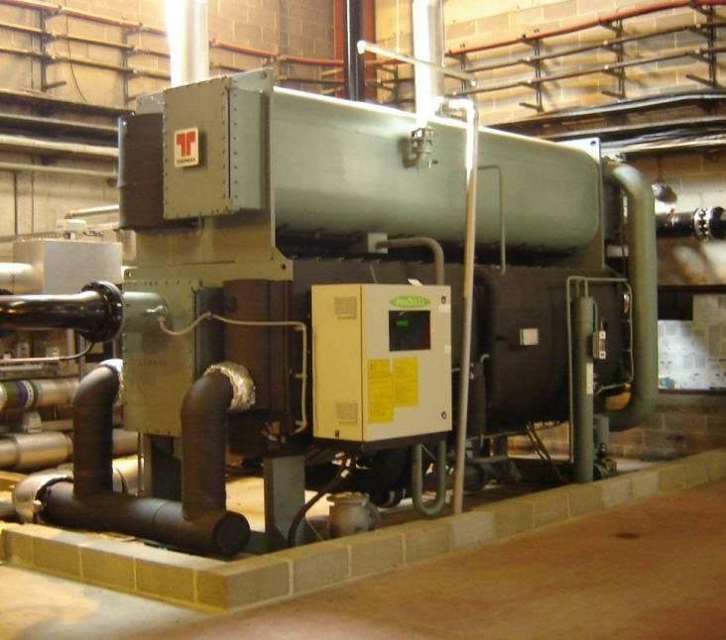
For optimum results: Care in matching demand is needed
Load Factor of CHP Plant at UEA
Demand for Heat is low in summer: plant cannot be used effectively.
More electricity could be generated in summer
A Paradox: Largest amount of electricity was imported when demand was least!
A 1 MW Adsorption chiller
Uses Waste Heat from CHP
Provides chilling requirements in summer
Reduces electricity demand in summer
Increases electricity generated locally
Saves ~500 tonnes Carbon Dioxide annually.

Slide 36
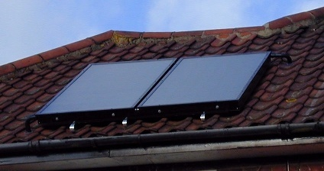
Low Carbon Strategies: Solar Thermal
Solar Thermal solutions can provide hot water
However, performance can be significantly affected by way normal central heating boiler is used for backup.
A factor of two in output has been measured for otherwise identical installations

Slide 37
More Solar Energy is Collected when Hot Water use is greater!!.
0.911kWh
1.164kWh
1.157kWh
0.083kWh
BS27: 15/05/2004
Sky became hazy at ~ 11:00
Substantial hot water demand at 13:30
Normal heat loss from tank if there had been no demand shown in black
1.157 kWh extra heat collected.
Note: further demand at 18:30 leading to further solar collection.
Even more solar collection would have been possible had collector been orientated SW rather than S
37
Notes:
37
Without draw off at mid day, black dashed line shows typical temperature drop from heat loss from cylinder. Solar energy is only effective again when the collector temperature exceed store temperature by at least 5ºC.

Slide 38
Technical Issues requiring awareness raising:
Solar Thermal Energy captured when combined with central heating
Tank with small residual hot water at top of tank in early morning
If Central Heating boiler heats up water – less opportunity for solar heating.
Zone heated by solar energy
Notes:
38
38

Slide 39
Technical Issues requiring awareness raising:
Tank with small residual hot water at top of tank in early morning
No hot water provided by central heating boiler.
Gain from solar energy is much higher.
More solar energy can be gained if boiler operation is delayed.
Boiler ON/OFF times should be adjusted between summer and winter for optimum performance
Notes:
39
39

Slide 40
Solar Rosette Diagram for East Norfolk/Suffolk
Tilt | 90
 | 85
 | 80
 | 75
 | 70
 | 65
 | 60
 | 55
 | 50
 | 45
 | 40
 | 35
 | 30
 | 25
 | 20
 | 15
 | 10
 | 5
 | 0
 |  | 0 | 5 | 10 | 15 | 20 | 25 | 30 | 35 | 40 | 45 | 50 | 55 | 60 | 65 | 70 | 75 | 80 | 85 | 90 | 95 | 100 | 105 | 110 | 115 | 120 | 125 | 130 | 135 | 140 | 145 | 150 | 155 | 160 | 165 | 170 | 175 | 180 | 185 | 190 | 195 | 200 | 205 | 210 | 215 | 220 | 225 | 230 | 235 | 240 | 245 | 250 | 255 | 260 | 265 | 270 | 275 | 280 | 285 | 290 | 295 | 300 | 305 | 310 | 315 | 320 | 325 | 330 | 335 | 340 | 345 | 350 | 355
0 30 60 90 120 150 180 210 240 270 300 330 360
N NE E SE S SW W NW N
Azimuth
Note:
Optimum direction for solar energy in East Anglia is NOT due south but ~ 10-15 degrees West of South.
Reduction for west facing roof is < 20%
For solar thermal a more westerly orientation is often preferable, but depends on hot water use during day
<20
20-30
30-40
40-50
50-60
60-70
70-80
80-90
90-100
100

Slide 41
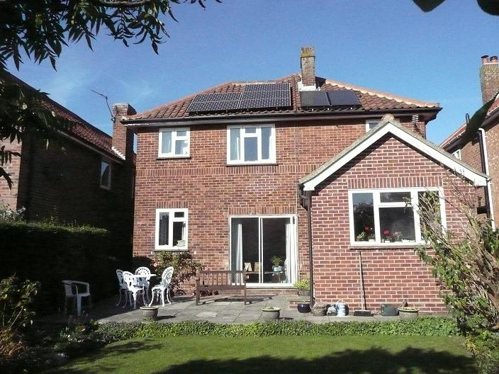
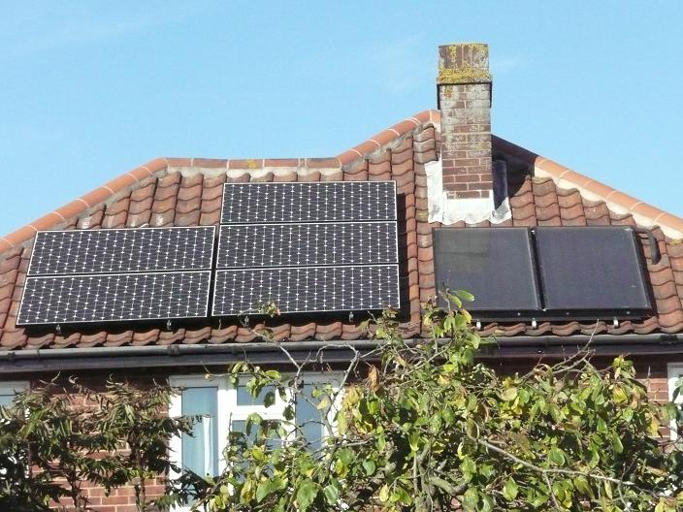
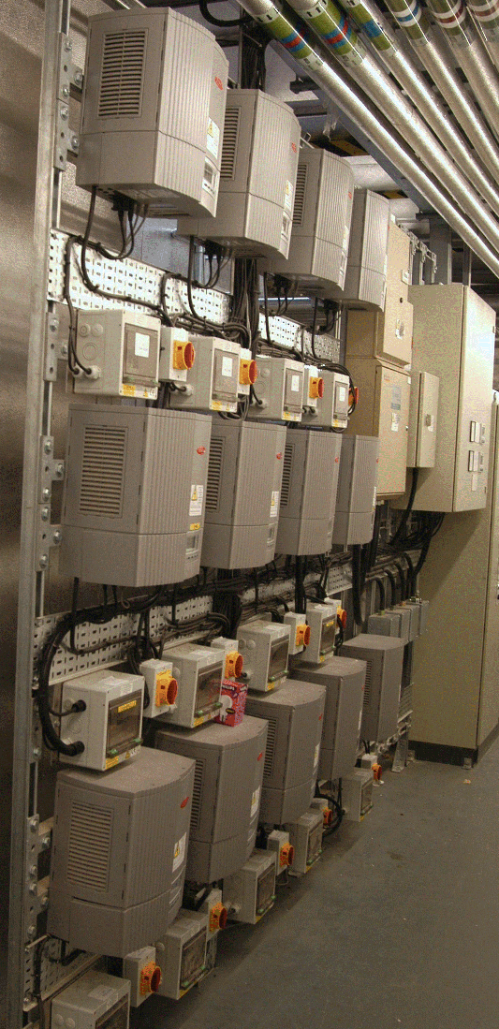
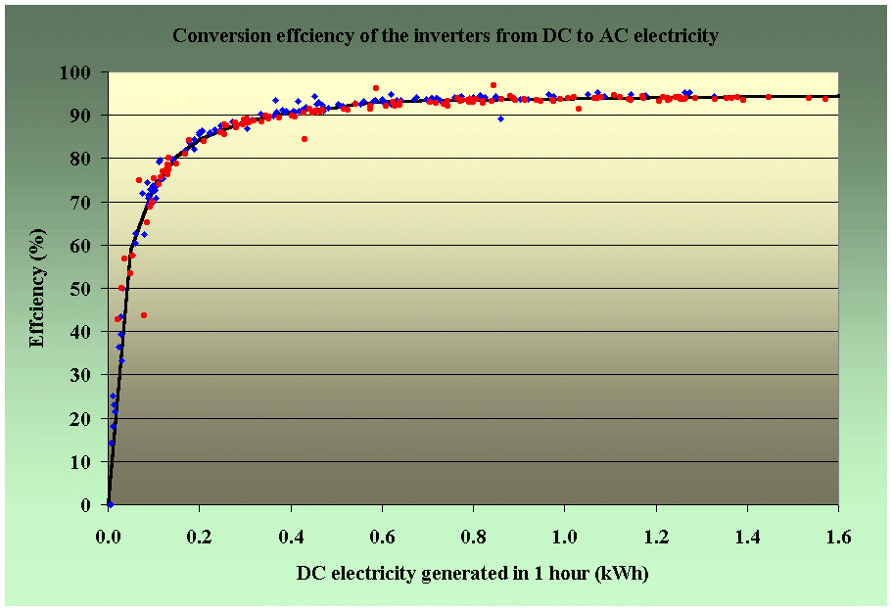
Building Integrated Renewable Electricity Generation - Solar
ZICER Building, UEA 34 kW
House with both Solar Thermal and Solar PV.
All electricity must be converted from DC to AC by use of inverters.
Inverters are only 92 - 93% efficient
In office buildings much use of electricity is for computers
DC power packs are typically ~70% efficient
Only 2/3rds of costly electricity is used effectively.
An integrated system in a new building would have both a DC and AC network.
Reduced heat gain in building leading to less air-conditioning.

Slide 42
Feed in Tariffs – Introduced 1st April 2010
Energy Source | Scale | Installation date |  |  |  | Duration (years)
 |  | 01/04/10 – 31/03/12 |  | Post Aug 1st 2011 | > 01/04/2012
Payments |  | To 31/03/11 | From 01/04/11 |  | Ofgem – Aug 2011 Reduced tariffs in later years
Solar PV | ≤4 kW new | 36.1 | 37.8 |  | 34.6 | 25
Solar PV | ≤4 kW retrofit | 41.3 | 43.3 |  | 39.6 | 25
Solar PV | >4-10kW | 36.1 | 37.8 |  | 34.6 | 25
Solar PV | >10 - 50kW | 31.4 | 32.9 |  | 30.1 | 25
Solar PV | >50-150kW | 31.4 | 32.9 | 19.0 | 17.4 | 25
Solar PV | >150-250kW | 29.3 | 30.7 | 15.0 | 13.7 | 25
Solar PV | >250kW - 5MW | 29.3 | 30.7 | 8.5 | 8.5 | 25
Solar PV | Standalone | 29.3 | 30.7 | 8.5 | 8.5 | 25
Wind | ≤1.5kW | 34.5 | 36.2 |  | 34.2 | 20
Wind | >1.5 - 15kW | 26.7 | 28.0 |  | 26.7 | 20
Wind | >15 - 100kW | 24.1 | 25.3 |  | 24.2 | 20
Wind | >100 - 500kW | 18.8 | 19.7 |  | 19.7 | 20
Wind | >500kW - 1.5MW | 9.4 | 9.9 |  | 9.9 | 20
Wind | >1.5MW - 5MW | 4.5 | 4.7 |  | 4.7 | 20
Existing generators transferred from RO |  | 9 | 9.4 |  | 9.4 | to 2027
Export Tariff |  | 3 | 3.1 |  | 3.1
Tariffs are index linked each year for existing generators only new generators are affected by revised prices which have still to be confirmed.
Tariffs also available for hydro, anerobic digestion and mini CHP.

Slide 43
Installations under Feed In Tariff Scheme ( to 28/09/2011)
Technology | Domestic Installations |  | Industrial & Commericial Installations |  | Community Installations |  | Total Installations
 | Number | Installed Capacity | Number | Installed Capacity | Number | Installed Capacity | Number | Installed Capacity
 |  | MW |  | MW |  | MW |  | MW
NORFOLK
Hydro | 2 | 0.021 | 0 | 0 | 0 | 0 | 2 | 0.021
Micro CHP | 3 | 0.003 | 0 | 0 | 0 | 0 | 3 | 0.003
Photovoltaic | 1667 | 4.691 | 17 | 0.071 | 7 | 0.074 | 1691 | 4.836
Wind | 28 | 0.197 | 7 | 0.048 | 5 | 0.026 | 40 | 0.27
Total Installed Capacity (MW) |  | 4.912 | 0 | 0.119 |  | 0.099 |  | 5.13
Total Installations | 1700 |  | 24 |  | 12 |  | 1736
SUFFOLK
Micro CHP | 2 | 0.002 | 0 | 0 | 0 | 0 | 2 | 0.002
Photovoltaic | 1519 | 4.216 | 16 | 0.103 | 6 | 0.027 | 1541 | 4.347
Wind | 28 | 0.188 | 2 | 0.01 | 1 | 0.006 | 31 | 0.204
Total Installed Capacity (MW) |  | 4.406 | 0 | 0.113 |  | 0.033 |  | 4.552
Total Installations | 1549 |  | 18 |  | 7 |  | 1574
The annual output from all schemes installed is ~ 7.5 GWh – the same output as 1.2 modern 3 MW wind turbines such as those at Kessingland.

Slide 44
Renewable Heat Incentive from 01/10/11 for Non-Domestic Installations
Tariff name | Eligible technology | Eligible sizes | Tariff rate (pence/ kWh) | Tariff duration (Years)
Small biomass | Solid biomass; Municipal Solid Waste (incl. CHP) | < 200 kWth | Tier 1: 7.6 | 20
 |  |  | Tier 2: 1.9
Medium biomass |  | 200 kWth to 1,000 kWth | Tier 1: 4.7
 |  |  | Tier 2: 1.9
 |  | >1,000 kWth | 2.6
Large biomass
Small ground source | Ground & Water -source heat pumps; deep geothermal | <100 kWth | 4.3 | 20
Large ground source |  | >100 kWth | 3
Solar thermal | Solar thermal | <200 kWth | 8.5 | 20
Biomethane injection and combustion except from landfill gas – all scales < 200 kWth |  |  | 6.5 | 20
Stop Press!!! 18:00 on 29th September 2011
The EU have rejected support level for large Biomass and scheme cannot now start until amendments to RHI Order are in place.
Tier 1 applies annually up to the Tier Break, Tier 2 above the Tier Break. The Tier Break is: installed capacity x 1,314 peak load hours, i.e.: kWth x 1,314
Temporary Grants for Domestic Installations – implementation 01/10/12
All Houses – voucher valid for 3 months | Houses not heated by gas from Gas Grid Vouchers valid for 6 months
£300 – solar thermal voucher | £950 biomass boiler voucher
 | £850 air source heat pump valid for 6 months
 | £1250 ground or water source heat pump voucher

Slide 45
How Variable is Wind Energy?
Wind Energy is often cited as being not predictable.
Data for 23-25th February 2011 from www.bmreports.com
Over 3.7 GW is now visible to National Grid out of 5.4GW.
Predictions are made 48hr and 24 hrs in advance
Generally good correlation with 24hr forecast
X-axis shows 30 minute periods from midnight on 23/24th September

Slide 46
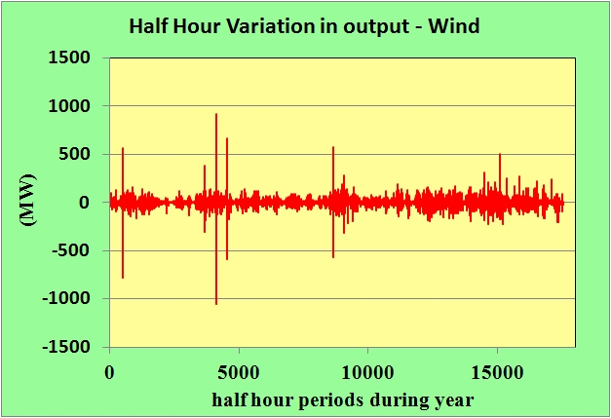
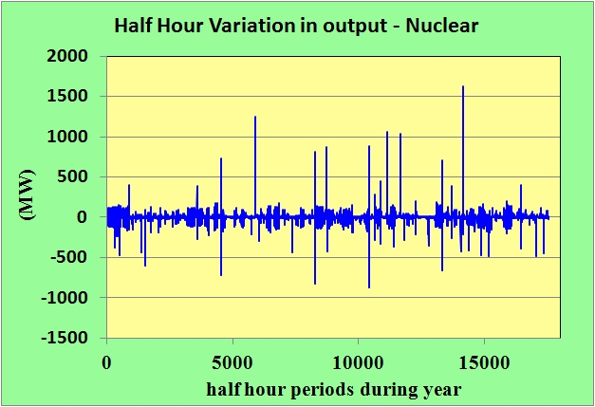
How Variable is Wind Energy?
Data for Sun/Mon 25/26 Sep 2011
Data from BMREPORTS for 2010
Changes in output over 30 minute period
Wind
Max: 914 MW
Min: – 1051 MW
StDev : 37.8 MW
Nuclear
Max: 1630 MW
Min: - 877 MW
StDev: 39.9MW

Slide 47
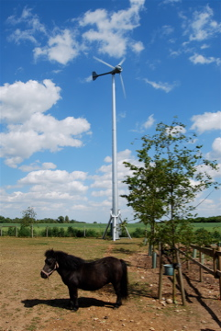
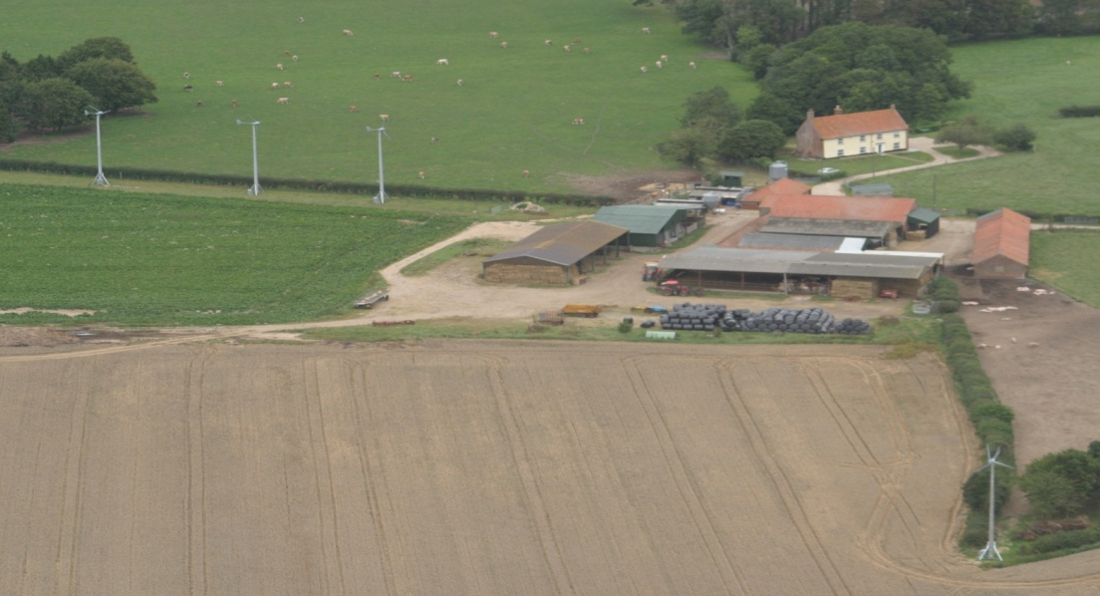
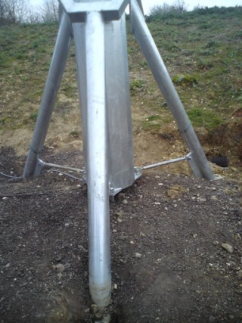
Alternative Strategies for Financing
Consumer purchases system and benefits from both reduction in imported electricity and Feed In Tariff – suitable for both domestic and commercial properties for those who are capital rich but income poor.
Company pays for and installs system and claims the Feed In Tariff – the owner of land benefits from reduced energy bills – for those with limited capital and less concerned with income.
Schemes exist for
small wind – e.g. Windcrop who offer 5kW turbines which are less affected by planning issues
Domestic/community PV up to 50kW
Images courtesy of WindCrop
Honningham Thorpe, Norfolk

Slide 48
Seeking Effective Low Carbon Solutions for Energy Supply
Some costs for providing a low carbon future
Small scale solar PV under the Feed in Tariff
~ £700+ per tonne CO₂ saved
Large Scale On-shore wind under Renewable obligation
~ £90+ per tonne CO₂ saved
Cavity Insulation
~ <£20 per tonne CO₂ saved
Effective Energy Management can often be cost negative in terms of CO₂ saved.
An effective strategy will focus on most cost effective solutions.

Slide 49
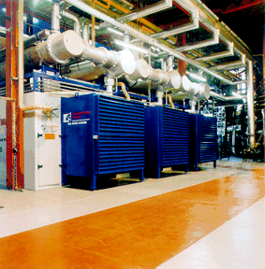
Conclusions: Strategies for Future Sustainable Energy Supply
Effective Awareness and Energy Management;
Improved Technology to make better use of existing energy;
Low Carbon Energy Supply – including:
Cost effective and technically mature renewables
Nuclear (?)
Carbon Capture and Sequestration – but this will not be available until mid 2020s on scale require.
Only On Shore Wind (??? Some biomass) will be cost effective solutions for renewable energy until at least 2020
Large Scale Wind is often meeting stiff opposition from planning issues – many of which are red-herrings
Innovative solutions for both financing and minimising planning are an effective way forward
e.g. The approach taken by WindCrop/RENEnergy

Slide 50
Conclusions
The UK needs to focus on both the short term (to 2025) and long term (to 2050) in formulating strategies for a low carbon, energy secure future.
Legislation affecting Energy use and production in UK
Carbon Reduction Commitment
Renewable Obligation
Feed In Tariffs
Renewable Heat Incentive
Renewable Transport Fuel Obligation
Electricity Market Reform
And Finally!
"If you do not change direction, you may end up where you are heading."
Lao Tzu (604-531 BC) Chinese Artist and Taoist Philosopher
This presentation will be available on the WEB from tomorrow at
www.cred-uk.org > follow academic links
Or http://www2.env.uea.ac.uk/cred/creduea.htm

Slide 52
Variation in Wholesale and Retail Electriity Prices
In recent years, electricity retail prices have varied much less than wholesale prices and have also risen less.
In Real Terms, Domestic Electricity Prices have only recently returned to 1981 levels

